Slide 1
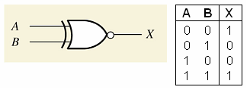
Comparators
The function of a comparator is to compare the magnitudes of two binary numbers to determine the relationship between them. In the simplest form, a comparator can test for equality using XNOR gates.
1-Bit Comparator
The output is 1 when the inputs are equal

Slide 2
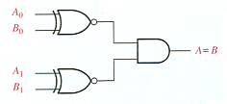
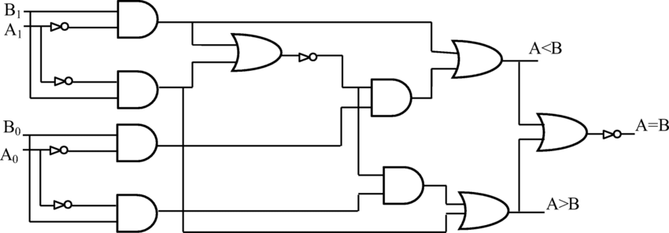
2-Bit Comparator
The output is 1 when A₀ = B₀ AND A₁ = B₁

Slide 3
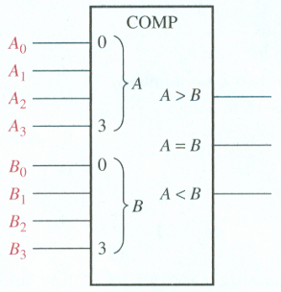
4-Bit Comparator
  One of three outputs will be HIGH:
    A greater than B (A > B)
    A equal to B (A = B)
    A less than B (A < B)

Slide 4
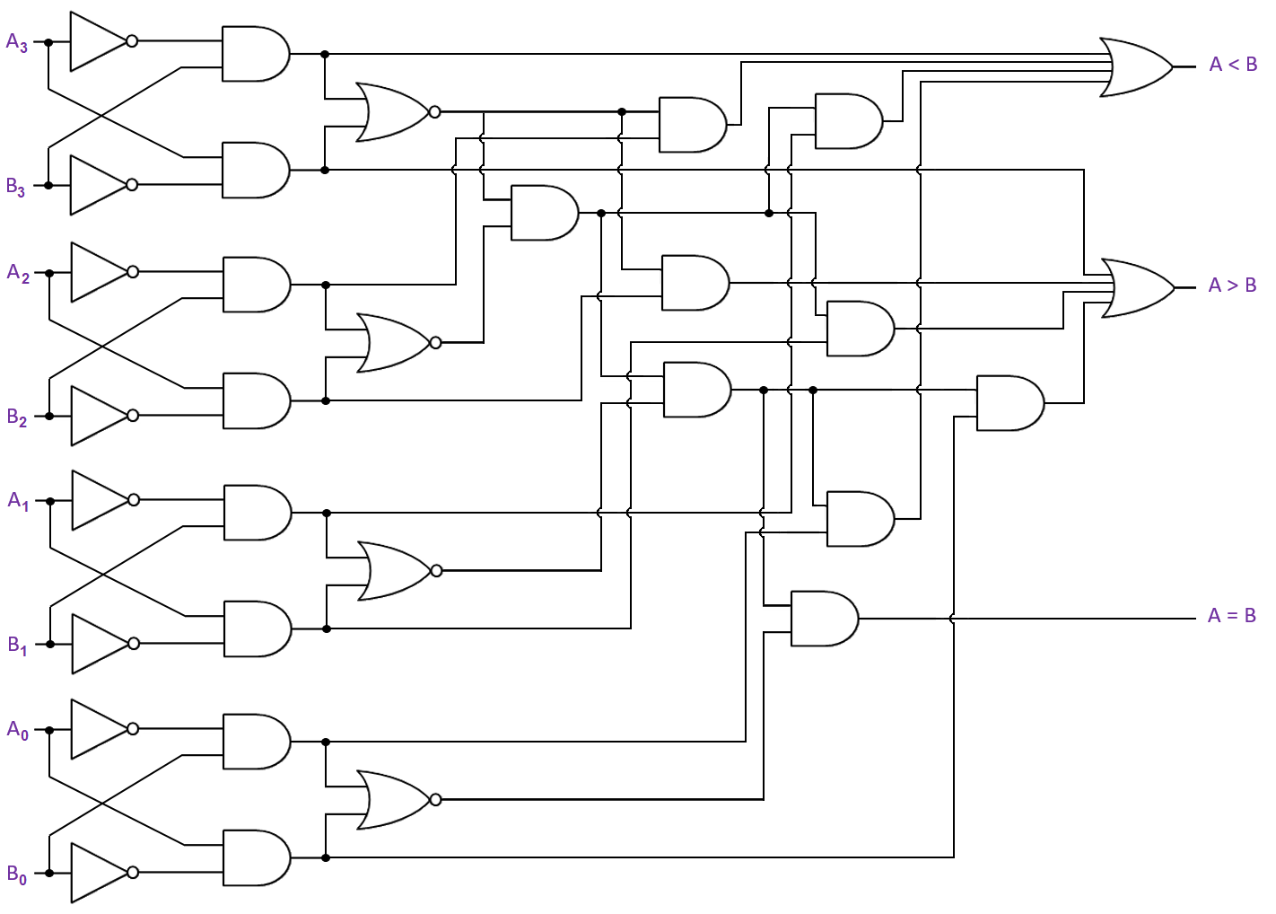

Slide 5
Code Converters
BCD-to-binary conversion
Binary-Gray conversions

Slide 6
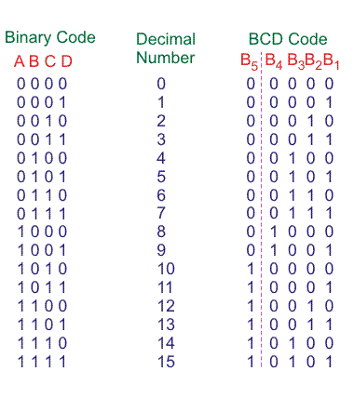

Slide 7
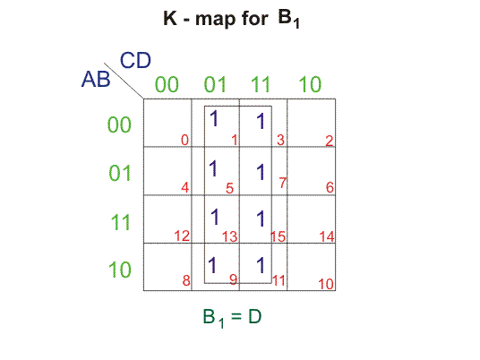
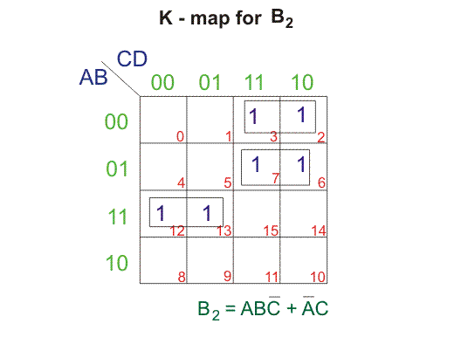
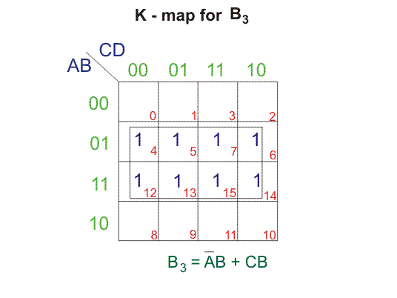
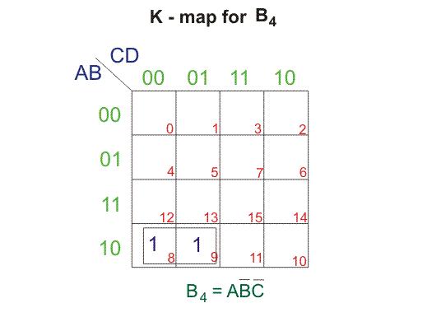
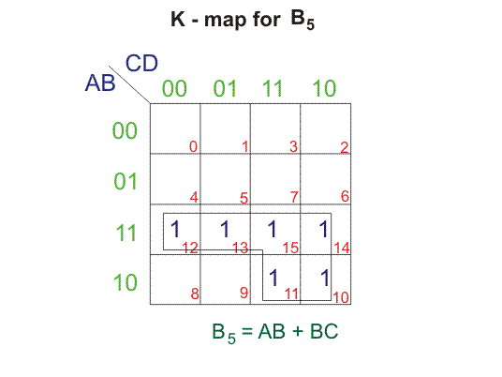
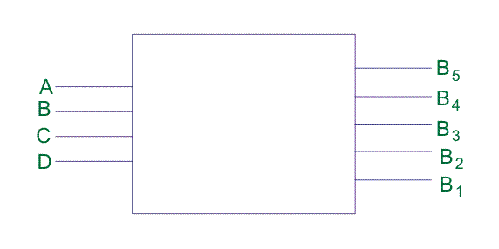

Slide 8
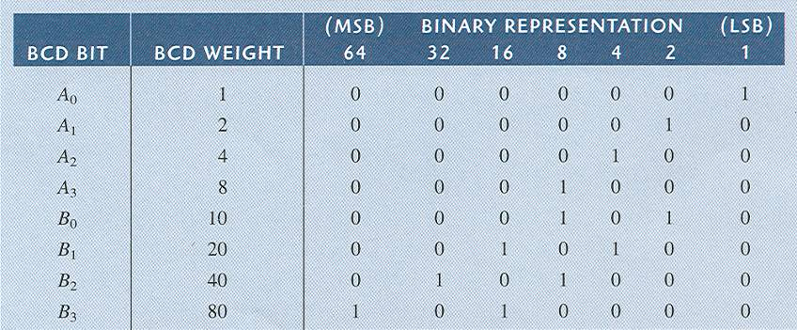

BCD-to-binary conversion

Slide 9
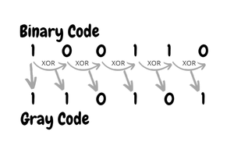

Slide 10
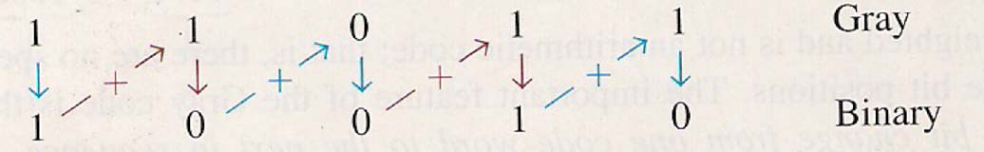
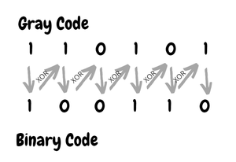

Slide 11
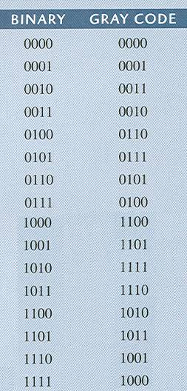
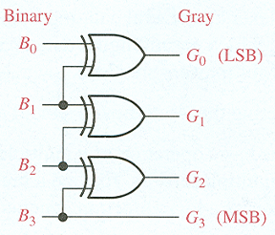
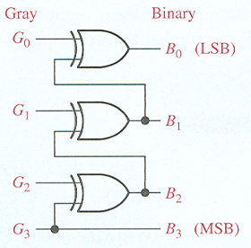
Binary-Gray conversions

