Slide 1
Graphs

Slide 2
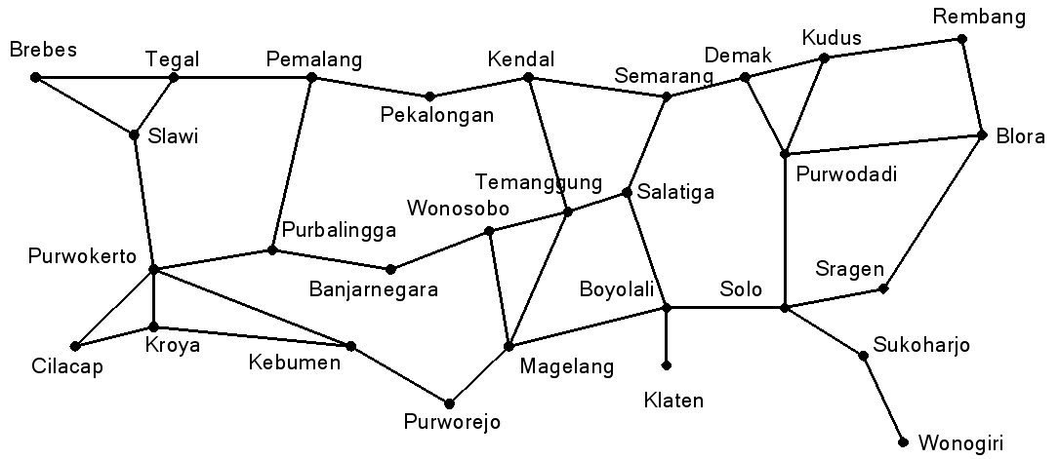
Definition of Graph
A graph is an abstract representation of a set of discrete objects where some pairs of the objects are connected by links.
The figure below shows a graph that represents a map of road network that connects a number of cities.
We think of a graph comprising dots (vertices) connected by line segments or curves (edges). We give every dot a label and form the vertex set V out of the labels. If there is a curve connecting dots a and b, we include the edge {a,b} in E.

Slide 3
Examples of Graphs

Slide 4
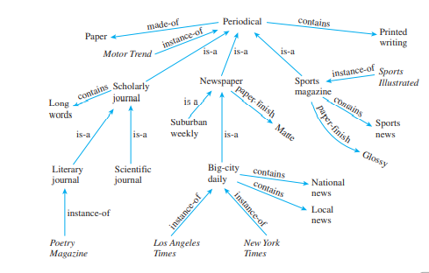
Examples of Graphs
Knowledge Representation Graph

Slide 5
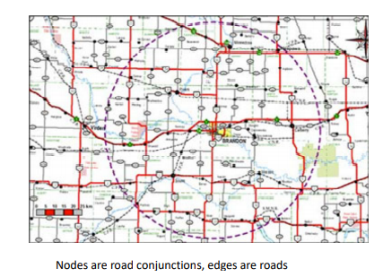
Examples of Graphs
Road Graph

Slide 6
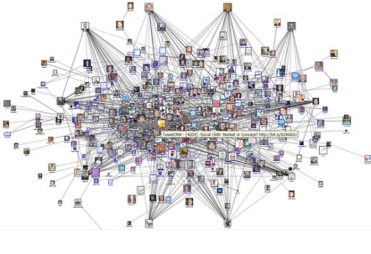
Examples of Graphs
Social Graphs

Slide 7
Basics

Slide 8
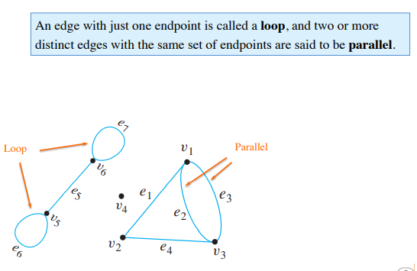
Basics

Slide 9
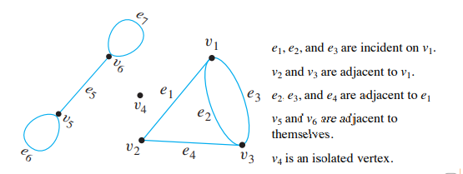
Basics
Two vertices that are connected by an edge are called adjacent; and a vertex that is an endpoint of a loop is said to be adjacent to itself. An edge is said to be incident on each of its endpoints, and two edges incident on the same endpoint are called adjacent. A vertex on which no edges are incident is called isolated

Slide 10
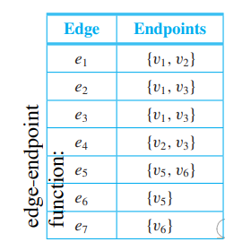
Basics
Example: write the vertex set, the edge set, and provide a table showing the edge-end point function.

Slide 11
Basics
Example: find all edges that are incident on $v_{1}$, all vertices that are adjacent to $v_{1}$, all edges that are adjacent to $e_{1}$, all loops, all parallel edges, all vertices that are adjacent to themselves, and all isolated vertices.
$e_{1},e_{2} and e_{3}$ are incident on $v_{1}$.
$v_{2} and v_{3}$ are adjacent to $v_{1}$.
$e_{2}, e_{3} and e_{4}$ are adjacent to $e_{1}$.
$e_{6} and e_{7}$ are loops.
$e_{2} and e_{3}$ are parallel.
$v_{5} and v_{6}$ are adjacent to themselves.
$v_{4}$ is an isolated vertex.

Slide 12
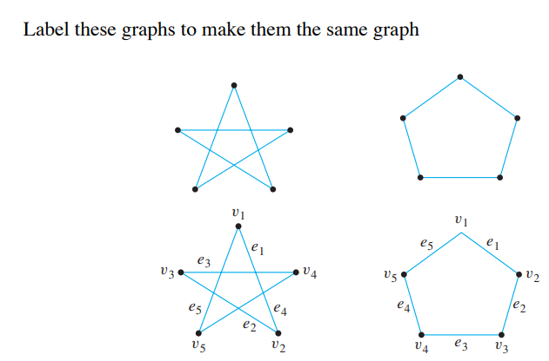
Same Graphs
Both drawings are representations of the same graph with edge-point function:
Endpoints | Edge
{v1,v2} | e1
{v2,v3} | e2
{v3,v4} | e3
{v4,v5} | e4
{v5,v1} | e5

Slide 13
Simple Graphs

Slide 14
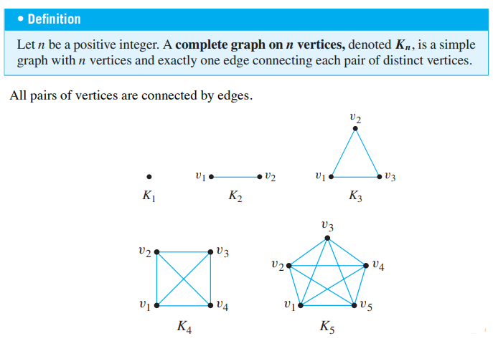
Complete Graphs

Slide 15
Bipartite Graphs (Bigraphs)

Slide 16
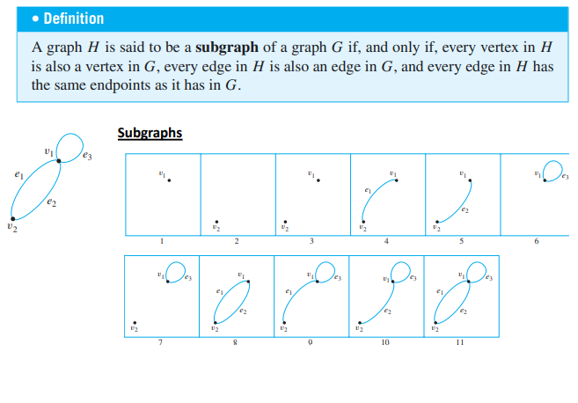
Sub-graphs

Slide 17
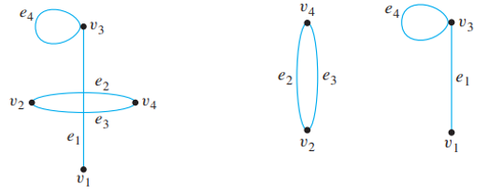
Sub-graphs

Slide 18
The Concept of Degree

Slide 19
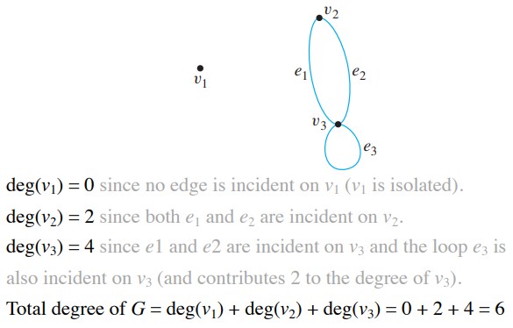
The Concept of Degree
Example:

Slide 20
The Concept of Degree
Example:
Can we calculate the graph degree directly?
Yes, it is (2 * number of edges)

