Slide 1
Relations

Slide 2
Summary
Relations and Functions
Properties of Relations
Reflexive Relations
Symmetric and Antisymmetric Relations
Transitive Relations
Combining Relations

Slide 3
Relations
Example: Let $A=\left\{0,1,2\right\}$ and $B=\left\{1,2,3\right\}$. An element $x in A$ is related to an element $y in B$ if, and only if, $x$ is less than y.
$x R y≡"x is related to y“$
$0 R 1 since 0<1$
$0 R 2 since 0<2$
$0 R 3 since 0<3$
$1 R 2 since 1<2$
$1 R 3 since 1<3$
$2 R 3 since 2<3$
$x R y ≡"x is not related to y“$
$1 R 1 since 1≮1$
$2 R 1 since 2≮1$
$2 R 2 since 2≮2$

Slide 4
Relations
The Cartesian product of $A and B$:
$A×B=\left\{\left(x,y\right)∣x∈A and y∈B\right\}$
$=\left\{\left(0,1\right),\left(0,2\right),\left(0,3\right),\left(1,1\right),\left(1,2\right),\left(1,3\right),\left(2,1\right),\left(2,2\right),\left(2,3\right)\right\}$
3 ⦿ ⦿ ⦿
$B=\left\{1,2,3\right\}$ 2 ⦿ ⦿ •
1⦿ • •
$\left(0,0\right)$ 1 2 3
$A=\left\{0,1,2\right\}$
The circled points represent the ordered pairs whose first and second elements are related. $x R y⇔x<y$

Slide 5
Binary Relation
Let $A$ and $B$ be sets. A binary relation $R$ from $A$ to $B$ is a subset of $A×B$.
Given an ordered pair $\left(x,y\right)$ in $A×B, x$ is related to $y$ by $R$, written $x R y$, if, and only if, $\left(x,y\right)$ is in $R$.
Symbolically:
$x R y⇔\left(x,y\right)∈R$
$x R y⇔\left(x,y\right)∉R$

Slide 6
Example
Let $A=\left\{1,2\right\}$ and $B=\left\{1,2,3\right\}$. Given any $\left(x,y\right)∈A×B$,
$\left(x,y\right)∈R⇔x−y$ is even.
① State explicitly which ordered pairs are in $A×B$ and which
are in $R$.
$②$ Graph $A×B$ by plotting all the points of $A×B$ in the
Cartesian plane and circling the points that are in $R$.
③ Is $1R3$
Is $2R3$
Is $2R2$
① $A×B=\left\{\left(1,1\right),\left(1,2\right),\left(1,3\right),\left(2,1\right),\left(2,2\right),\left(2,3\right)\right\}$
$\left(1,1\right)∈R$ because: $1−1=0 and 0 is even \left(0=2×0\right)$

Slide 7
Example
$\left(1,2\right)∉R$ because: $1−2=−1 and is not even.$
$\left(since −1≠2×k, for any integer k\right).$
$\left(1,3\right)∈R$ because: $1−3=−2 and −2 is even$.
$\left(2,1\right)∉R$ because: $2−1=1 and 1 is not even$.
$\left(2,2\right)∈R$ because: $2−2=0 and 0 is even$.
$\left(2,3\right)∉R$ because: $2−3=−1 and −1 is not even$.

Slide 8
Example
②
$B=\left\{1,2,3\right\}$
3 ⦿ • $x R y⇔x−y is even$
The circled points represent
2 • ⦿ the ordered pairs whose
first and second elements
1 ⦿ • are related.
(0,0)
$A=\left\{1,2\right\}$

Slide 9
Example
$1 R 3 since \left(1,3\right)∈R$
$2 R 3 since \left(2,3\right)∉R$
$2 R 2 since \left(2,2\right)∈R$

Slide 13
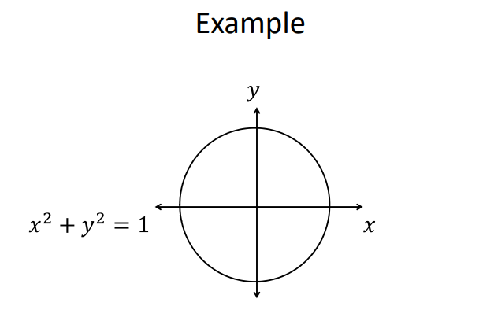

Slide 23
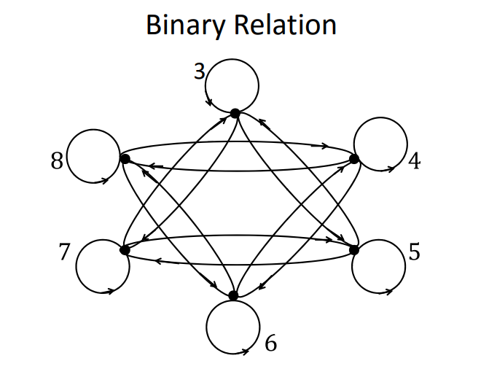

Slide 24
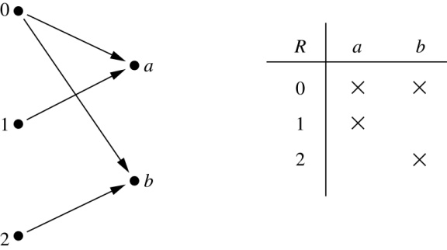
Binary Relations
Definition: A binary relation R from a set A to a set B is a subset R ⊆ A × B.
Example:
Let A = {0,1,2} and B = {a,b}
{(0, a), (0, b), (1,a) , (2, b)} is a relation from A to B.
We can represent relations from a set A to a set B graphically or using a table:
Relations are more general than functions. A function is a relation where each element of $A$ is associated with a unique element of $B$.

Slide 25
Binary Relation on a Set
Definition: A binary relation R on a set A is a subset of A × A or a relation from A to A.
Example:
Suppose that A = {a,b,c}. Then R = {(a,a),(a,b), (a,c)} is a relation on A.
Let A = {1, 2, 3, 4}. The ordered pairs in the relation R = {(a,b) | a divides b} are
(1,1), (1, 2), (1,3), (1, 4), (2, 2), (2, 4), (3, 3), and (4, 4).
“a divides b” means a and b are integers and there is an integer n, such that n×a = b, or
b/a ∊ Z , b is divisable by a with no remainder

Slide 26
Binary Relations on a Set (cont.)
Example: Consider these relations on the set of integers:
R₁ = {(a,b) | a ≤ b}, R₄ = {(a,b) | a = b},
R₂ = {(a,b) | a > b}, R₅ = {(a,b) | a = b + 1},
R₃ = {(a,b) | a = b or a = −b}, R₆ = {(a,b) | a + b ≤ 3}.
Which of these relations contain each of the pairs
(1,1), (1, 2), (2, 1), (1, −1), and (2, 2)?
Solution: Checking the conditions that define each relation, we see that the pair (1,1) is in R₁, R₃, R₄ , and R₆: (1,2) is in R₁ and R₆: (2,1) is in R₂, R₅, and R₆: (1, −1) is in R₂, R₃, and R₆ : (2,2) is in R₁, R₃, and R₄.
Note that these relations are on an infinite set and each of these relations is an infinite set.

Slide 27
Binary Relations on a Set (cont.)
Example: Consider these relations on the set of integers:
R₁ = {(a,b) | a ≤ b}, R₄ = {(a,b) | a = b},
R₂ = {(a,b) | a > b}, R₅ = {(a,b) | a = b + 1},
R₃ = {(a,b) | a = b or a = −b}, R₆ = {(a,b) | a + b ≤ 3}.
Which of these relations contain each of the pairs
(1,1), (1, 2), (2, 1), (1, −1), and (2, 2)?
R1 = {(1,1), (1,2), (2,2)}
R2 = {(2,1), (1,-1)}
R3 = {(1,1), (1,-1), (2,2)}
R4 = {(1,1), (2,2)}
R5 = {(2,1)}
R6 = {(1,1), (1,2), (2,1), (1,-1)}

Slide 28
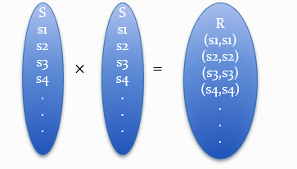
Reflexive Relations انعكاسي
Definition: R is reflexive iff (a,a) ∊ R for every element a ∊ A. Written symbolically, R is reflexive if and only if
∀x[x∊U ⟶ (x,x) ∊ R]
R is Reflexive if each element is related to itself.
Let’s take any set K =(2,8,9}
If Relation M ={(2,2), (8,8),(9,9), ……….} exists, then relation M is called a Reflexive relation.
If A = ∅ then the empty relation is reflexive vacuously. That is the empty relation on an empty set is reflexive!

Slide 29
Reflexive Relations
A relation R in a set X is not reflexive if at least one element exists such that x ∈ X such and (x, x) ∉ R.
For example, a set X = {p, q, r, s}.
The relation R1 = {(p, p), (p, r), (q, q), (r, r), (r, s), (s, s)} in X follows the reflexive property, since every element in X is R1-related to itself.
But the relation R2 = {(p, p), (p, r), (q, r), (q, s), (r, s)} does not follow the reflexive property in X since q, r, s ∈ X but (q, q) ∉ R2, (r, r) ∉ R2 and (s, s) ∉ R2

Slide 31
Symmetric Relations متماثل وتبادلي
Definition: R is symmetric iff (b,a) ∊ R whenever (a,b) ∊ R for all a,b ∊ A. Written symbolically, R is symmetric if and only if
∀x∀y [(x,y) ∊R ⟶ (y,x) ∊ R]
R is symmetric If any one element is related to any other element, then the second is related to the first.
R is not symmetric If there are elements x and y in A such that xRy but yRx [that is, such that (x,y) ∊ R but (y, x) $∉$ R].
“Is equal to” is a symmetric relation, such as 3 = 2+1 and 1+2=3.

Slide 32
Symmetric Relations
Example: Suppose R is a relation in a set A, where
A = {1,2,3}, {(1,1), (1,2), (1,3), (2,3), (3,1)} check if this relation is symmetric or not.
(1,2) ∈ R but no pair is there which contains (2,1), also (2,3) ∈ R but (3,2) $∉$ R
So, for R = {(1,1), (1,2), (1,3), (2,3), (3,1)} in symmetry relation we must have (2,1), (3,2).
Then only we can say that the above relation is in symmetric relation.
i.e. R = {(1,1), (1,2), (1,3), (2,3), (3,1), (2,1), (3,2)}

Slide 33
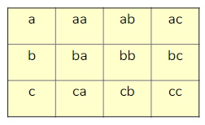
Symmetric Relations
Example: Suppose A = {a,b,c} so A×A that is matrix representation of the subset product would be
Which of the below are Symmetric Relations?
{(a, b), (b, a)}
{(b, c), (c, b), (b, b), (c, c)}
{(a, a), (b, b), (c, c)}
ø
A × A
{(a, b), (b, c), (a, c)}

Slide 34
Symmetric Relations
Solution:
Symmetric relation as when we flip a, b we get b, a .
Symmetric relation.
3. (a, a), (b, b), and (c, c) are diagonal and reflexive pairs these are symmetric to itself. Hence it is also a symmetric relationship.
4. This is not symmetry as (a, b) does not belong to ø.
5. AXA is a cartesian product. As the cartesian product shown in the above Matrix has all the symmetric. Hence this is a symmetric relationship.
6. It is not a symmetric relationship.

Slide 36
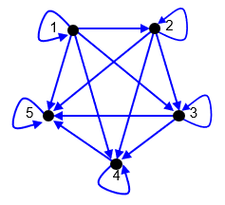
Antisymmetric Relationsغير متماثل
Definition: A relation R is not antisymmetric if there exist x,y ∈ A such that (x,y) ∈ R and (y,x) ∈ R but x ≠ y.
Given a relation R on a set A we say that R is antisymmetric if and only if for all (a,b)∈R where a≠b we must have (b,a)∉R.
In other words, if for every edge, there is not an edge in the other direction, then the relation is antisymmetric
Loops are allowed in the digraph

Slide 37
Antisymmetric Relationsغير متماثل
Example: If A = {1,2,3,4} and R is the relation on set A, then find the antisymmetric relation on set A.
Solution: The antisymmetric relation on set A = {1,2,3,4} will be;
R = {(1,1), (2,2),(3,3),(4,4)}

Slide 38
Antisymmetric Relationsغير متماثل
Example: Which of these are antisymmetric?
(i) R = {(1,1),(1,2),(2,1),(2,2),(3,4),(4,1),(4,4)}
(ii) R = {(1,1),(1,3),(3,1)}
(iii) R = {(1,1),(1,2),(1,4),(2,1),(2,2),(3,3),(4,1),(4,4)}
Solution:
(i) R is not antisymmetric here because of (1,2) ∈ R and (2,1) ∈ R, but 1 ≠ 2.
(ii) R is not antisymmetric here because of (1,3) ∈ R and (3,1) ∈ R, but 1 ≠ 3.
(iii) R is not antisymmetric here because of (1,2) ∈ R and (2,1) ∈ R, but 1 ≠ 2 and also (1,4) ∈ R and (4,1) ∈ R but 1 ≠ 4.

Slide 40
Transitive Relations علاقة متعدية
Definition: A relation R on a set A is called transitive if whenever (a,b) ∊ R and (b,c) ∊ R, then (a,c) ∊ R, for all a,b,c ∊ A. Written symbolically, R is transitive if and only if
∀x∀y ∀z[(x,y) ∊R ∧ (y,z) ∊ R ⟶ (x,z) ∊ R ]
If "a" is related to "b" and "b" is related to "c", then "a" has to be related to "c".
Example:
A = {a, b, c} , R is a transitive relation defined on the set A. Then, R = { (a, b), (b, c), (a, c)}

Slide 41
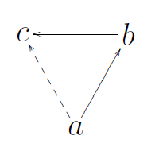
Transitive Relations
Transitive relation is:
(a,b) ∊ R and (b,c) ∊ R, then (a,c) ∊ R
Example:
R={(a,b), (b,c), (a,c)} is transitive

Slide 42
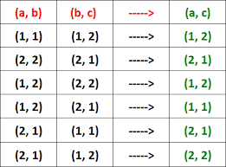
Transitive Relations
Example:

Slide 43
Transitive Relations
Example: Let A = { 1, 2, 3 } and R be a relation defined on
set A as "is less than" and R = {(1, 2), (2, 3), (1,3)}
Verify R is transitive.
Solution :
From the given set A, let
a = 1
b = 2
c = 3
Then, we have
(a, b) = (1, 2) -----> 1 is less than 2
(b, c) = (2, 3) -----> 2 is less than 3
(a, c) = (1, 3) -----> 1 is less than 3
That is, if 1 is less than 2 and 2 is less than 3, then 1 is less than 3.
More clearly,
1R2, 2R3 -----> 1R3
Clearly, the above points prove that R is transitive.

Slide 44
Combining Relations
Given two relations R₁ and R₂, we can combine them using basic set operations to form new relations such as R₁ ∪ R₂, R₁ ∩ R₂, R₁ − R₂, and R₂ − R₁.
Example: Let A = {1,2,3} and B = {1,2,3,4}. The relations R₁ = {(1,1),(2,2),(3,3)} and R₂ = {(1,1),(1,2),(1,3),(1,4)} can be combined using basic set operations to form new relations:
R₂ ∪ R₁ ={(1,1),(1,2),(1,3),(1,4),(2,2),(3,3)}
R₁ ∩ R₂ ={(1,1)}
R₁ − R₂ ={(2,2),(3,3)}
R₂ − R₁ ={(1,2),(1,3),(1,4)}

Slide 45
Composition التركيب
Definition: Suppose
R₁ is a relation from a set A to a set B.
R₂ is a relation from B to a set C.
Then the composition (or composite) of R₂ with R₁, is a relation from A to C where
if (x,y) is a member of R₁ and (y,z) is a member of R₂, then (x,z) is a member of R₁∘ R₂ .

Slide 46
Representing the Composition of a Relation: Example
R₁
R₂
w
m
a
x
n
b
y
o
c
p
z
(a, p), (b, m) are members of R₁
(m, x), (m, z), (n, w) are members of R₂
R₁∘ R₂ = {(b,x),(b,z)}

Slide 47
Representing Relations Representing Relations using Matrices Representing Relations using Digraphs

Slide 48
Representing Relations Using Matrices
A relation between finite sets can be represented using a zero-one matrix.
Suppose R is a relation from A = {a₁, a₂, …, a_{m}} to B = {b₁, b₂, …, b_{n}}.
The elements of the two sets can be listed in any particular arbitrary order. When A = B, we use the same ordering.
The relation R is represented by the matrix M_{R} = [m_{ij}], where
The matrix representing R has a 1 as its (i,j) entry when a_{i} is related to b_{j} and a 0 if a_{i} is not related to b_{j}.

Slide 49
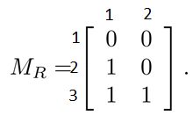
Examples of Representing Relations Using Matrices
Example 1: Suppose that A = {1,2,3} and B = {1,2}. Let R be the relation from A to B containing (a,b) if a ∈ A, b ∈ B, and a > b. What is the matrix representing R (assuming the ordering of elements is the same as the increasing numerical order)?
Solution: Set A = {1,2,3} is rows and set B = {1,2} is columns. Based on condition a > b the
R = {(2,1), (3,1),(3,2)}, the matrix is

Slide 50
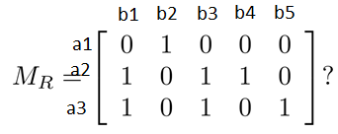
Examples of Representing Relations Using Matrices (cont.)
Example 2: Let A = {a₁,a₂, a₃} and B = {b₁,b₂, b₃,b₄, b₅}. Which ordered pairs are in the relation R represented by the matrix
Solution: Because R consists of those ordered pairs (a_{i},b_{j}) with m_{ij} = 1, it follows that: R = {(a1, b2), (a2, b1),(a2, b3), (a2, b4),(a3, b1), {(a3, b3), (a3, b5)}.

Slide 51
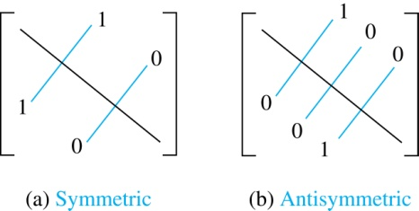
Matrices of Relations on Sets
If R is a reflexive relation, all the elements on the main diagonal of M_{R} are equal to 1.
R is a symmetric relation, if and only if m_{ij} = 1 whenever m_{ji} = 1. R is an antisymmetric relation, if and only if m_{ij} = 0 or m_{ji} = 0 when i≠ j.

Slide 52
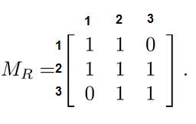
Example of a Relation on a Set
Example 3: Suppose that the relation R on a set is represented by the matrix
Is R reflexive, symmetric, and/or antisymmetric?
Solution: Because all the diagonal elements are equal to 1, R is reflexive. Because M_{R} is symmetric, R is symmetric and not antisymmetric because both m_{1,2} and m_{2,1} are 1.

Slide 53
Relations using matrices
Consider the relation of who is enrolled in which class
Let A = { Alice, Bob, Claire, Dan }
Let B = { CS101, CS201, CS202 }
R = { (a,b) | person a is enrolled in course b }
 | CS101 | CS201 | CS202
Alice | X
Bob |  | X | X
Claire
Dan |  | X | X

Slide 54
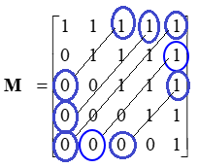
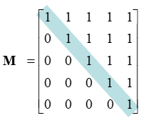
Summary
Symmetric
Antisymmetric
Reflexive
Let A = { 1, 2, 3, 4, 5 }
If, for every value and the value in its transposed position, if they are not both 1, then the relation is antisymmetric
The center diagonal can have both 1’s and 0’s
If, for every value, it is the equal to the value in its transposed position, then the relation is symmetric
If the center (main) diagonal is all 1’s, a relation is reflexive

Slide 55
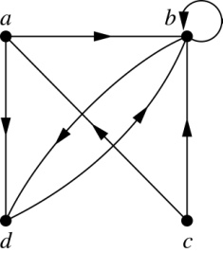
Representing Relations Using Digraphs
Definition: A directed graph, or digraph, consists of a set V of vertices (or nodes) together with a set E of ordered pairs of elements of V called edges (or arcs). The vertex a is called the initial vertex of the edge (a,b), and the vertex b is called the terminal vertex of this edge.
An edge of the form (a,a) is called a loop.
Example 7: A drawing of the directed graph with vertices a, b, c, and d, and edges (a, b), (a, d), (b, b), (b, d), (c, a), (c, b), and (d, b) is shown here.

Slide 57
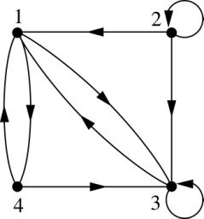
Examples of Digraphs Representing Relations
Example 8: What are the ordered pairs in the relation
represented by this directed graph?
Solution: The ordered pairs in the relation are
(1, 3), (1, 4), (2, 1), (2, 2), (2, 3), (3, 1), (3, 3), (4, 1), and (4, 3)

Slide 58
Determining which Properties a Relation has from its Digraph
Reflexivity: A loop must be present at all vertices in the graph.
Symmetry: If (x,y) is an edge, then so is (y,x) edge.
Antisymmetry: If (x,y) with x ≠ y is an edge, then (y,x) is not an edge.
Transitivity: If (x,y) and (y,z) are edges, then so is (x,z) edge.

Slide 59
Determining which Properties a Relation has from its Digraph – Example 1
a
b
c
d
Reflexive? No, there are no loops
Symmetric? No, there is an edge from a to b, but not from b to a
Antisymmetric? No, there is an edge from d to b and b to d
Transitive? No, there are edges from a to b and from b to d,
but there is no edge from a to d

Slide 60
Determining which Properties a Relation has from its Digraph – Example 2
a
b
Reflexive:
Sym:
Anti:
Trans:
c
d
Reflexive? No, there are no loops
Symmetric? No, for example, there is no edge from c to a
Antisymmetric? Yes, whenever there is an edge from one
vertex to another, there is not one going back
Transitive? No, (a,c), (c,b), but there is no (a, b)
there is no edge from a to b

Slide 61
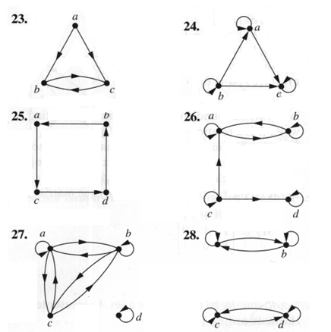
Sample questions
Which of the graphs are reflexive, irreflexive, symmetric, asymmetric, antisymmetric, or transitive
 | 23 | 24 | 25 | 26 | 27 | 28
Reflexive
Symmetric
Anti-symmetric
Transitive

