Slide 1
Discrete Mathematics

Slide 2
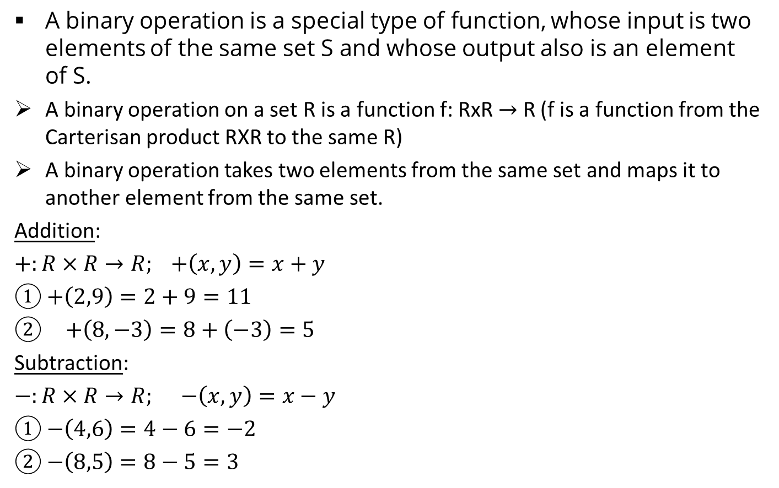
Binary Operations
A binary operation is a special type of function, whose input is two elements of the same set S and whose output also is an element of S.
A binary operation on a set R is a function f: RxR $→$ R (f is a function from the Carterisan product RXR to the same R)
A binary operation takes two elements from the same set and maps it to another element from the same set.
Addition:
$+:R×R→R; +\left(x,y\right)=x+y$
① $+\left(2,9\right)=2+9=11$
$+\left(8,−3\right)=8+\left(−3\right)=5$
Subtraction:
$−:R×R→R; −\left(x,y\right)=x−y$
① $−\left(4,6\right)=4−6=−2$
②$−\left(8,5\right)=8−5=3$

Slide 3
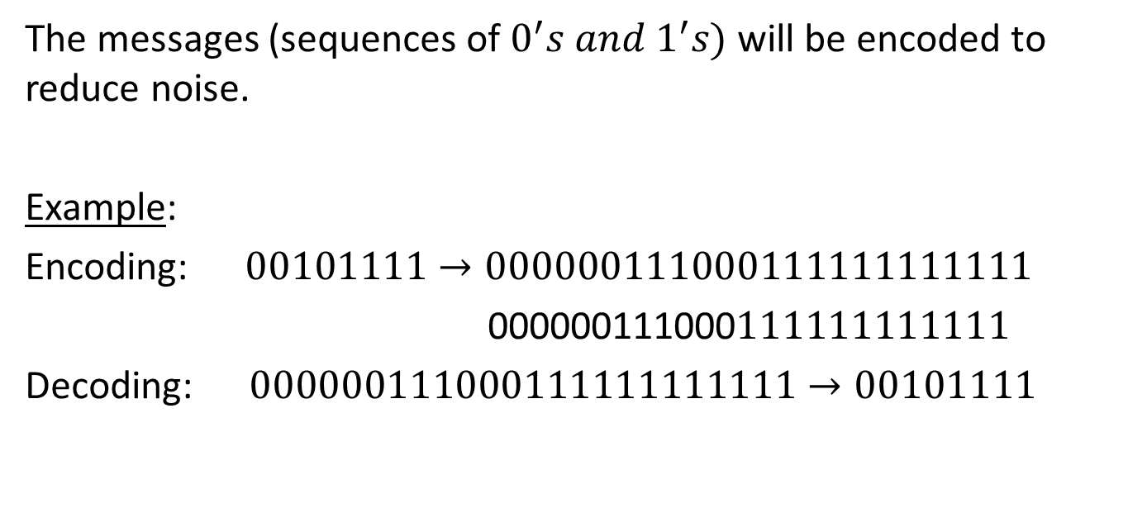
Encoding and Decoding Functions
The messages (sequences of $0^{′}s and 1^{′}s)$ will be encoded to reduce noise.
Example:
Encoding: $00101111→000000111000111111111111$
000000111000$111111111111$
Decoding: $000000111000111111111111→00101111$

Slide 4
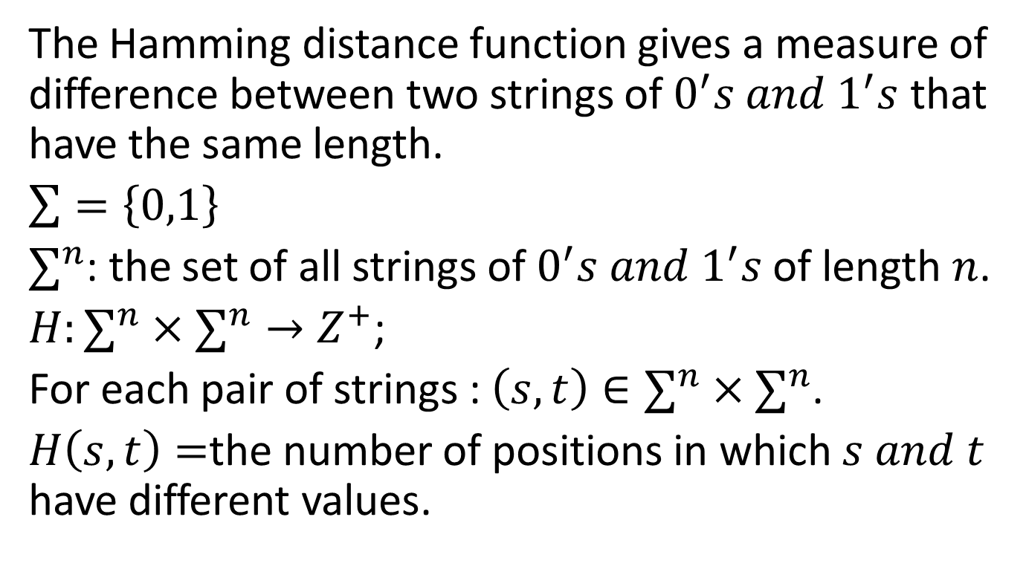
Hamming Distance Function
The Hamming distance function gives a measure of difference between two strings of $0^{′}s and 1^{′}s$ that have the same length.
$\sum{=\left\{0,1\right\}}$
$∑^{n}$: the set of all strings of $0^{′}s and 1^{′}s$ of length $n$.
$H:∑^{n}×∑^{n}→Z^{+}$;
For each pair of strings : $\left(s,t\right)∈∑^{n}×∑^{n}$.
$H\left(s,t\right)=$the number of positions in which $s and t$ have different values.

Slide 5

Examples
$H\left(\begin{aligned}11111, \\ 00000\end{aligned}\right)=5$
$H\left(\begin{aligned}11000, \\ 00000\end{aligned}\right)=2$
$H\left(\begin{aligned}00101, \\ 01110\end{aligned}\right)=3$
$H\left(\begin{aligned}10001, \\ 01111\end{aligned}\right)=4$
AHMED
AHMAD

Slide 6
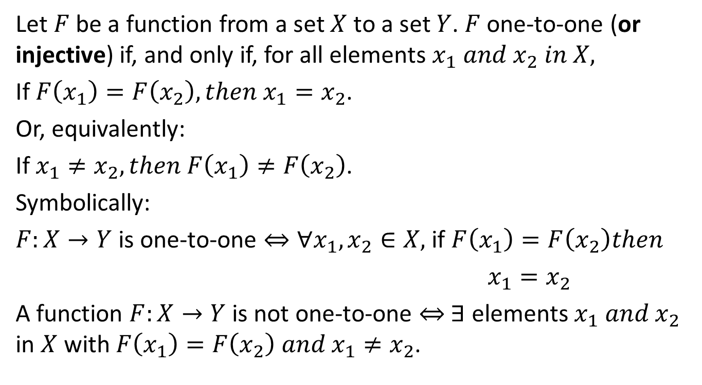
One-to-one Functions
Let $F$ be a function from a set $X$ to a set $Y$. $F$ one-to-one (or injective) if, and only if, for all elements $x_{1} and x_{2} in X,$
If $F\left(x_{1}\right)=F\left(x_{2}\right), then x_{1}=x_{2}$.
Or, equivalently:
If $x_{1}≠x_{2}, then F\left(x_{1}\right)≠F\left(x_{2}\right)$.
Symbolically:
$F:X→Y$ is one-to-one $⇔∀x_{1}, x_{2}∈X,$if $F\left(x_{1}\right)=F\left(x_{2}\right)then$
$x_{1}=x_{2}$
A function $F:X→Y$ is not one-to-one ⇔ $∃$ elements $x_{1} and x_{2}$ in $X$ with $F\left(x_{1}\right)=F\left(x_{2}\right) and x_{1}≠x_{2}$.
لا يجوز أن يكون عنصرين لهما نفس الصورة

Slide 7
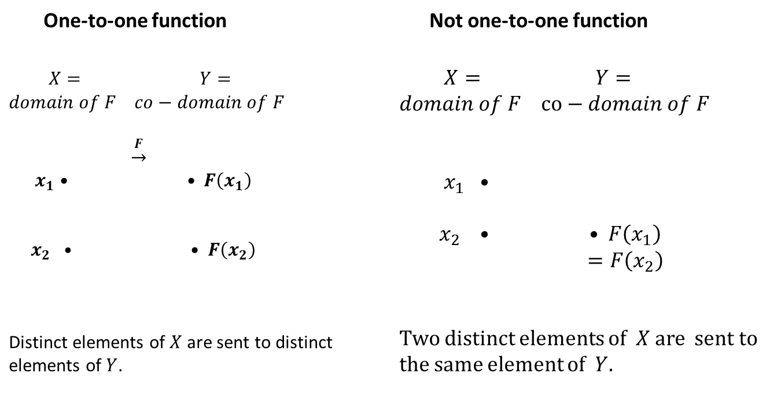
One-to-one Functions
One-to-one function | Not one-to-one function
$X=$ $Y=$ $domain of F$ $co−domain of F$ $\underset{→}{F}$ $x_{1}$• • $F\left(x_{1}\right)$ $x_{2} •$ • $F\left(x_{2}\right)$ Distinct elements of $X$ are sent to distinct elements of $Y$. | $X=$ $Y=$ $domain of F$ $co−domain of F$ $x_{1}$ • $x_{2} •$ • $F\left(x_{1}\right)$ $=F\left(x_{2}\right)$ Two distinct elements of $X$ are sent to the same element of $Y$.

Slide 8
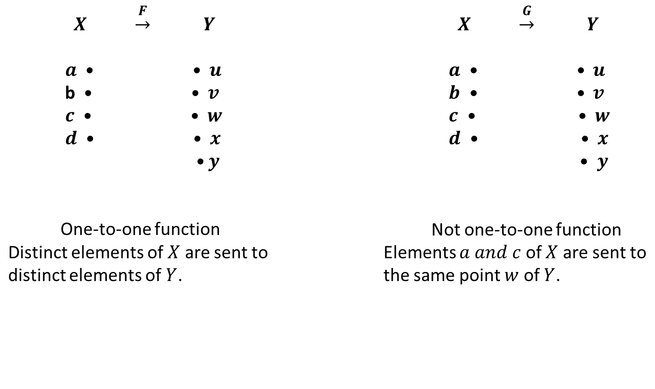
Example
Which of the arrow diagrams below define one-to-one functions?
$X$ $\underset{→}{F}$ $Y$ $a$ • • $u$ b • • $v$ $c$ • • $w$ $d$ • • $x$ • $y$ One-to-one function Distinct elements of $X$ are sent to distinct elements of $Y$. | $X$ $\underset{→}{G}$ $Y$ $a$ • • $u$ $b$ • • $v$ $c$ • • $w$ $d$ • • $x$ • $y$ Not one-to-one function Elements $a and c$ of $X$ are sent to the same point $w$ of $Y$.

Slide 9
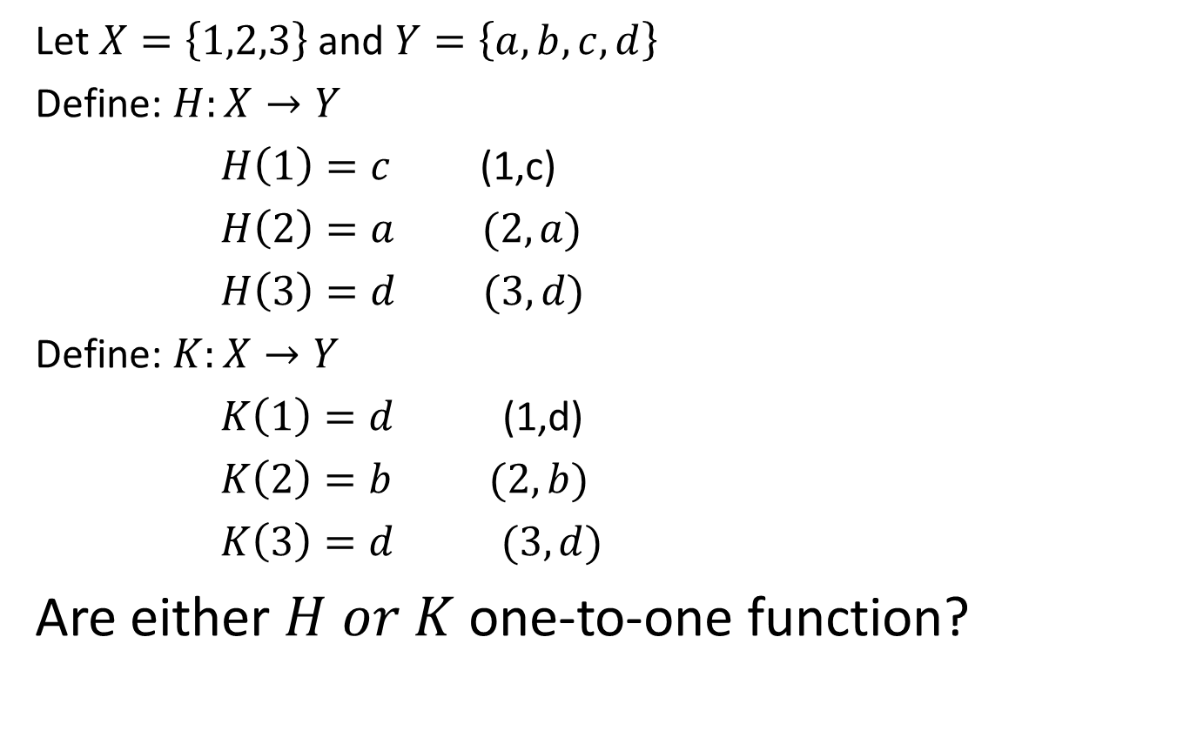
Example
Let $X=\left\{1,2,3\right\}$ and $Y=\left\{a,b,c,d\right\}$
Define: $H:X→Y$
$H\left(1\right)=c$ (1,c)
$H\left(2\right)=a (2,a)$
$H\left(3\right)=d (3,d)$
Define: $K:X→Y$
$K\left(1\right)=d$ (1,d)
$K\left(2\right)=b (2,b)$
$K\left(3\right)=d (3,d)$
Are either $H or K$ one-to-one function?

Slide 10
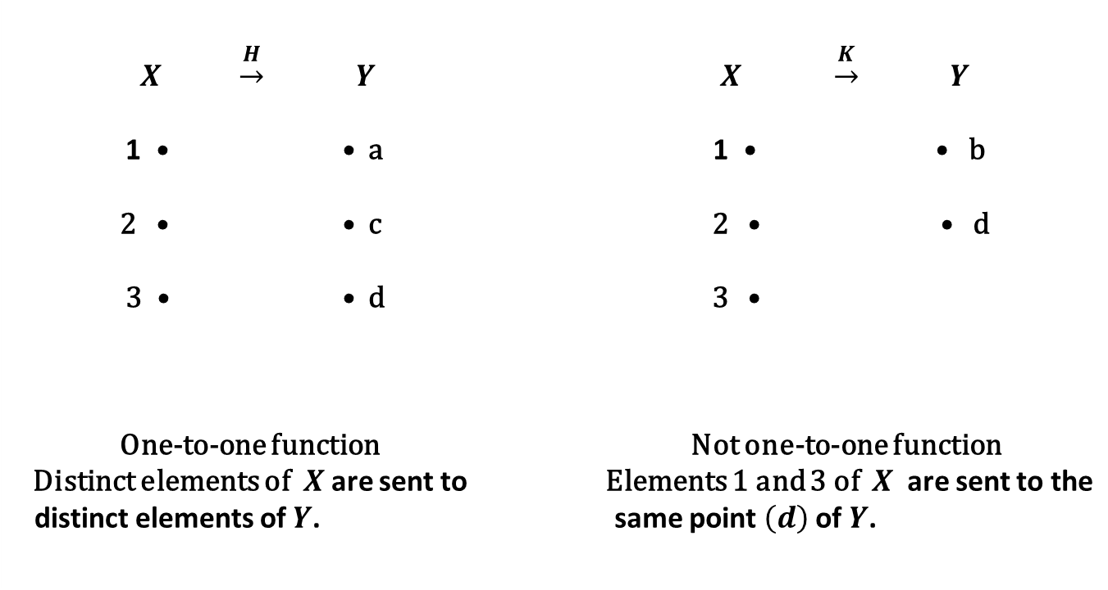
Example
$X$ $\underset{→}{H}$ $Y$ 1 • • a 2 • • c 3 • • d One-to-one function Distinct elements of $X$ are sent to distinct elements of $Y$. | $X$ $\underset{→}{K}$ $Y$ 1 • • b 2 • • d 3 • Not one-to-one function Elements 1 and 3 of $X$ are sent to the same point $\left(d\right)$ of $Y$.

Slide 11

One-to-one Function on an Infinite Sets
Let $f$ be a function defined on an infinite set $X$. By definition, $f$ is one-to-one if, and only if, the following universal statement is true:
$$∀x_{1},x_{2}∈X,if f\left(x_{1}\right)=f\left(x_{2}\right) then x_{1}=x_{2}$$

Slide 12
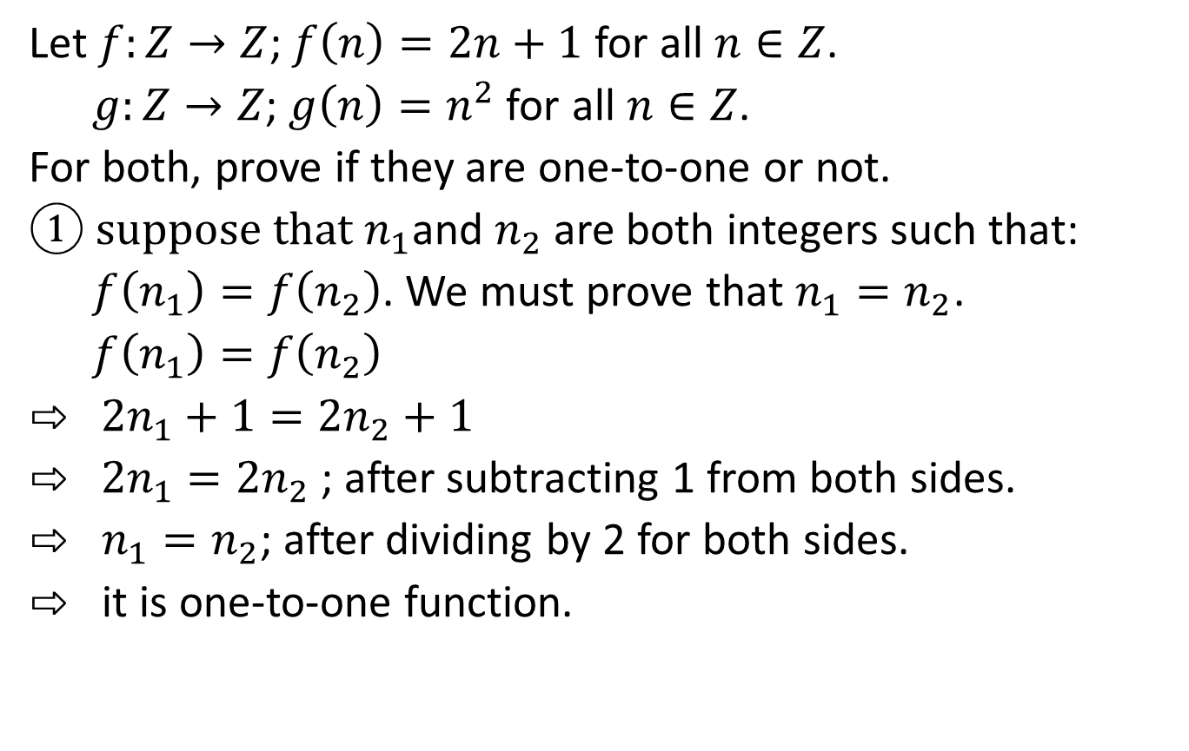
Example
Let $f:Z→Z$; $f\left(n\right)=2n+1$ for all $n∈Z$.
$g:Z→Z$; $g\left(n\right)=n^{2}$ for all $n∈Z$.
For both, prove if they are one-to-one or not.
① suppose that $n_{1}$and $n_{2}$ are both integers such that:
$f\left(n_{1}\right)=f\left(n_{2}\right)$. We must prove that $n_{1}=n_{2}$.
$f\left(n_{1}\right)=f\left(n_{2}\right)$
⇨ $2n_{1}+1=2n_{2}+1$
⇨ $2n_{1}=2n_{2}$ ; after subtracting 1 from both sides.
$⇨$ $n_{1}=n_{2}$; after dividing by 2 for both sides.
$⇨$ it is one-to-one function.

Slide 13
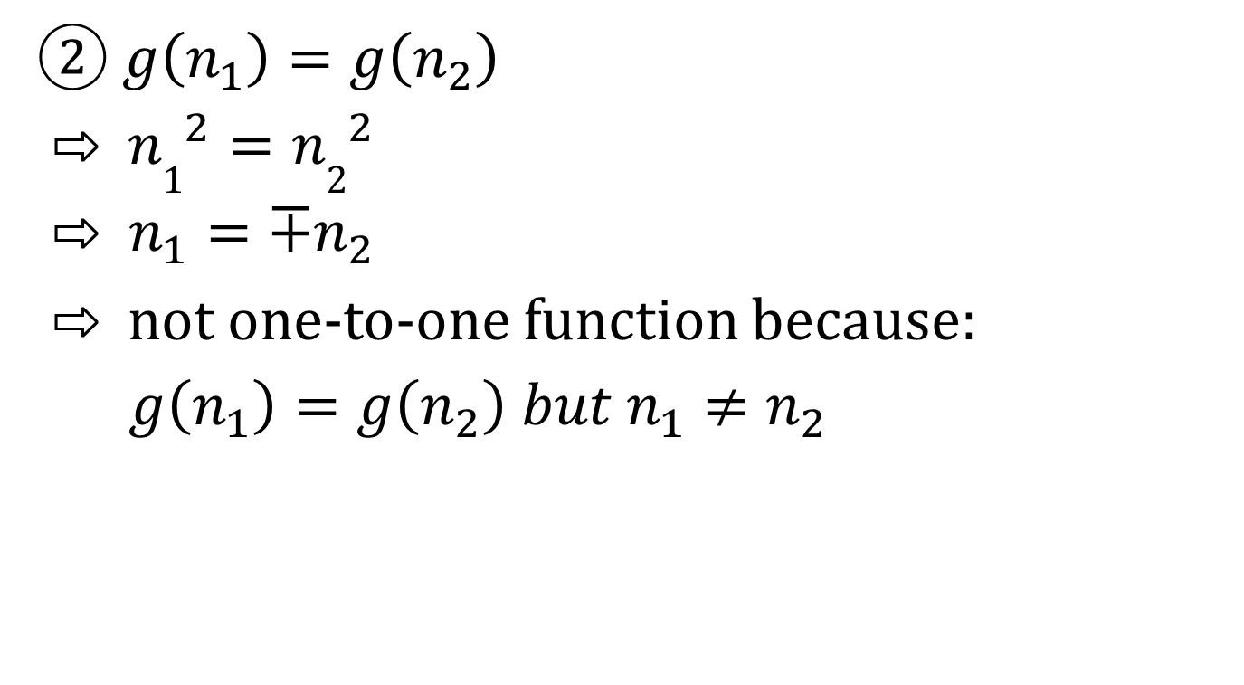
Example
② $g\left(n_{1}\right)=g\left(n_{2}\right)$
⇨ ${n1}^{2}={n2}^{2}$
⇨ $n_{1}=∓n_{2}$
⇨ not one-to-one function because:
$g\left(n_{1}\right)=g\left(n_{2}\right) but n_{1}≠n_{2}$

Slide 14
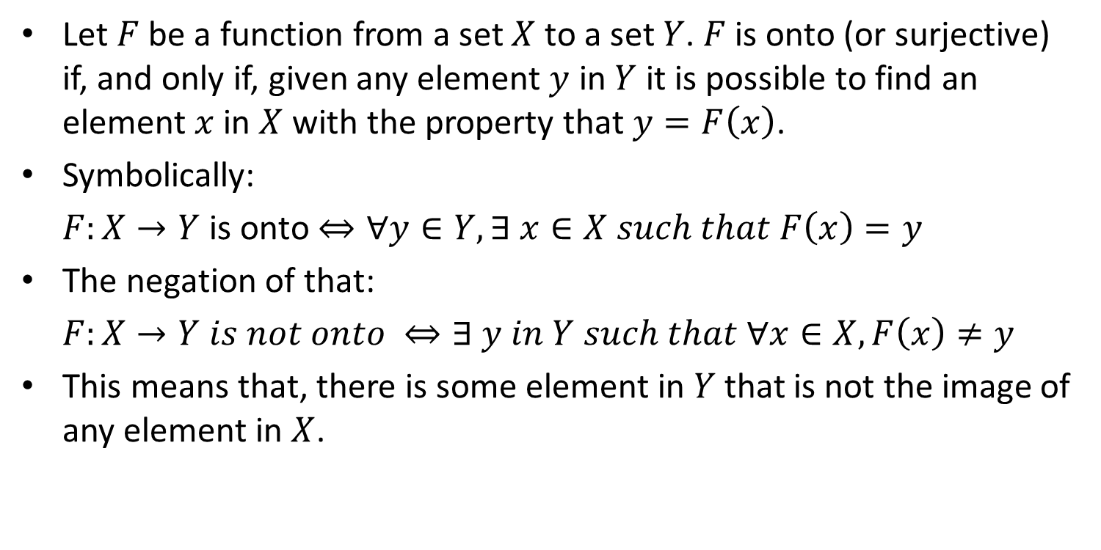
Onto Functions
Let $F$ be a function from a set $X$ to a set $Y$. $F$ is onto (or surjective) if, and only if, given any element $y$ in $Y$ it is possible to find an element $x$ in $X$ with the property that $y=F\left(x\right)$.
Symbolically:
$F:X→Y$ is onto $⇔∀y∈Y,∃ x∈X such that F\left(x\right)=y$
The negation of that:
$F:X→Y is not onto ⇔∃ y in Y such that ∀x∈X, F\left(x\right)≠y$
This means that, there is some element in $Y$ that is not the image of any element in $X$.
كل العناصر الموجودة في ال
co domain
يصلها سهم من
domain

Slide 15
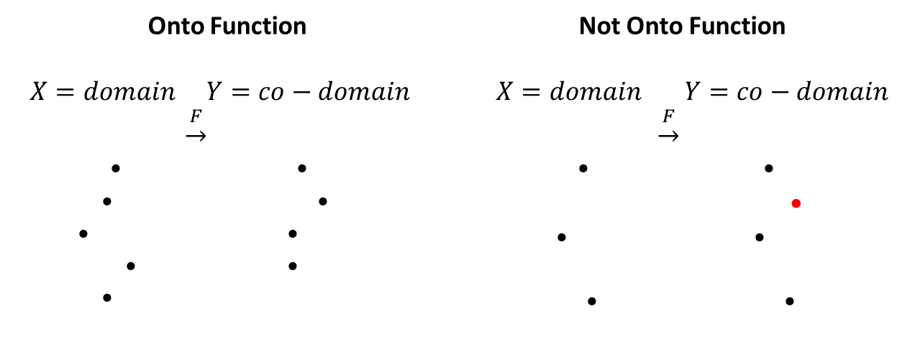
Onto Functions
A function is onto if each element of the co-domain has an arrow pointing to it from element of the domain. And a function is not onto if at least one element in its co-domain does not have an arrow pointing to it.
When a function is onto, its range is equal to its co-domain.
Onto Function | Not Onto Function
$X=domain$ $Y=co−domain$ $\underset{→}{F}$ • • • • • • • • • | $X=domain$ $Y=co−domain$ $\underset{→}{F}$ • • • • • • •

Slide 16
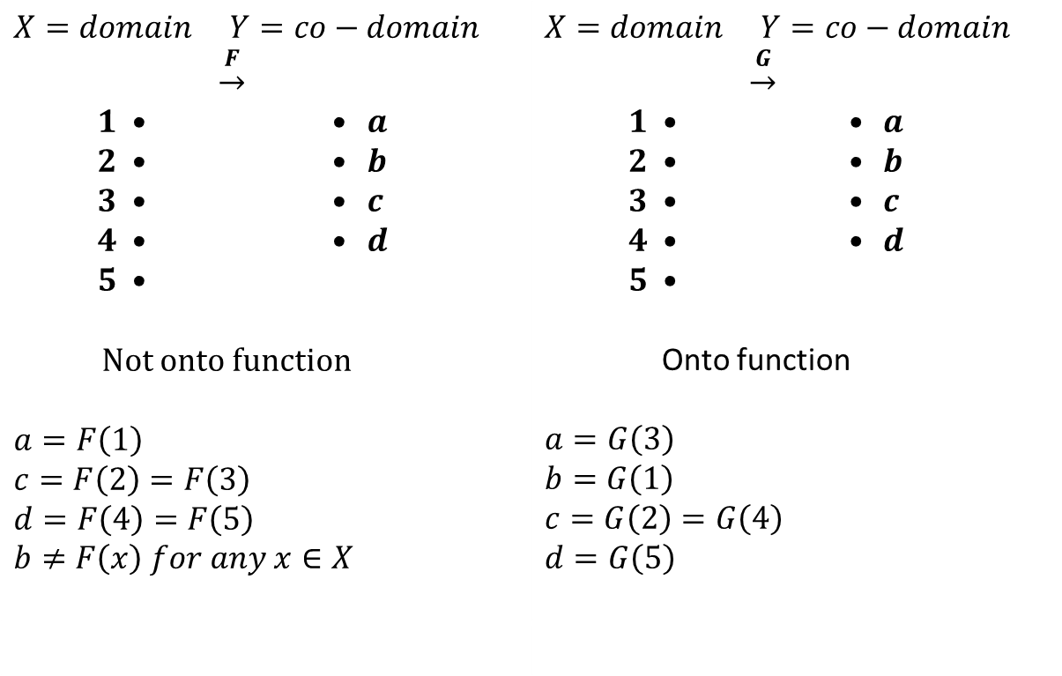
Example
Which of the arrow diagrams below define onto functions?
$X=domain$ $Y=co−domain$ $\underset{→}{F}$ $1$ • • $a$ $2$ • • $b$ $3$ • • $c$ $4$ • • $d$ $5$ • Not onto function $a=F\left(1\right)$ $c=F\left(2\right)=F\left(3\right)$ $d=F\left(4\right)=F\left(5\right)$ $b≠F\left(x\right) for any x∈X$ | $X=domain$ $Y=co−domain$ $\underset{→}{G}$ $1$ • • $a$ $2$ • • $b$ $3$ • • $c$ $4$ • • $d$ $5$ • Onto function $a=G\left(3\right)$ $b=G\left(1\right)$ $c=G\left(2\right)=G\left(4\right)$ $d=G\left(5\right)$

Slide 17
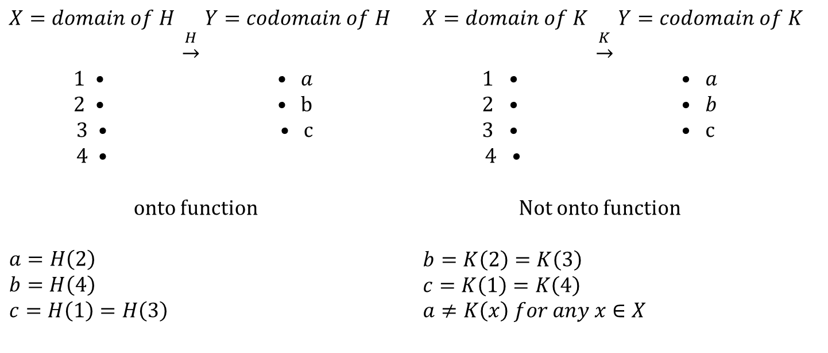

Example
Let $X=\left\{1,2,3,4\right\}$ and $Y=\left\{a,b,c\right\}$. Define $H:X→Y$ by specifying that: $H\left(1\right)=c, H\left(2\right)=a, H\left(3\right)=c and H\left(4\right)=b$.
Define $K:X→Y$ by specifying that: $K\left(1\right)=c, K\left(2\right)=b, K\left(3\right)=b and K\left(4\right)=c.$ Are either $H or K$ represent onto functions.
$X=domain of H$ $Y=codomain of H$ $\underset{→}{H}$ $1$ • • $a$ $2$ • • b $3$ • • c $4$ • onto function $a=H\left(2\right)$ $b=H\left(4\right)$ $c=H\left(1\right)=H\left(3\right)$ | $X=domain of K$ $Y=codomain of K$ $\underset{→}{K}$ $1$ • • $a$ $2$ • • $b$ $3$ • • c $4$ • Not onto function $b=K\left(2\right)=K\left(3\right)$ $c=K\left(1\right)=K\left(4\right)$ $a≠K\left(x\right) for any x∈X$

Slide 18
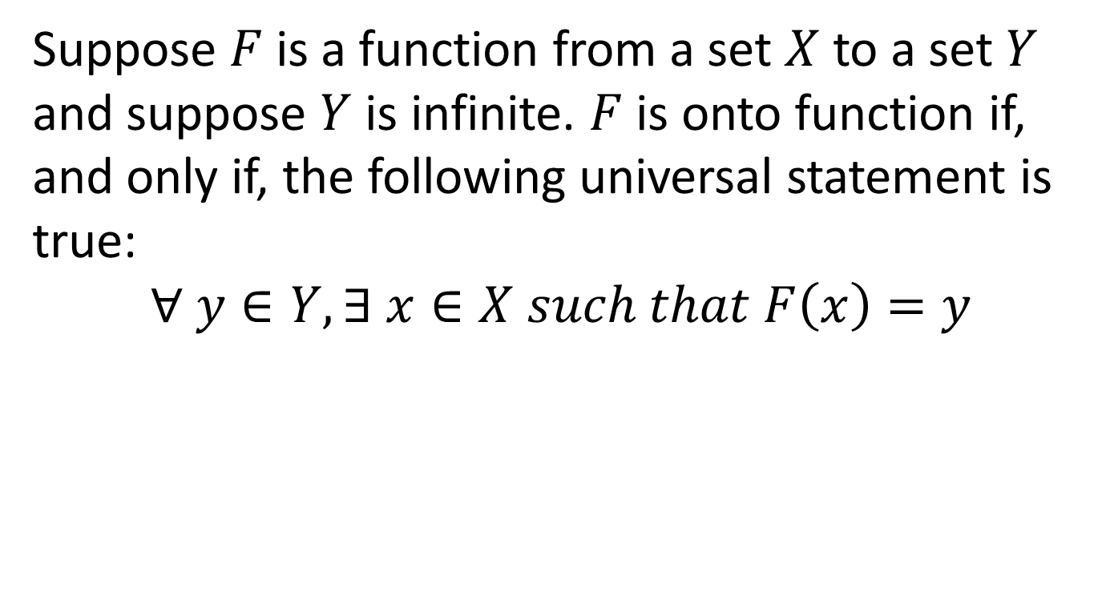
Onto Functions on Infinite Sets
Suppose $F$ is a function from a set $X$ to a set $Y$ and suppose $Y$ is infinite. $F$ is onto function if, and only if, the following universal statement is true:
$$∀ y∈Y, ∃ x∈X such that F\left(x\right)=y$$

Slide 19
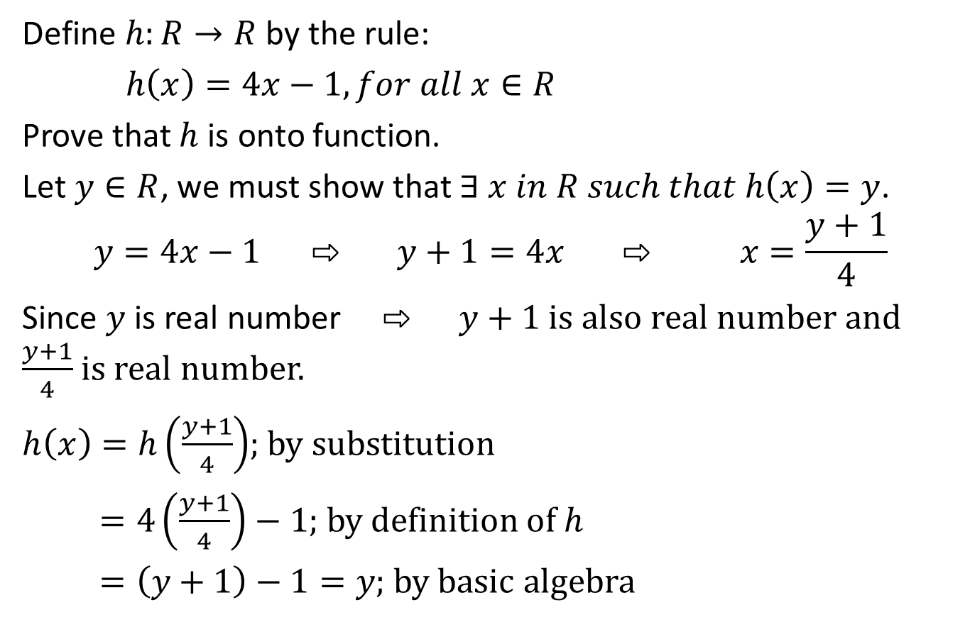
Example
Define $h:R→R$ by the rule:
$h\left(x\right)=4x−1, for all x∈R$
Prove that $h$ is onto function.
Let $y∈R$, we must show that $∃ x in R such that h\left(x\right)=y$.
$$y=4x−1 ⇨ y+1=4x ⇨ x=\frac{y+1}{4}$$
Since $y$ is real number ⇨ $y+1$ is also real number and $\frac{y+1}{4}$ is real number.
$h\left(x\right)=h\left(\frac{y+1}{4}\right)$; by substitution
$=4\left(\frac{y+1}{4}\right)−1$; by definition of $h$
$=\left(y+1\right)−1=y$; by basic algebra

Slide 20
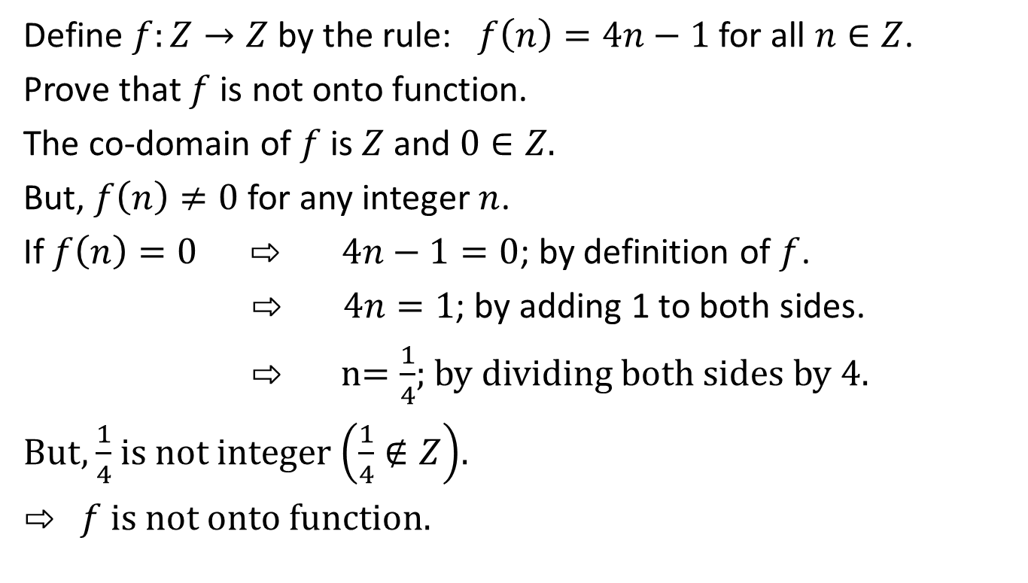
Example
Define $f:Z→Z$ by the rule: $f\left(n\right)=4n−1$ for all $n∈Z$.
Prove that $f$ is not onto function.
The co-domain of $f$ is $Z$ and $0∈Z.$
But, $f\left(n\right)≠0$ for any integer $n$.
If $f\left(n\right)=0 ⇨ 4n−1=0$; by definition of $f$.
$⇨ 4n=1$; by adding 1 to both sides.
⇨ n$=\frac{1}{4}$; by dividing both sides by 4.
But, $\frac{1}{4}$ is not integer $\left(\frac{1}{4}∉Z\right)$.
⇨ $f$ is not onto function.

Slide 21

One-to-one Correspondences
A one-to-one correspondence (or bijective) from a set $X$ to a set $Y$ is a function $F:X→Y$ that is both one-to-one and onto.
$X$ $\underset{→}{F}$ $Y$
$a$ • • $v$
$b$ • • $w$
$c$ • • $x$
$d$ • • y
$e$ • • $z$
لا يجوز أن يكون عنصرين لهما نفس الصورة
كل العناصر الموجودة في ال
co domain
يصلها سهم من
domain

Slide 22
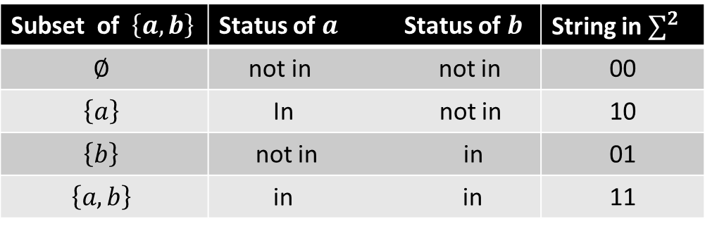

Example
Let $P\left(\left\{a,b\right\}\right)$ be the set of all subsets of $\left\{a,b\right\}$ and let $∑^{2}$ be the set of all strings of length made up of $0^{′}s and 1^{′}s$.
$P\left(\left\{a,b\right\}\right)=\left\{∅,\left\{a\right\},\left\{b\right\},\left\{a,b\right\}\right\}$
$∑^{2}=\left\{00,01,10,11\right\}$
Define $h:P\left(\left\{a,b\right\}\right)→∑^{2}$ such that:
Subset of $\left\{a,b\right\}$ | Status of $a$ Status of $b$ | String in $∑^{2}$
$$∅$$ | not in not in | 00
$$\left\{a\right\}$$ | In not in | 10
$$\left\{b\right\}$$ | not in in | 01
$$\left\{a,b\right\}$$ | in in | 11

Slide 23

Example
Is $h$ represents a one-to-one correspondence?
$P\left(\left\{a,b\right\}\right)$ $\underset{→}{h}$ $∑^{2}$
$∅$ • •00
$\left\{a\right\}$ • •$10$
$\left\{b\right\}$ • • 01
$\left\{a,b\right\}$• • 11
⇨ $h$ is one-to-one correspondence.

Slide 24
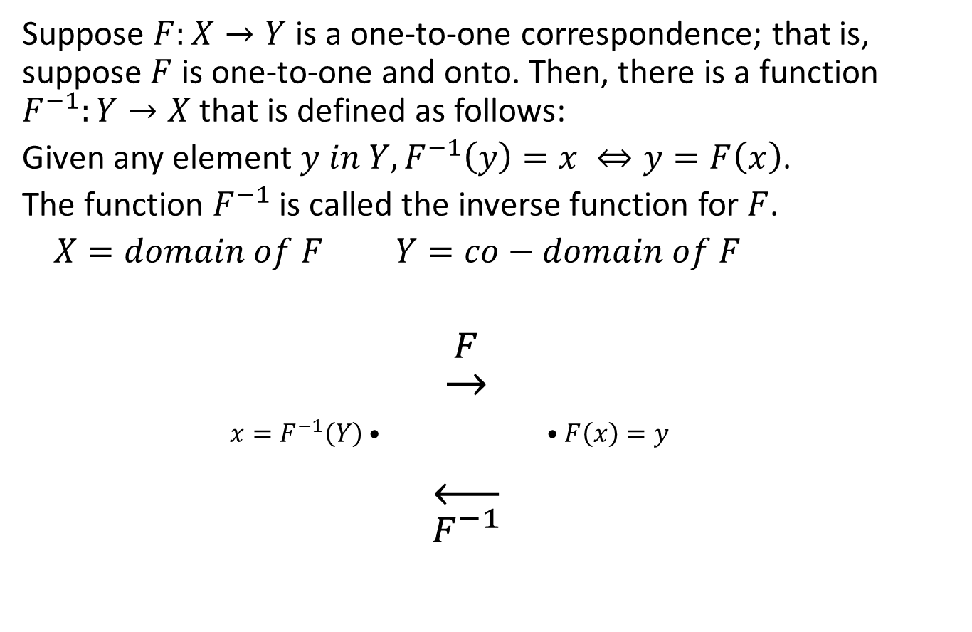
Inverse Functions
Suppose $F:X→Y$ is a one-to-one correspondence; that is, suppose $F$ is one-to-one and onto. Then, there is a function $F^{−1}:Y→X$ that is defined as follows:
Given any element $y in Y, F^{−1}\left(y\right)=x ⇔y=F\left(x\right)$.
The function $F^{−1}$ is called the inverse function for $F$.
$X=domain of F$ $Y=co−domain of F$
$\underset{→}{F}$
$x=F^{−1}\left(Y\right)$ • • $F\left(x\right)=y$
$\overset{←}{F^{−1}}$

Slide 25
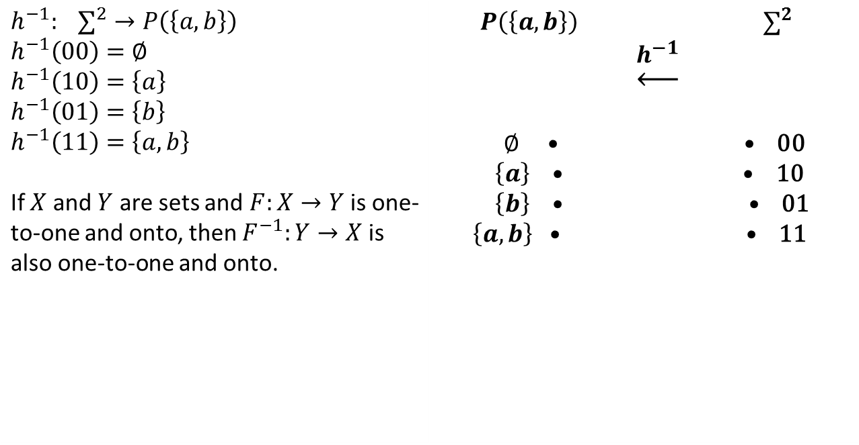
Example
Define inverse function for the one-to-one correspondence in the previous example.
$h^{−1}: ∑^{2}→P\left(\left\{a,b\right\}\right)$ $h^{−1}\left(00\right)=∅$ $h^{−1}\left(10\right)=\left\{a\right\}$ $h^{−1}\left(01\right)=\left\{b\right\}$ $h^{−1}\left(11\right)=\left\{a,b\right\}$ If $X$ and $Y$ are sets and $F:X→Y$ is one-to-one and onto, then $F^{−1}:Y→X$ is also one-to-one and onto. | $P\left(\left\{a,b\right\}\right)$ $∑^{2}$ $\underset{←}{h^{−1}}$ $∅$ • • 00 $\left\{a\right\}$ • • 10 $\left\{b\right\}$ • • 01 $\left\{a,b\right\}$ • • 11

