Slide 1
Sequential Circuits
Combinational Logic:
Output depends only on current input
Has no memory
Sequential Logic:
Output depends not only on current input but also on past input values, e.g., design a counter
Need some type of memory to remember the past input values

Slide 2
Sequential Circuits
Circuits that we
have learned
so far
Information Storing
Circuits
Timed “States”

Slide 3
Sequential Logic: Concept
Sequential Logic circuits remember past inputs and past circuit state.
Outputs from the system are “fed back” as new inputs
With gate delay and wire delay
The storage elements are circuits that are capable of storing binary information: memory.

Slide 4
Synchronous vs. Asynchronous
There are two types of sequential circuits:
Synchronous sequential circuit: circuit output changes only at some discrete instants of time. This type of circuits achieves synchronization by using a timing signal called the clock.
Asynchronous sequential circuit: circuit output can change at any time (clockless).

Slide 5
Synchronous Sequential Circuits: Flip flops as state memory
The flip-flops receive their inputs from the combinational circuit and also from a clock signal with pulses that occur at fixed intervals of time, as shown in the timing diagram.

Slide 6
Clock Period
FF
Combinational Circuit
FF
FF
Smallest clock period = largest combinational circuit delay between any two directly connected FF, subjected to impact of FF setup time.

Slide 7
SR Latch (NAND version)
The SR latch is a circuit with two cross-coupled NOR gates or two cross-coupled NAND gates. It has two inputs labeled S for set and R for reset.
0
S’
S’ R’ Q Q’
Q
1
0 0
0 1
1 0
1 1
1 0 Set
Q’
0
1
R’
X Y NAND
0 0 1
0 1 1
1 0 1
1 1 0

Slide 8
SR Latch (NAND version)
1
S’
S’ R’ Q Q’
Q
1
0 0
0 1
1 0
1 1
1 0 Set
Q’
0
1
R’
1 0 Hold
X Y NAND
0 0 1
0 1 1
1 0 1
1 1 0

Slide 9
SR Latch (NAND version)
1
S’
S’ R’ Q Q’
Q
0
0 0
0 1
1 0
1 1
1 0 Set
0 1 Reset
Q’
1
0
R’
1 0 Hold
X Y NAND
0 0 1
0 1 1
1 0 1
1 1 0

Slide 10
SR Latch (NAND version)
1
S’
S’ R’ Q Q’
Q
0
0 0
0 1
1 0
1 1
1 0 Set
0 1 Reset
Q’
1
1
R’
1 0 Hold
0 1 Hold
X Y NAND
0 0 1
0 1 1
1 0 1
1 1 0

Slide 11
SR Latch (NAND version)
0
S’
S’ R’ Q Q’
Q
1
0 0
0 1
1 0
1 1
1 1 Disallowed
1 0 Set
0 1 Reset
Q’
1
0
R’
1 0 Hold
0 1 Hold
X Y NAND
0 0 1
0 1 1
1 0 1
1 1 0

Slide 12
SR Latch with Clock signal
Latch is sensitive to input changes ONLY when C=1

Slide 13
D Latch
One way to eliminate the undesirable indeterminate state in the RS flip flop is to ensure that inputs S and R are never 1 simultaneously. This is done in the D latch:

Slide 14
D Latch with Transmission Gates
1
2
C=1 → TG1 closes and TG2 opens → Q’=D’ and Q=D
C=0 → TG1 opens and TG2 closes → Hold Q and Q’

Slide 15
Flip-Flops
The state of a latch or flip-flop is switched by a change in the control input. This momentary change is called a trigger and the transition it cause is said to trigger the flip-flop. The D latch with pulses in its control input is essentially a flip-flop that is triggered every time the pulse goes to the logic 1 level. As long as the pulse input remains in the level, any changes in the data input will change the output and the state of the latch.
Latches are “transparent” (= any change on the inputs is seen at the outputs immediately when C=1).
This causes synchronization problems.
Solution: use latches to create flip-flops that can respond (update) only on specific times (instead of any time).
Types: RS flip-flop and D flip-flop

Slide 16
Master-Slave FF configuration using SR latches

Slide 17
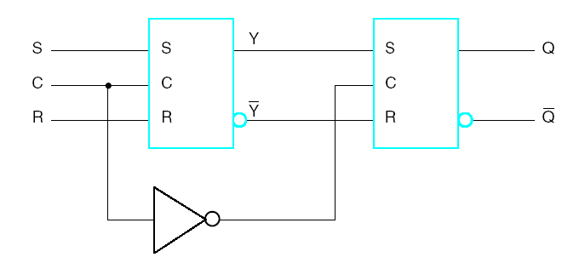
Master-Slave FF configuration using SR latches (cont.)
S R CLK Q Q’
When C=1, master is enabled and stores new data, slave stores old data.
When C=0, master’s state passes to enabled slave, master not sensitive to new data (disabled).
0 0 1 Q₀ Q₀’ Store
0 1 1 0 1 Reset
1 0 1 1 0 Set
1 1 1 1 1 Disallowed
X X 0 Q₀ Q₀’ Store

Slide 18
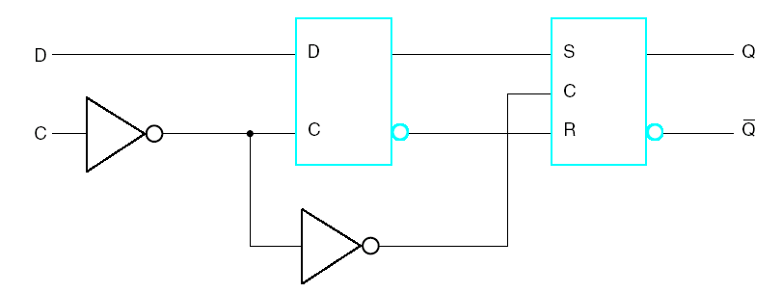
D Flip-Flop
Characteristic Tables
Defines the logical properties of a flip-flop (such as a truth table does for a logic gate).
Q(t) – present state at time t
Q(t+1) – next state at time t+1

Slide 19
SR Flip-Flop
S | R | Q(t+1) | Operation
0 | 0 | Q(t) | No change/Hold
0 | 1 | 0 | Reset
1 | 0 | 1 | Set
1 | 1 | ? | Undefined/Invalid
D Flip-Flop
D |  | Q(t+1) | Operation
0 |  | 0 | Set
1 |  | 1 | Reset
Characteristic Equation: Q(t+1) = D(t)

Slide 20
D Flip-Flop Timing Parameters
Setup time

Slide 21
Sequential Circuit Analysis
Analysis: Consists of obtaining a suitable description that demonstrates the time sequence of inputs, outputs, and states.
Logic diagram: Boolean gates, flip-flops (of any kind), and appropriate interconnections.
The logic diagram is derived from any of the following:
Boolean Equations (FF-Inputs, Outputs)
State Table
State Diagram

Slide 22
State Table Characteristics
State table – a multiple variable table with the following four sections:
Present State – the values of the state variables for each allowed state.
Input – the input combinations allowed.
Next-state – the value of the state at time (t+1) based on the present state and the input.
Output – the value of the output as a function of the present state and (sometimes) the input.
From the viewpoint of a truth table:
the inputs are Input, Present State
and the outputs are Output, Next State

Slide 23
Example: State Table
The state table can be filled in using the next state and output equations:
A(t+1) = A(t)x(t) + B(t)x(t)
B(t+1) =‾A (t)x(t);
y(t) =‾x (t)(B(t) + A(t))
Present State
Input
Next State
Output
A(t) B(t)
x(t)
A(t+1) B(t+1)
y(t)
0 0
0
0 0
0
0 0
1
0 1
0
0 1
0
0 0
1
0 1
1
1 1
0
1 0
0
0 0
1
1 0
1
1 0
0
1 1
0
0 0
1
1
1
1
1 0
0

Slide 24
State Diagrams
The sequential circuit function can be represented in graphical form as a state diagram with the following components:
A circle with the state name in it for each state
A directed arc from the Present State to the Next State for each state transition
A label on each directed arc with the Input values which causes the state transition, and
A label:
On each circle with the output value produced, or
On each directed arc with the output value produced.

Slide 25
Example: State Diagram
x=0/y=0
x=0/y=1
Diagram gets confusing for large circuits
For small circuits, usually easier to understand than the state table
x=1/y=0
A B
0 0
x=0/y=1
1 0
x=1/y=0
x=1/y=0
x=0/y=1
0 1
1 1
x=1/y=0
Notes:
Type: Mealy

Slide 26
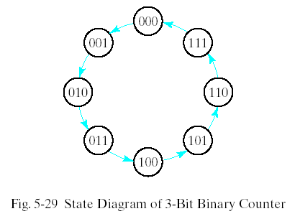
Synthesis Using T Flip-Flops
The synthesis using T flip-flops will be demonstrated by designing a binary counter. An n-bit binary counter consists of n flip-flops that can count in binary from 0 to 2^{n}-1. The state diagram of a 3-bit counter is shown in Fig. 5-29.
Ref. Table 5-1

Slide 27
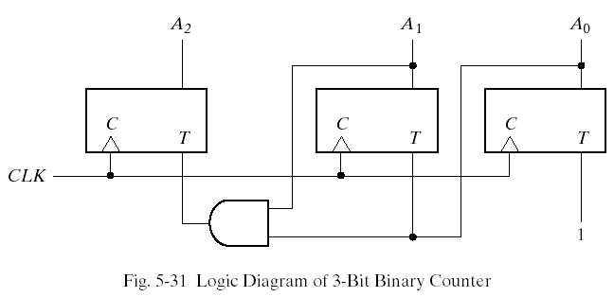
Synthesis Using T Flip-Flops

