Slide 1
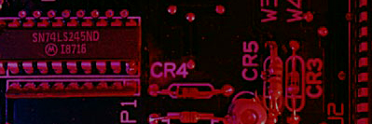
Summary
Half-Adder
Basic rules of binary addition are performed by a half adder, which has two binary inputs (A and B) and two binary outputs (Carry out and Sum).
The inputs and outputs can be summarized on a truth table.
The logic symbol and equivalent circuit are:
Σ
Σ
A
Σ
A
C_{out}
B
C_{out}
B

Slide 2
Summary
Full-Adder
By contrast, a full adder has three binary inputs (A, B, and Carry in) and two binary outputs (Carry out and Sum). The truth table summarizes the operation.
A full-adder can be constructed from two half adders as shown:
Σ
Σ
Σ
Σ
A
A
A
Sum
Σ
B
B
C_{out}
B
C_{out}
A
Σ
B
C_{out}
C_{in}
C_{in}
C_{out}
Symbol

Slide 3
Summary
Full-Adder
Σ
Σ
1
Σ
Σ
0
Sum
1
A
A
Example
B
0
1
0
C_{out}
B
C_{out}
For the given inputs, determine the intermediate and final outputs of the full adder.
1
C_{out}
1
Solution
The first half-adder has inputs of 1 and 0; therefore the Sum =1 and the Carry out = 0.
The second half-adder has inputs of 1 and 1; therefore the Sum = 0 and the Carry out = 1.
The OR gate has inputs of 1 and 0, therefore the final carry out = 1.

Slide 4
Summary
Full-Adder
Notice that the result from the previous example can be read directly on the truth table for a full adder.
Σ
Σ
1
Σ
Σ
0
Sum
1
A
A
B
0
1
0
C_{out}
B
C_{out}
1
C_{out}
1

Slide 5
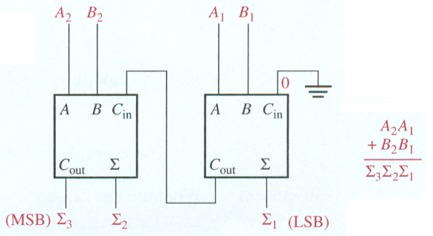
Parallel Binary Adders
Two-bit parallel binary adder
Full adders are combined into parallel adders that can add binary numbers with multiple bits. A 2-bit adder is shown.
The output carry (C_{out}) is not ready until it propagates through the two full adders. This is called ripple carry, delaying the addition process.

Slide 6
Summary
Parallel Adders
Full adders are combined into parallel adders that can add binary numbers with multiple bits. A 4-bit adder is shown.
The output carry (C₄) is not ready until it propagates through the two full adders. This is called ripple carry, delaying the addition process.

