Slide 1
Discrete Mathematics

Slide 2
Functions
A function $f$ from a set $X$ to a set $Y$ is a rule of correspondence by which each element of $X$ is associated with a unique element of $Y$.
The notation $f:X→Y$ means that $f$ is a function from $X$ to $Y$. $X$ is called the domain of $f$ and $Y$ is called the co-domain of $f$.
Given an element $x$ in $X$, there is a unique element $y$ in $Y$ that corresponds to $x$. We say $"f sends x to y“$ and write $x\underset{→}{f}y$ or, simply, $x→y$. The unique element $y$ to which $f$sends $x$ is denoted: $f\left(x\right)$ and is called $f of x$, or the value of $f at x$, or the image of $x$ under $f$.

Slide 3
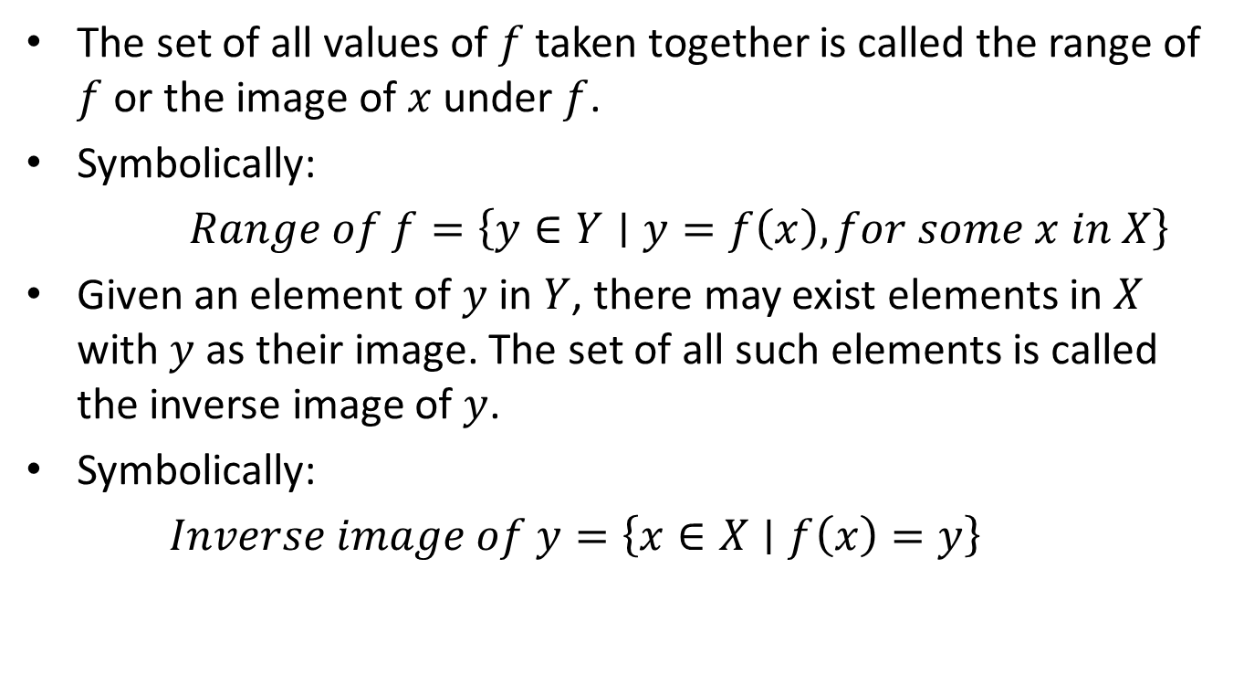
Functions
The set of all values of $f$ taken together is called the range of $f$ or the image of $x$ under $f$.
Symbolically:
$Range of f=\left\{y∈Y∣y=f\left(x\right), for some x in X\right\}$
Given an element of $y$ in $Y$, there may exist elements in $X$ with $y$ as their image. The set of all such elements is called the inverse image of $y$.
Symbolically:
$Inverse image of y=\left\{x∈X∣f\left(x\right)=y\right\}$

Slide 4

Arrow Diagrams
$X$ $\underset{→}{f}$ $Y$
$x$• •$f\left(x\right)$
$X$ $\underset{→}{f}$ $Y$
$x_{1}•$ ${ •y}_{1}$
$x_{2}•$ • $y_{2}$
$x_{3} •$ • $y_{3}$
$x_{4} •$ • $y_{4}$
• $y_{5}$

Slide 5
Arrow Diagrams
The definition of function implies that the arrow diagram for a function $f$ has the following two properties:
① every element of $X$ has an arrow coming
out of it.
② no element of $X$ has two arrows coming
out of that point to two different elements
of $Y$.

Slide 6
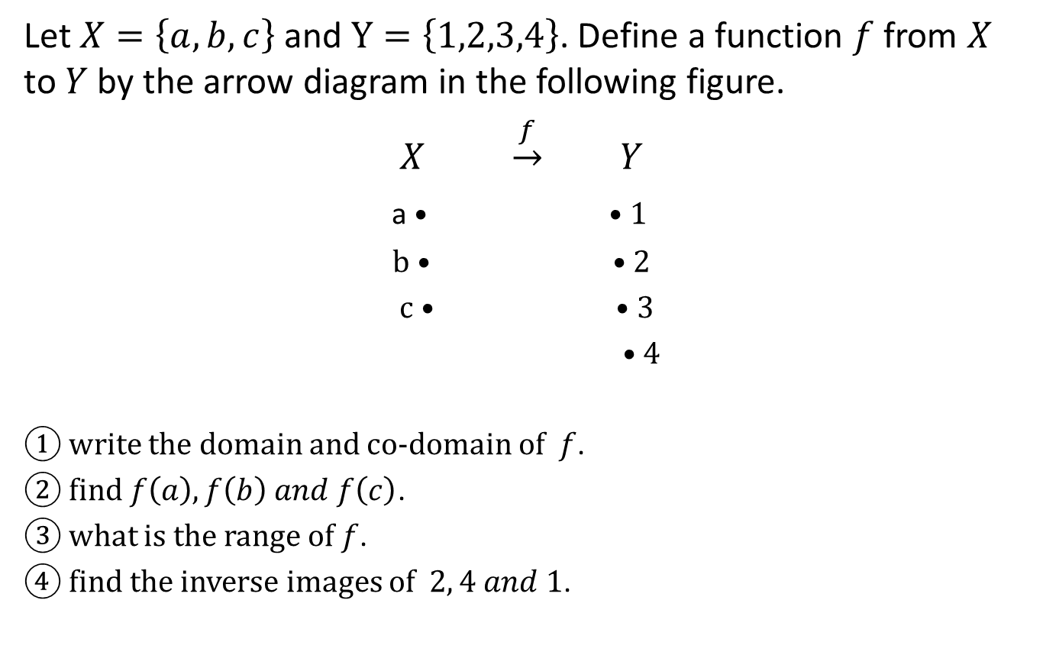
Example
Let $X=\left\{a,b,c\right\}$ and $Y=\left\{1,2,3,4\right\}$. Define a function $f$ from $X$ to $Y$ by the arrow diagram in the following figure.
$X$ $\underset{→}{f}$ $Y$
a • • 1
b • • 2
c • • 3
• 4
① write the domain and co-domain of $f$.
② find $f\left(a\right), f\left(b\right) and f\left(c\right)$.
③ what is the range of $f$.
④ find the inverse images of $2, 4 and 1$.

Slide 7
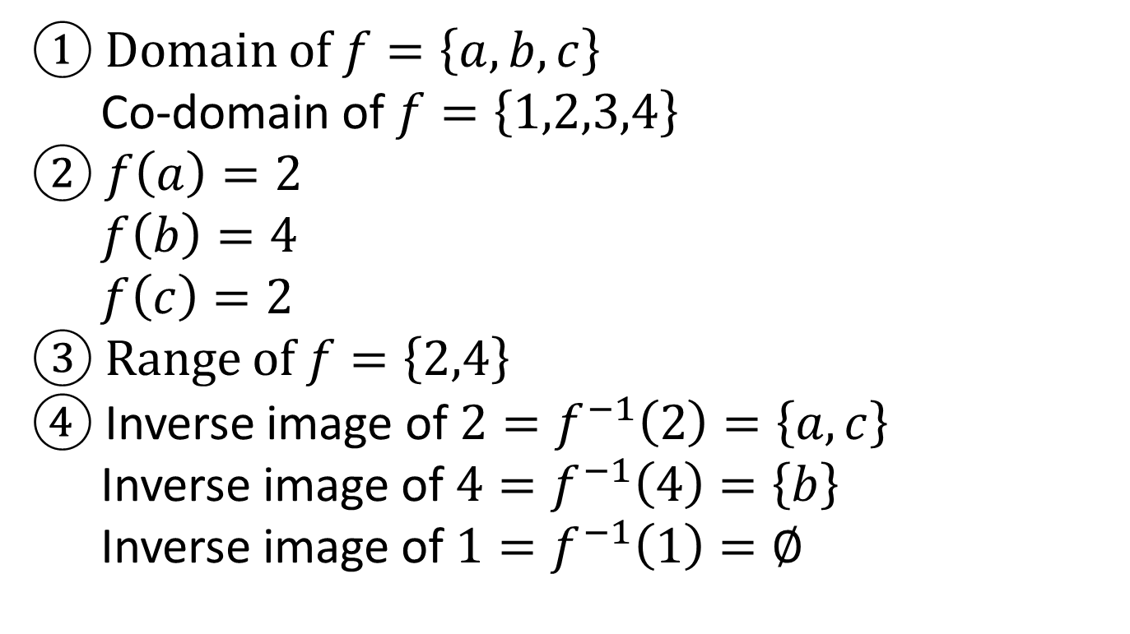
Example
① Domain of $f=\left\{a,b,c\right\}$
Co-domain of $f=\left\{1,2,3,4\right\}$
② $f\left(a\right)=2$
$f\left(b\right)=4$
$f\left(c\right)=2$
③ Range of $f=\left\{2,4\right\}$
$④$ Inverse image of $2=f^{−1}\left(2\right)=\left\{a,c\right\}$
Inverse image of $4=f^{−1}\left(4\right)=\left\{b\right\}$
Inverse image of $1=f^{−1}\left(1\right)=∅$

Slide 8
Example
Which of the following arrow diagrams in the figure below define functions from $X=\left\{a,b,c\right\}$ to $Y=\left\{1,2,3\right\}$ ?
$X$ $\underset{→}{f}$ Y $X \underset{→}{f} Y$ $X \underset{→}{f} Y$
a • • 1 a • • 1 a • • 1
b • • 2 b • • 2 b • • 2
c • • 3 c • • 3 c • • 3
• 4 • 4 • 4
not function not function function
There is no arrow there are two arrows there is one arrow
out from b out from c out of each element

Slide 9
Arrow Diagram for a Function on an Infinite Set
Example:
Define a function $f$ from the set of all integers $Z$ to itself by the rule $n→2n$; that is, $f\left(n\right)=2n$ for all $n∈Z$.
① draw an arrow diagram for $f$.
② find $f\left(f\left(1\right)\right)$ and $f\left(f\left(f\left(3\right)\right)\right)$.

Slide 10
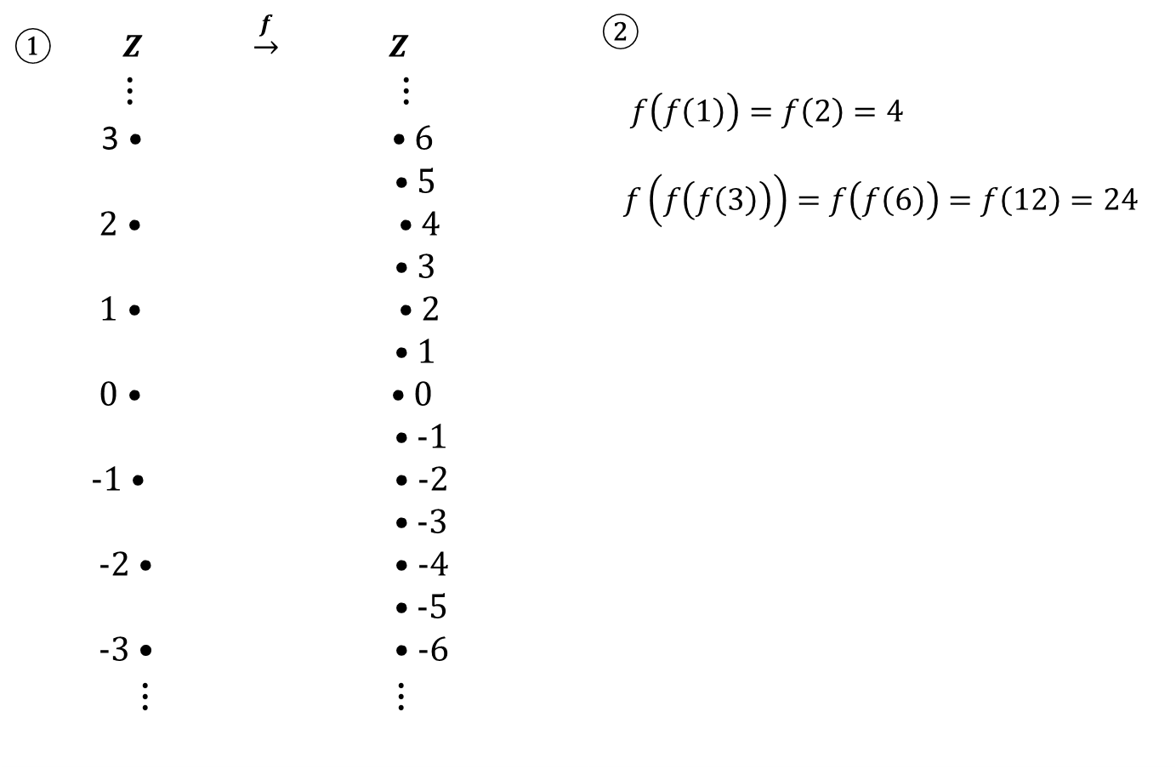
Arrow Diagram for a Function on an Infinite Set
① $Z$ $\underset{→}{f}$ $Z$ $⋮$ $⋮$ 3 • • 6 • 5 2 • • 4 • 3 1 • • 2 • 1 0 • • 0 • -1 -1 • • -2 • -3 -2 • • -4 • -5 -3 • • -6 $⋮ ⋮$ | ② $f\left(f\left(1\right)\right)=f\left(2\right)=4$ $f\left(f\left(f\left(3\right)\right)\right)=f\left(f\left(6\right)\right)=f\left(12\right)=24$

Slide 11
The Identity on a Set
Given a set $X$, define a function $i_{x}$ from $X$ to $X$ by the rule: $i_{X}\left(x\right)=x$ for all $x$ in X.
The function $i_{X}$ is called the identity function $X$ because it sends each element of $X$ to the element that is identical to it.

Slide 12
Example
① let $X=R$, the set of all real numbers. Find:
$i_{R}\left(−1\right), i_{R}\left(\sqrt{2}\right), and i_{R}\left(π\right)$.
$i_{R}\left(\sqrt{2}\right)=\sqrt{2}$
$i_{R}\left(π\right)=π$
② let $A=X$ be any set and suppose that ${aij}^{k}$, $∅\left(z\right)$ and $H\left(j\left(v\right)\right)$
are all elements of $X$. Find : $i_{X}\left({aij}^{k}\right)$, $i_{X}\left(∅\left(z\right)\right)$ and
$i_{X}\left(H\left(j\left(v\right)\right)\right)$.
$i_{X}\left({aij}^{k}\right)={aij}^{k}$
$i_{X}\left(∅\left(z\right)\right)=∅\left(z\right)$
$i_{X}\left(H\left(j\left(v\right)\right)\right)=H\left(j\left(v\right)\right)$

Slide 13
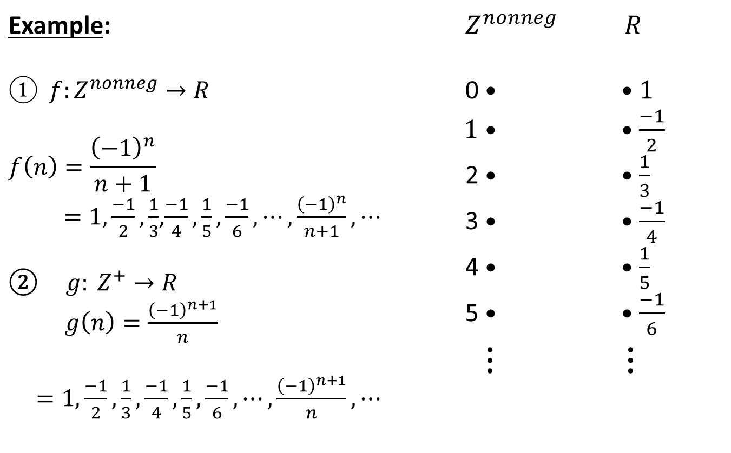
Sequences
Example: $① f:Z^{nonneg}→R$ $$f\left(n\right)=\frac{{\left(−1\right)}^{n}}{n+1}$$ $=1, \frac{−1}{2}, \frac{1}{3}$,$\frac{−1}{4}, \frac{1}{5}, \frac{−1}{6}, ⋯, \frac{{\left(−1\right)}^{n}}{n+1}, ⋯$ $g: Z^{+}→R$ $g\left(n\right)=\frac{{\left(−1\right)}^{n+1}}{n}$ $=1, \frac{−1}{2}, \frac{1}{3}, \frac{−1}{4}, \frac{1}{5}, \frac{−1}{6}, ⋯, \frac{{\left(−1\right)}^{n+1}}{n}, ⋯$ | $Z^{nonneg}$ $R$ 0 • • 1 1 • • $\frac{−1}{2}$ 2 • • $\frac{1}{3}$ 3 • • $\frac{−1}{4}$ 4 • • $\frac{1}{5}$ 5 • • $\frac{−1}{6}$ $⋮$ $⋮$

Slide 14
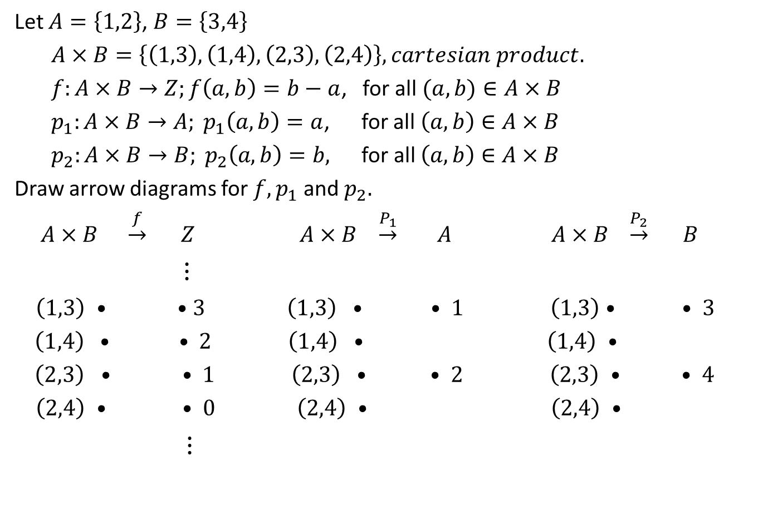
Example
Let $A=\left\{1,2\right\}$, $B=\left\{3,4\right\}$
$A×B=\left\{\left(1,3\right),\left(1,4\right),\left(2,3\right), \left(2,4\right)\right\}, cartesian product.$
$f:A×B→Z;f\left(a,b\right)=b−a$, for all $(a,b)∈A×B$
$p_{1}:A×B→A; p_{1}\left(a,b\right)=a$, for all $\left(a,b\right)∈A×B$
$p_{2}:A×B→B; p_{2}\left(a,b\right)=b,$ for all $\left(a,b\right)∈A×B$
Draw arrow diagrams for $f, p_{1}$ and $p_{2}.$
$A×B \underset{→}{f} Z$ $A×B$ $\underset{→}{P_{1}} A$ $A×B$ $\underset{→}{P_{2}} B$
$⋮$
$\left(1,3\right)$ • • 3 $\left(1,3\right) •$ • 1 $\left(1,3\right)$ • • 3
$\left(1,4\right) •$ • 2 $\left(1,4\right)$ • $\left(1,4\right)$ •
$\left(2,3\right)$ • • 1 $\left(2,3\right) •$ • 2 $\left(2,3\right)$ • • 4
$\left(2,4\right)$ • • 0 $\left(2,4\right)$ • $\left(2,4\right)$ •
$⋮$

