Slide 1
Discrete Mathematics

Slide 2
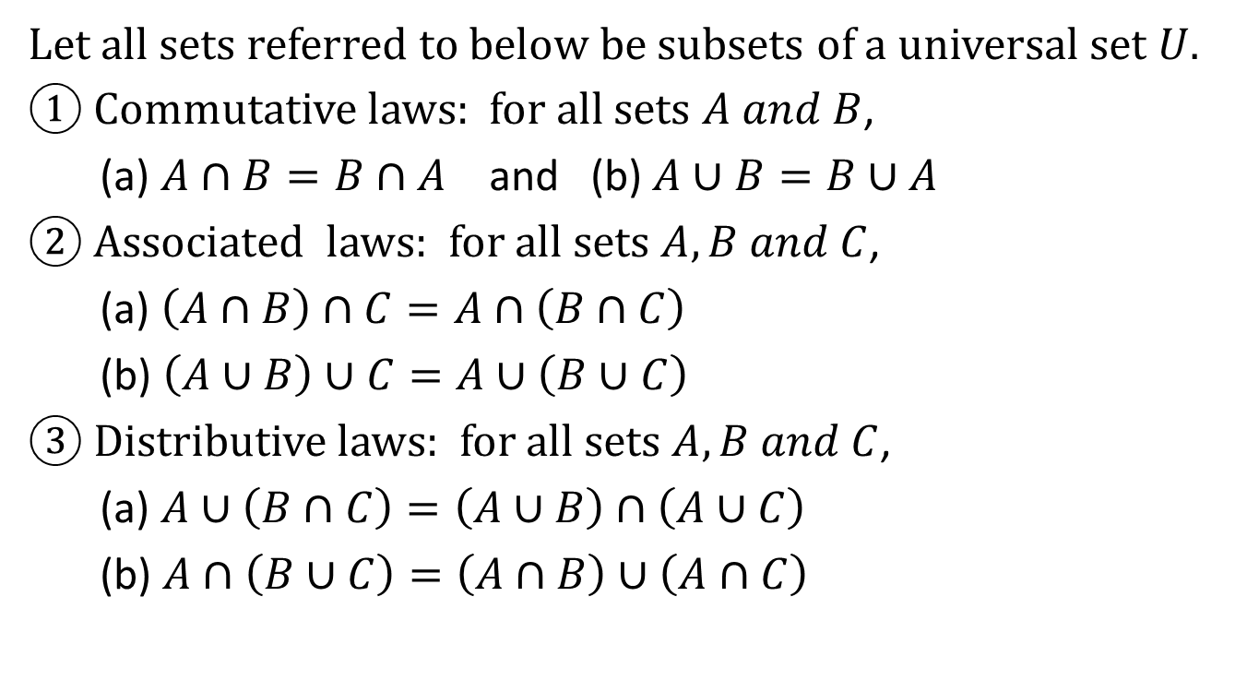
Set Identities
Let all sets referred to below be subsets of a universal set $U$.
① Commutative laws: for all sets $A and B$,
(a) $A∩B=B∩A$ and (b) $A∪B=B∪A$
② Associated laws: for all sets $A, B and C$,
(a) $\left(A∩B\right)∩C=A∩\left(B∩C\right)$
(b) $\left(A∪B\right)∪C=A∪\left(B∪C\right)$
③ Distributive laws: for all sets $A,B and C$,
(a) $A∪\left(B∩C\right)=\left(A∪B\right)∩\left(A∪C\right)$
(b) $A∩\left(B∪C\right)=\left(A∩B\right)∪\left(A∩C\right)$

Slide 3
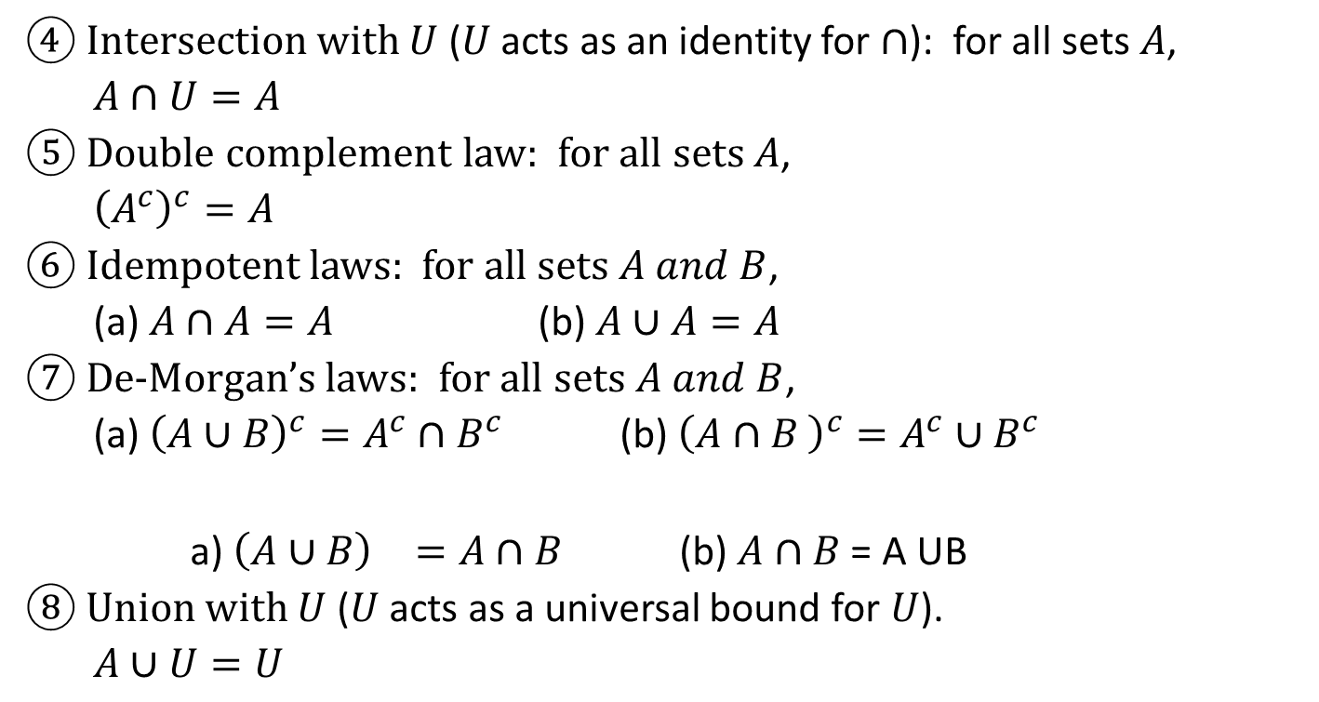
Set Identities
U
④ Intersection with $U$ ($U$ acts as an identity for $∩$): for all sets $A$,
$A∩U=A$
⑤ Double complement law: for all sets $A$,
${\left(A^{c}\right)}^{c}=A$
⑥ Idempotent laws: for all sets $A and B$,
(a) $A∩A=A$ (b) $A∪A=A$
⑦ De-Morgan’s laws: for all sets $A and B$,
(a) ${\left(A∪B\right)}^{c}=A^{c}∩B^{c}$ (b) ${\left(A∩B \right)}^{c}=A^{c}∪B^{c}$
a) ${\left(A∪B\right)}^{}=A∩B$ (b) $A∩B$ = A UB
⑧ Union with $U$ ($U$ acts as a universal bound for $U$).
$A∪U=U$
A
A
B

Slide 4
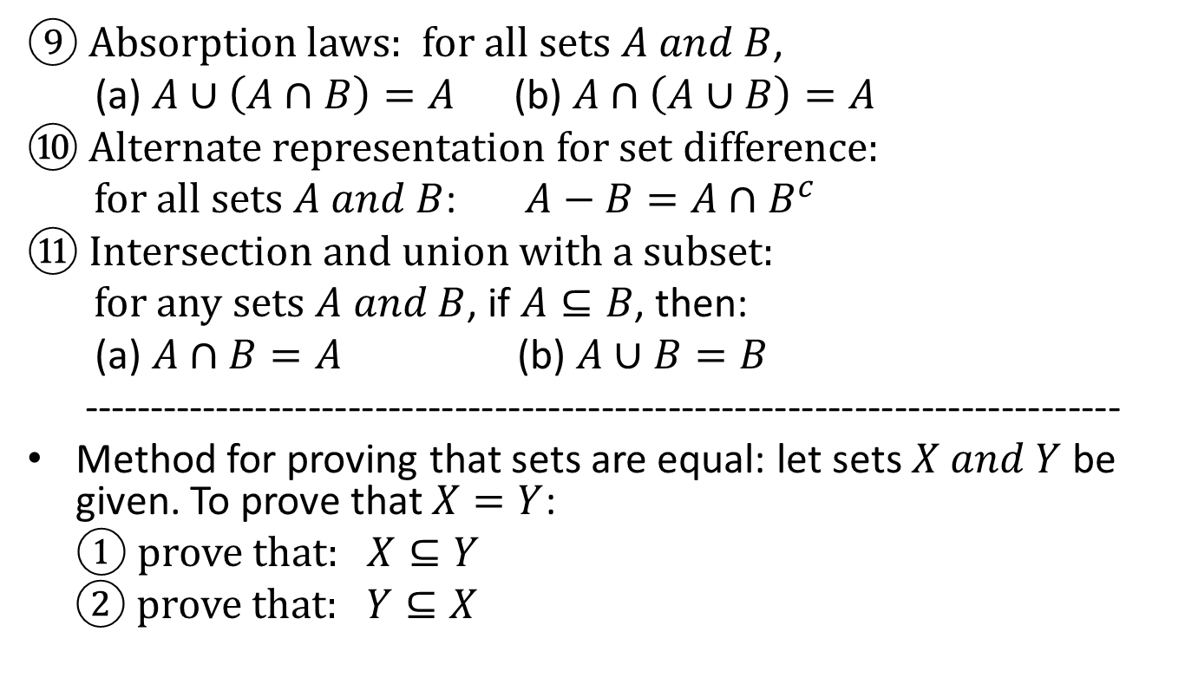
Set Identities
A
B
⑨ Absorption laws: for all sets $A and B$,
(a) $A∪\left(A∩B\right)=A$ (b) $A∩\left(A∪B\right)=A$
⑩ Alternate representation for set difference:
for all sets $A and B$: $A−B=A∩B^{c}$
⑪ Intersection and union with a subset:
for any sets $A and B$, if $A⊆B$, then:
(a) $A∩B=A$ (b) $A∪B=B$
------------------------------------------------------------------------------
Method for proving that sets are equal: let sets $X and Y$ be given. To prove that $X=Y$:
① prove that: $X⊆Y$
② prove that: $Y⊆X$
A
B
A
B
A
B

Slide 5

Venn’s Diagrams for U, I, D and C
The Venn’s diagram representations for union, intersection, difference and complement are shown below:
A B U A B U
$A∪B$ $A∩B$
A B U A B U
$$B−A A^{c}$$

Slide 6
Example
Using Venn’s diagrams, show that the following property is not true: for all sets $A, B and C$,
$\left(A−B\right)∪\left(B−C\right)=A−C$
A B A B
$≠$
C C
LHS RHS

Slide 7
Example
Draw Venn’s diagrams for the followings:
① $A∩B∩C$ ② $\left(A−B\right)∩C$ $③$ $\overline{A}∩B$
A B A B A B
C U C U U

Slide 8

Example
Let $U=\left\{1,2,3,⋯,10\right\}, A=\left\{2,4,6\right\}$
$B=\left\{1,3,5,9\right\}$, $C=\left\{5,10\right\}$
Draw Venn’s diagrams for the followings:
① $B−C$ ② $A∩C$ ③ $A∪\left(B∩C\right)$
C B A
10 5 1 2
3 4
9 6
7 8 U
C B A C B A C B A
U U U

Slide 9
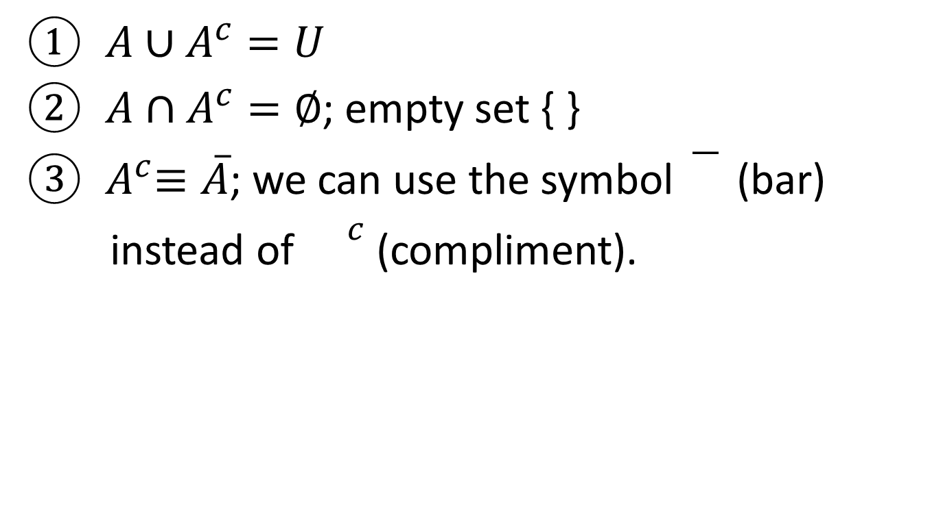
Theorems
$A∪A^{c}=U$
$A∩A^{c}=∅$; empty set { }
${ A}^{c}≡\overline{A}$; we can use the symbol (bar)
instead of ${}^{c}$ (compliment).

Slide 10
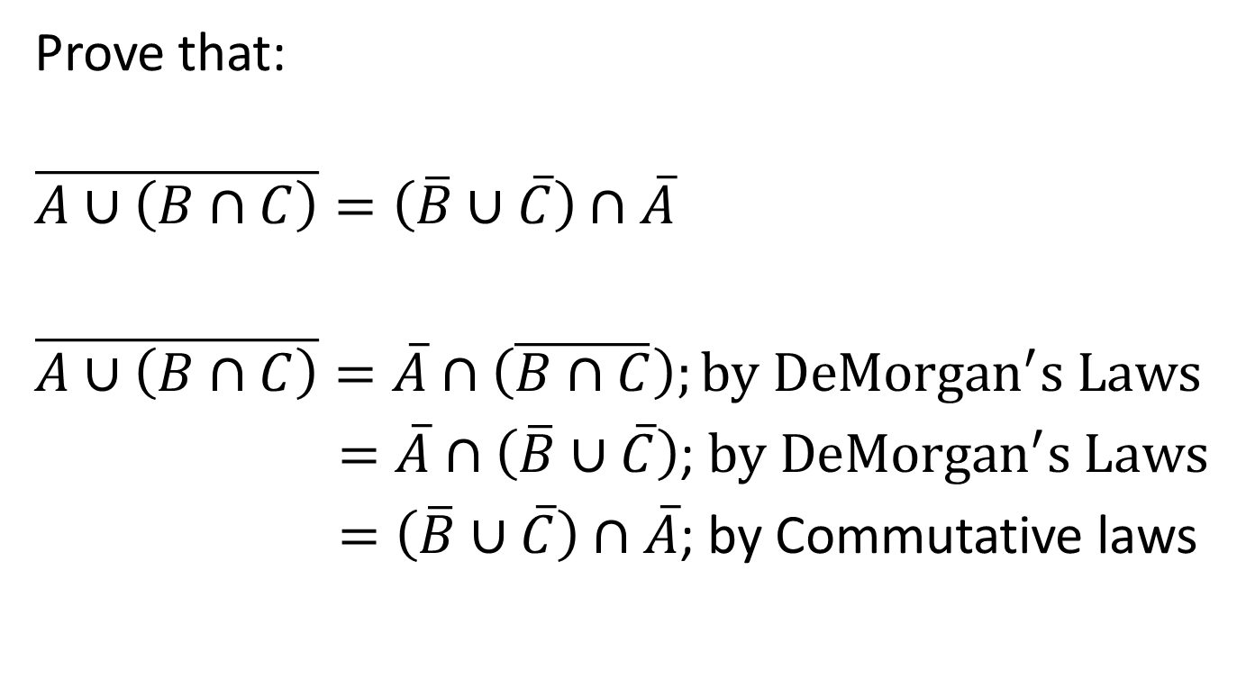
Example
Prove that:
$$\overline{A∪\left(B∩C\right)}=\left(\overline{B}∪\overline{C}\right)∩\overline{A}$$
$\overline{A∪\left(B∩C\right)}=\overline{A}∩\left(\overline{B∩C}\right);by {DeMorgan}^{′}s Laws$
$=\overline{A}∩\left(\overline{B}∪\overline{C}\right)$; $by {DeMorgan}^{′}s Laws$
$=\left(\overline{B}∪\overline{C}\right)∩\overline{A}$; by Commutative laws

Slide 11
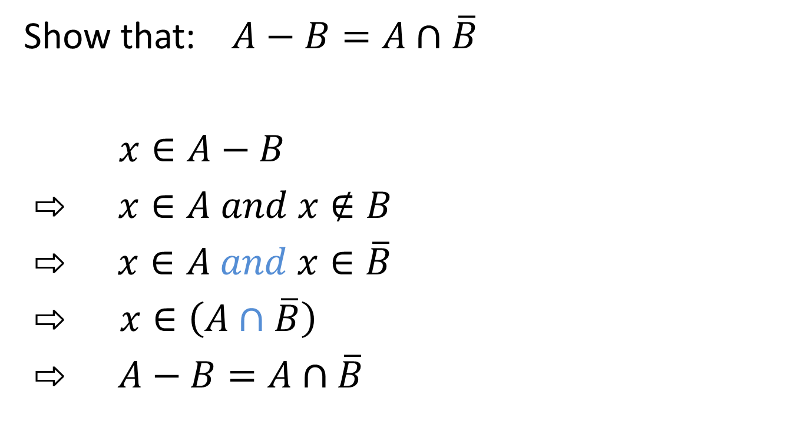
Example
Show that: $A−B=A∩\overline{B}$
$x∈A−B$
⇨ $x∈A and x∉B$
⇨ $x∈A and x∈\overline{B}$
$⇨$ $x∈\left(A∩\overline{B}\right)$
⇨ $A−B=A∩\overline{B}$
B
A

Slide 12
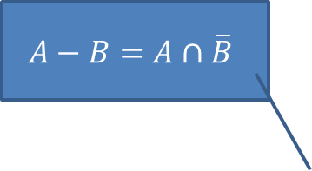
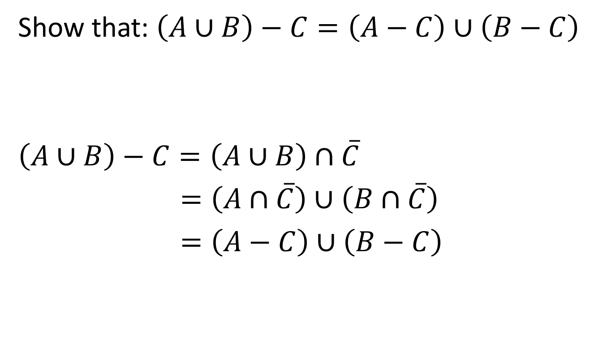

Example
Show that: $\left(A∪B\right)−C=\left(A−C\right)∪\left(B−C\right)$
$\left(A∪B\right)−C=\left(A∪B\right)∩\overline{C}$
$=\left(A∩\overline{C}\right)∪\left(B∩\overline{C}\right)$
$=\left(A−C\right)∪\left(B−C\right)$
$$A−B=A∩\overline{B}$$
$$B−C=B∩\overline{C}$$
$$A−C=A∩\overline{C}$$

Slide 13
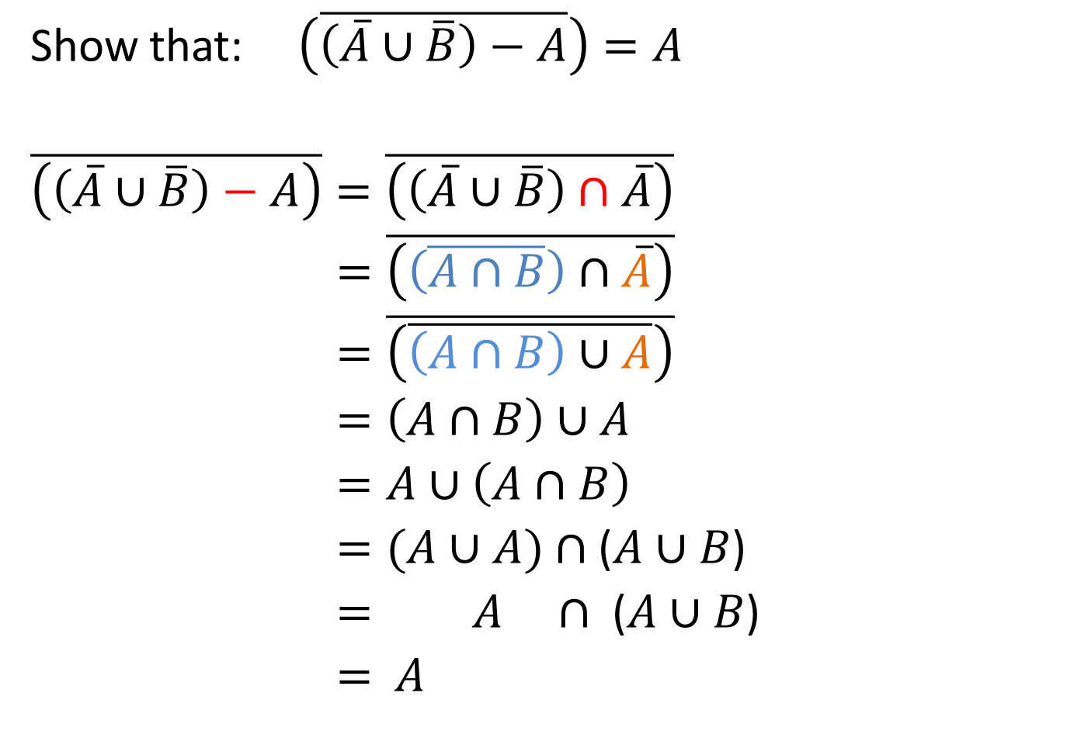
Example
Show that: $\left(\overline{\left(\overline{A}∪\overline{B}\right)−A}\right)=A$
$\overline{\left(\left(\overline{A}∪\overline{B}\right)−A\right)}=\overline{\left(\left(\overline{A}∪\overline{B}\right)∩\overline{A}\right)}$
$=\overline{\left(\left(\overline{A∩B}\right)∩\overline{A}\right)}$
$=\overline{\left(\overline{\left(A∩B\right)∪A}\right)}$
$=\left(A∩B\right)∪A$
$=A∪\left(A∩B\right)$
$=(A∪$ $A)$ $∩$ ($A∪B$)
$= A$ $∩$ ($A∪B$)
$=$ $A$
Second step:
$${\left(A∩B\right)}^{}=A∪B$$
First step:
$$A−B=A∩\overline{B}$$
Third step:
$${\left(A∪B\right)}^{}=A∩B$$
Forth step:
${\left(A^{c}\right)}^{c}=A$
A
B

