Slide 1
Discrete Mathematics

Slide 2
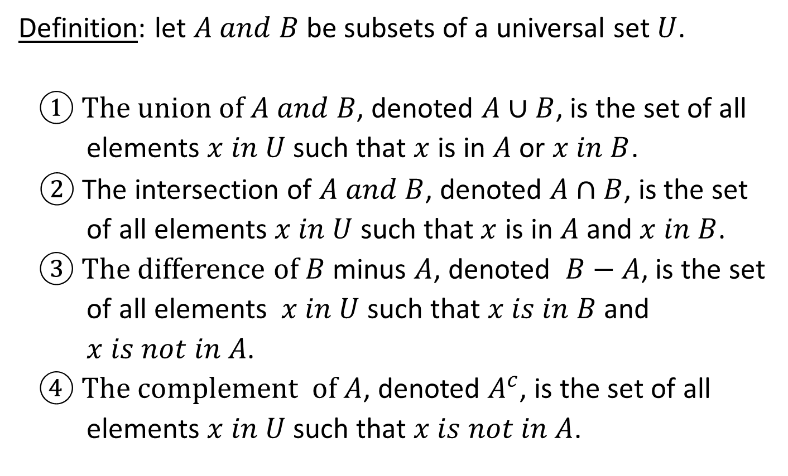
Operations on Sets
Definition: let $A and B$ be subsets of a universal set $U$.
① The union of $A and B$, denoted $A∪B$, is the set of all
elements $x in U$ such that $x$ is in $A$ or $x in B$.
$②$ The intersection of $A and B$, denoted $A∩B$, is the set
of all elements $x in U$ such that $x$ is in $A$ and $x in B$.
③ The difference of $B$ minus $A$, denoted $B−A$, is the set
of all elements $x in U$ such that $x is in B$ and
$x is not in A$.
④ The complement of $A$, denoted $A^{c}$, is the set of all
elements $x in U$ such that $x is not in A$.

Slide 3
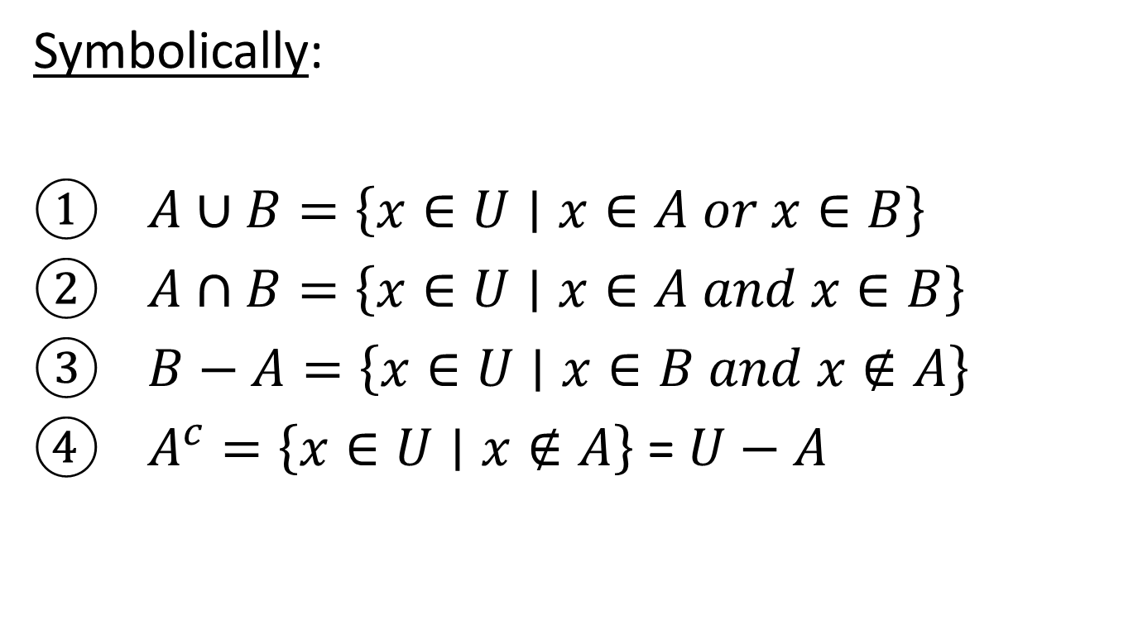
Operations on Sets
Symbolically:
① $A∪B=\left\{x∈U∣x∈A or x∈B\right\}$
② $A∩B=\left\{x∈U∣x∈A and x∈B\right\}$
③ $B−A=\left\{x∈U∣x∈B and x∉A\right\}$
④ $A^{c}=\left\{x∈U∣x∉A\right\}$ = $U$ $− A$

Slide 4
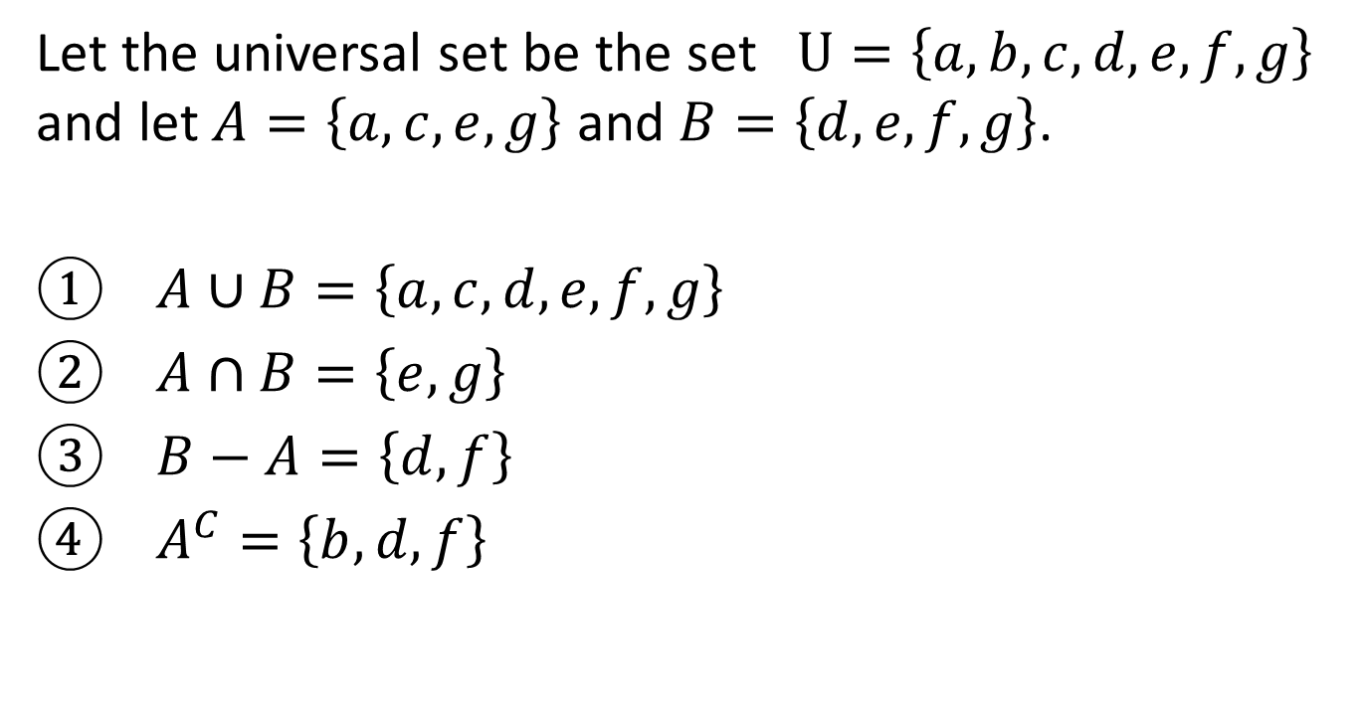
Example
Let the universal set be the set $U=\left\{a,b,c,d,e,f,g\right\}$ and let $A=\left\{a,c,e,g\right\}$ and $B=\left\{d,e,f,g\right\}$.
① $A∪B=\left\{a,c,d,e,f,g\right\}$
② $A∩B=\left\{e,g\right\}$
③ $B−A=\left\{d,f\right\}$
④ $A^{C}=\left\{b,d,f\right\}$

Slide 5
Example
Let the universal set be the set $R$ of all real numbers and let:
$A=\left\{x∈R∣−1<x≤0\right\}$ $B=\left\{x∈R∣0≤x<1\right\}$
Find:
① $A∪B$
② $A∩B$
③ $A^{c}$
$$⊶$$

Slide 6

Example
① $A∪B=\left\{x∈R∣−1<x≤0 or 0≤x<1\right\}$
$$=\left\{x∈R∣−1<x<1\right\}$$
⧟
② $A∩B=\left\{x∈R∣−1<x≤0 and 0≤x<1\right\}=\left\{0\right\}$
⦁

Slide 7

Example
③ $A^{c}=\left\{x∈R∣x≤−1 or x>0\right\}$

Slide 8

Example
Let A = { x : x $∈$ N, x ≥ 6}
B = { x : x $∈$ N, x ≥ 11}
Find $A∩B$
$A∩B$ = { x : x $∈$ N, x ≥ 11}

Slide 9

Venn’s Diagrams for U, I, D and C
The Venn’s diagram representations for union, intersection, difference and complement are shown below:
A B U A B U
$A∪B$ $A∩B$
A B U A B U
$$B−A A^{c}$$

Slide 10
Lecture 9

Slide 11
Ordered n-tuple
Tuple = ordered list
Let $n$ be a positive integer and let $x_{1}, x_{2},⋯,x_{n}$ be elements. The ordered $n−tuple, \left(x_{1},x_{2},⋯,x_{n}\right)$, consists of $x_{1},x_{2},⋯,x_{n}$ together with the ordering: first $x_{1}$, then $x_{2}$, and so forth up to $x_{n}$. An ordered $2−tuple$ is called an ordered pair, and ordered $3−tuple$ is called an ordered triple.
Two ordered $n−tuples$ $\left\{x_{1},x_{2},⋯,x_{n}\right\}$ and $\left\{y_{1},y_{2},⋯,y_{n}\right\}$ are equal if, and only if, $x_{1}=y_{1}, x_{2}=y_{2},⋯,x_{n}=y_{n}$.
Symbolically:
$\left(x_{1},x_{2},⋯,x_{n}\right)=\left(y_{1},y_{2},⋯,y_{n}\right)⇔x_{1}=y_{1},x_{2}=y_{2},⋯,x_{n}=y_{n}$
In particular: $\left(a,b\right)=\left(c,d\right)⇔a=c and b=d$

Slide 12
Example
① Is $\left(1,2\right)=\left(2,1\right)$?
$\left(1,2\right)=\left(2,1\right)⇔1=2 and 2=1$
but $1≠2$ ⇨ the ordered pairs are not equal
② Is $\left(3,{\left(−2\right)}^{2},\frac{1}{2} \right)=\left(\sqrt{9},4,\frac{3}{6}\right)$?
$\left(3,{\left(−2\right)}^{2},\frac{1}{2}\right)=\left(\sqrt{9,}4,\frac{3}{6}\right)⇔3=\sqrt{9}, {\left(−2\right)}^{2}=4 and \frac{1}{2}=\frac{3}{6}$
since these equations are all true, the two ordered triples are
equal.

Slide 13
Cartesian Product
Given two sets $A and B$, the Cartesian product of $A and B$, denoted $A×B (read\text{ "}\text{A} \text{cross} \text{B}\text{"})$, is the set of all ordered pairs $\left(a,b\right)$, where $a in A and b is in B$.
Given sets $A_{1}, A_{2},⋯,A_{n}$, the Cartesian product of $A_{1}, A_{2},⋯$,$A_{n}$, denoted $A_{1}×A_{2}×⋯×A_{n}$, is the set of all ordered $n−tuples$ $\left(a_{1}, a_{2},⋯,a_{n}\right)$, where $a_{1}∈A_{1}, a_{2}∈A_{2}, ⋯, a_{n}∈A_{n}$.
Symbolically
$A×B=\left\{\left(a,b\right)∣a∈A and b∈B\right\}$
$A_{1}×A_{2}×⋯×A_{n}=\left\{\left(a_{1},a_{2},⋯,a_{n}\right)∣a_{1}∈A_{1}, a_{2}∈A_{2}, ⋯, a_{n}∈A_{n}\right\}$

Slide 14
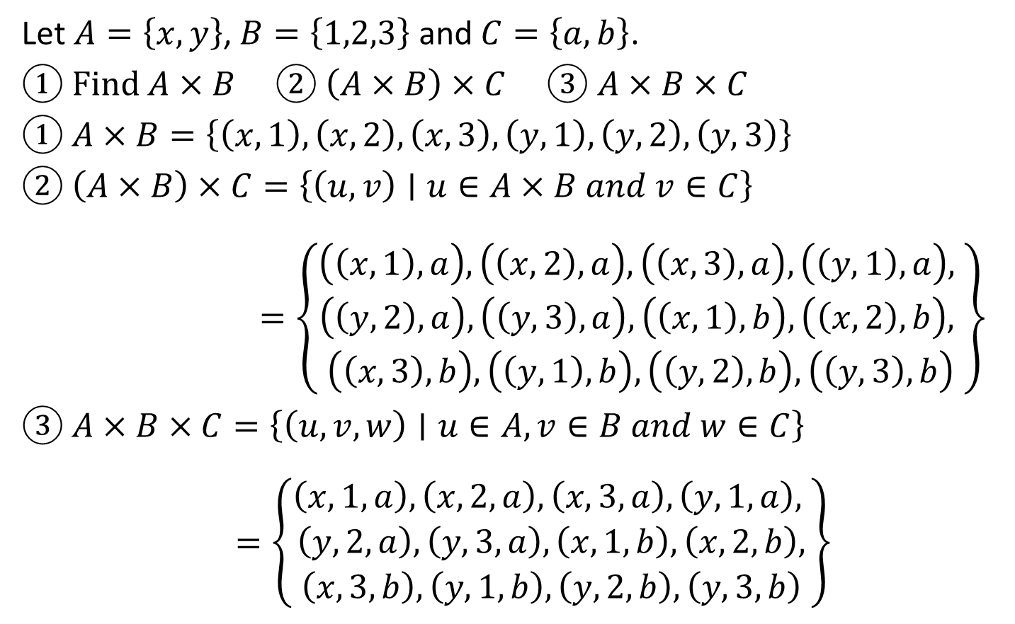
Example
Let $A=\left\{x,y\right\}$, $B=\left\{1,2,3\right\}$ and $C=\left\{a,b\right\}$.
① Find $A×B$ ② $\left(A×B\right)×C$ ③ $A×B×C$
① $A×B=\left\{\left(x,1\right), \left(x,2\right), \left(x,3\right), \left(y,1\right), \left(y,2\right),\left(y,3\right)\right\}$
② $\left(A×B\right)×C=\left\{\left(u,v\right)∣u∈A×B and v∈C\right\}$
$=\left\{\begin{aligned}\left(\left(x,1\right),a\right), \left(\left(x,2\right),a\right), \left(\left(x,3\right),a\right), \left(\left(y,1\right),a\right), \\ \begin{aligned}\left(\left(y,2\right),a\right), \left(\left(y,3\right),a\right), \left(\left(x,1\right),b\right), \left(\left(x,2\right),b\right), \\ \left(\left(x,3\right),b\right), \left(\left(y,1\right),b\right), \left(\left(y,2\right),b\right), \left(\left(y,3\right),b\right)\end{aligned}\end{aligned}\right\}$
③ $A×B×C=\left\{\left(u,v,w\right)∣u∈A, v∈B and w∈C\right\}$
$=\left\{\begin{aligned}\left(x,1,a\right), \left(x,2,a\right), \left(x,3,a\right), \left(y,1,a\right), \\ \begin{aligned}\left(y,2,a\right), \left(y,3,a\right), \left(x,1,b\right),\left(x,2,b\right), \\ \left(x,3,b\right), \left(y,1,b\right), \left(y,2,b\right), \left(y,3,b\right)\end{aligned}\end{aligned}\right\}$

Slide 15
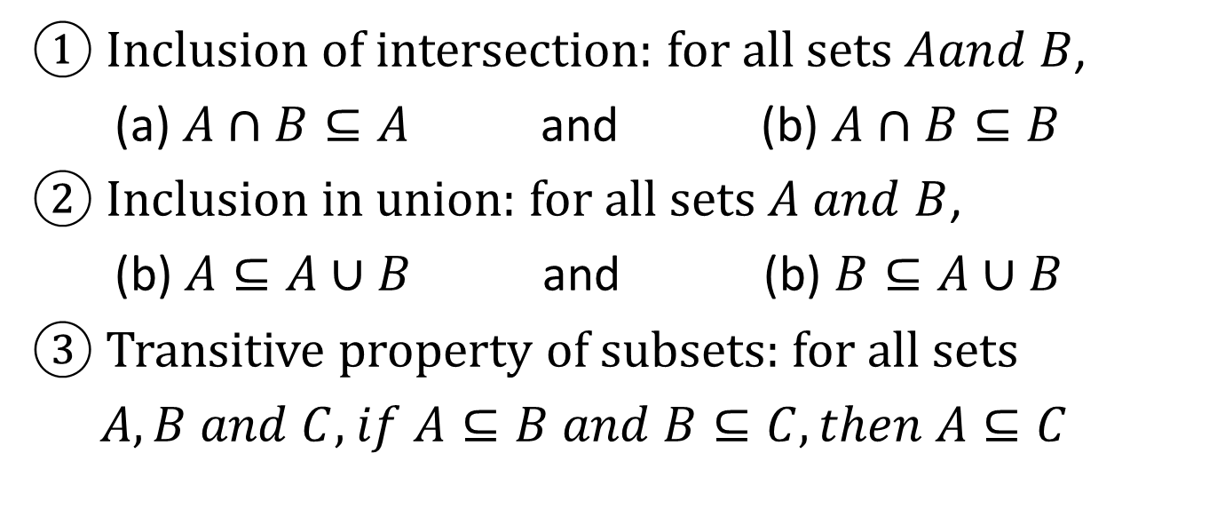
Theorems
① Inclusion of intersection: for all sets $Aand B$,
(a) $A∩B⊆A$ and (b) $A∩B⊆B$
② Inclusion in union: for all sets $A and B$,
(b) $A⊆A∪B$ and (b) $B⊆A∪B$
③ Transitive property of subsets: for all sets
$A, B and C$, $if A⊆B and B⊆C, then A⊆C$

Slide 16
Procedural Versions of Set Definitions
Let $X and Y$ be subsets of a universal set $U$ and suppose $x and y$ are elements of $U$.
① $x∈X∪Y⇔x∈X or x∈Y$
② $x∈X∩Y⇔x∈X and x∈Y$
③ $x∈X−Y⇔x∈X and x∉Y$
④ $x∈X^{c}⇔x∉X$
⑤ $\left(x,y\right)∈X×Y⇔x∈X and y∈Y$

