Slide 1
Discrete Mathematics

Slide 2
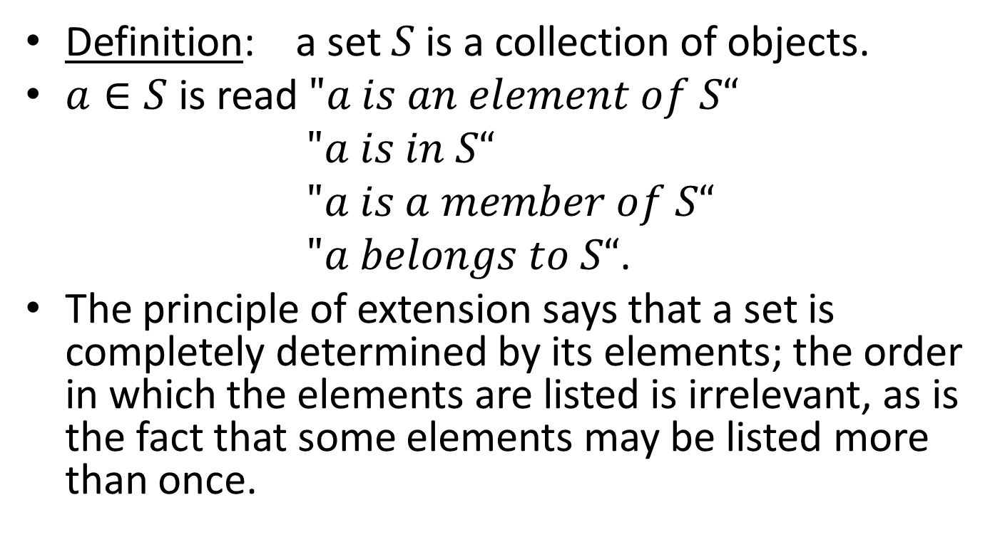
Set Theory
Definition: a set $S$is a collection of objects.
$a∈S$ is read $"a is an element of S“$
$"a is in S“$
$"a is a member of S“$
$"a belongs to S“$.
The principle of extension says that a set is completely determined by its elements; the order in which the elements are listed is irrelevant, as is the fact that some elements may be listed more than once.

Slide 3
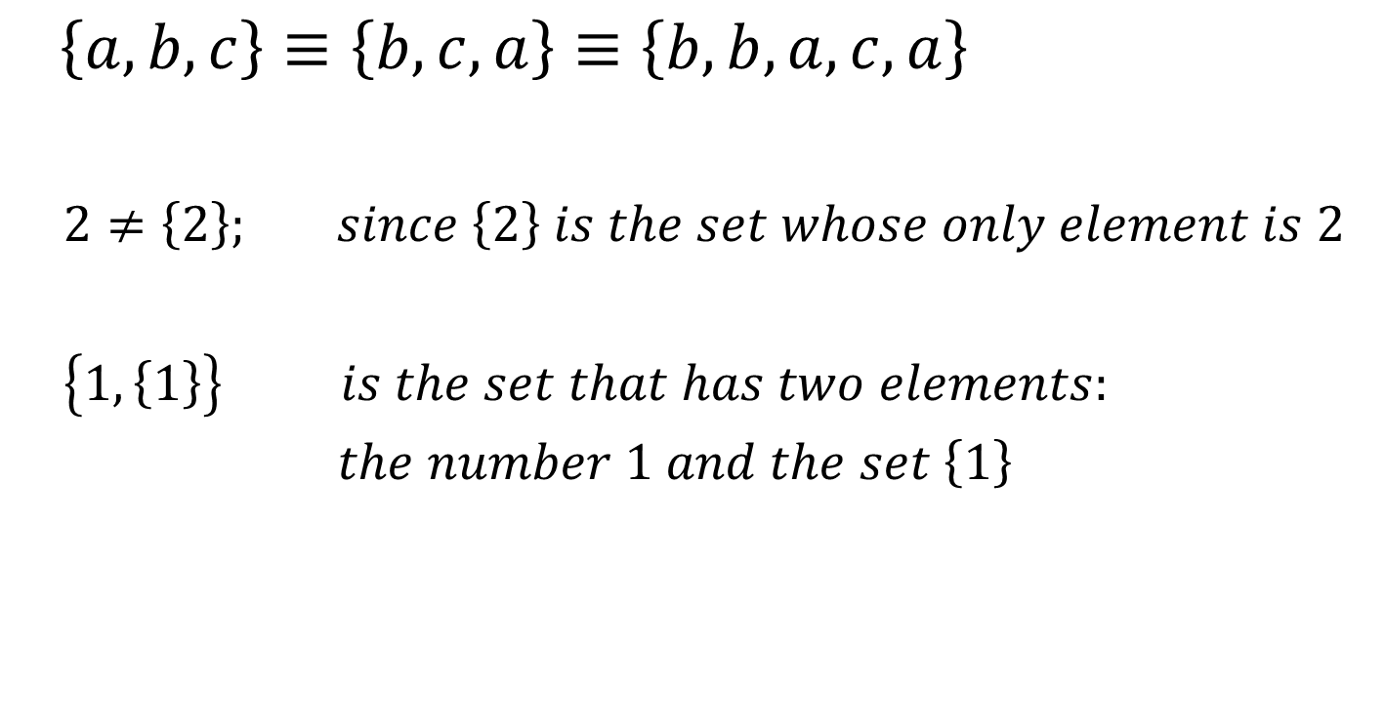
Set Theory
$\left\{a, b,c\right\}≡\left\{b,c,a\right\}≡\left\{b,b,a,c,a\right\}$
$2≠\left\{2\right\}; since \left\{2\right\} is the set whose only element is 2$
$\left\{1,\left\{1\right\}\right\} is the set that has two elements:$
$the number 1 and the set \left\{1\right\}$

Slide 4
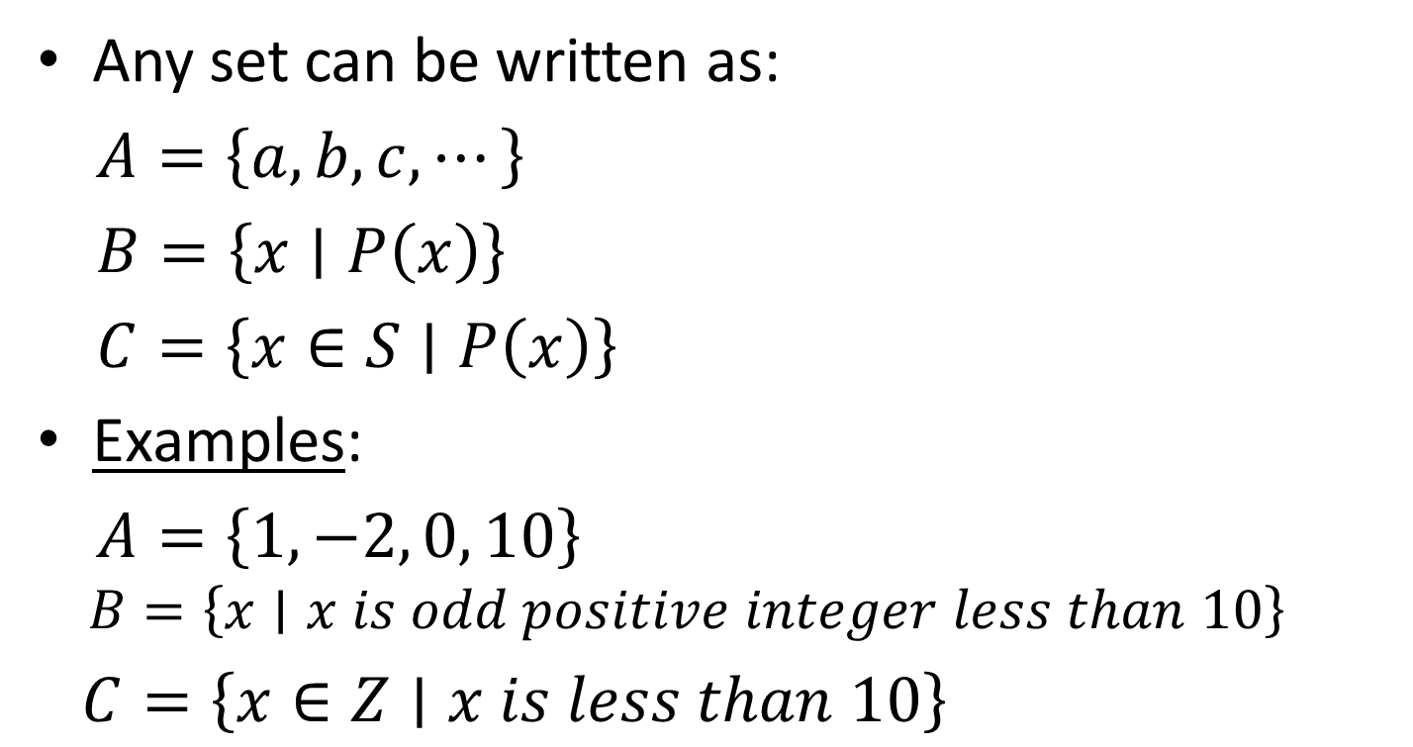
Set’s Forms
Any set can be written as:
$A=\left\{a,b,c,⋯\right\}$
$B=\left\{x∣P\left(x\right)\right\}$
$C=\left\{x∈S∣P\left(x\right)\right\}$
Examples:
$A=\left\{1, −2, 0, 10\right\}$
$$B=\left\{x∣x is odd positive integer less than 10\right\}$$
$C=\left\{x∈Z∣x is less than 10\right\}$

Slide 5

Integers, Rational and Real Numbers
$$Z:set of all integers$$
$$Q:set of all rational numbers or quotients of integers$$
$$R:set of all real numbers$$

Slide 6
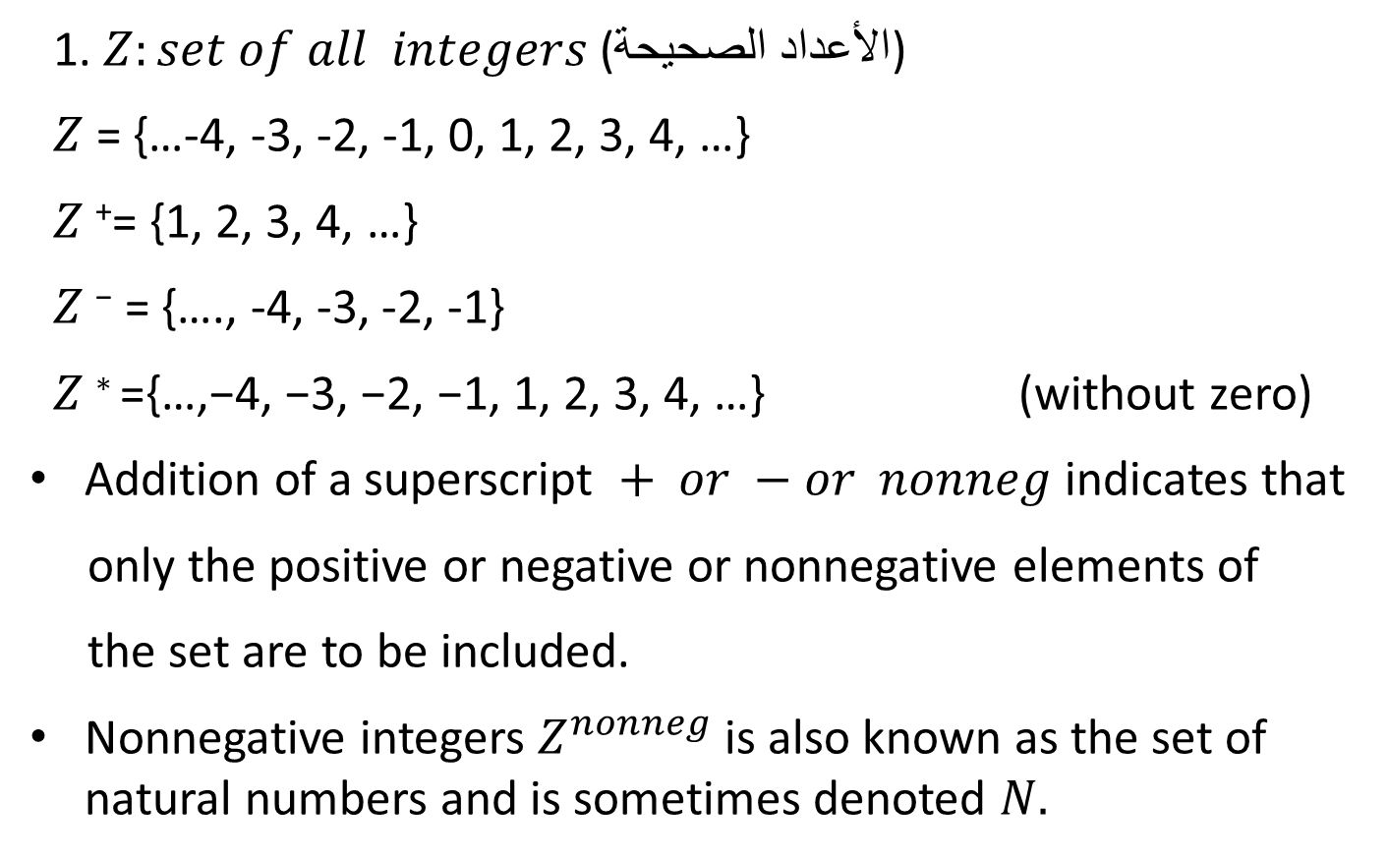
Integers, Rational and Real Numbers
1. $Z:set of all integers$ (الأعداد الصحيحة)
$Z$ = {…-4, -3, -2, -1, 0, 1, 2, 3, 4, …}
$Z$⁺= {1, 2, 3, 4, …}
$Z \text{−}$ = {…., -4, -3, -2, -1}
$Z \text{∗ }\text{=\{}\text{…}\text{,}\text{−}\text{4}\text{, }\text{−}\text{3}\text{, }\text{−}\text{2}\text{, }\text{−}\text{1}\text{, }\text{1}\text{, }\text{2}\text{, }\text{3}\text{, }\text{4}\text{, }\text{…}\text{\}}$ (without zero)
Addition of a superscript $+ or −or nonneg$ indicates that
only the positive or negative or nonnegative elements of
the set are to be included.
Nonnegative integers $Z^{nonneg}$ is also known as the set of natural numbers and is sometimes denoted $N.$

Slide 7
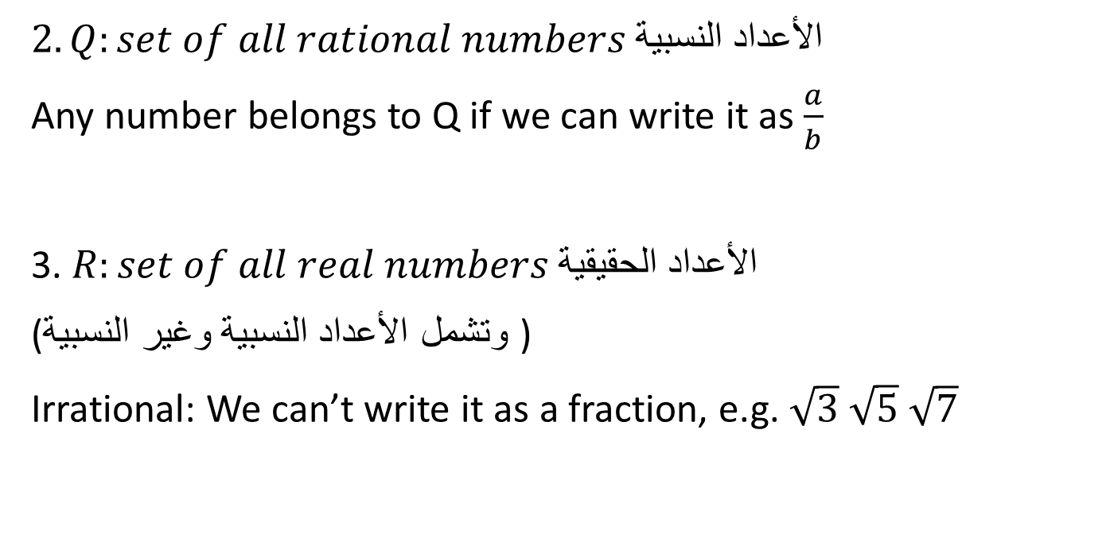
Integers, Rational and Real Numbers
$2. Q:set of all rational numbers$ الأعداد النسبية
Any number belongs to Q if we can write it as $\frac{a}{b}$
3. $R:set of all real numbers$ الأعداد الحقيقية
( وتشمل الأعداد النسبية وغير النسبية)
Irrational: We can’t write it as a fraction, e.g. $\sqrt{3}$ $\sqrt{5}$ $\sqrt{7}$

Slide 8
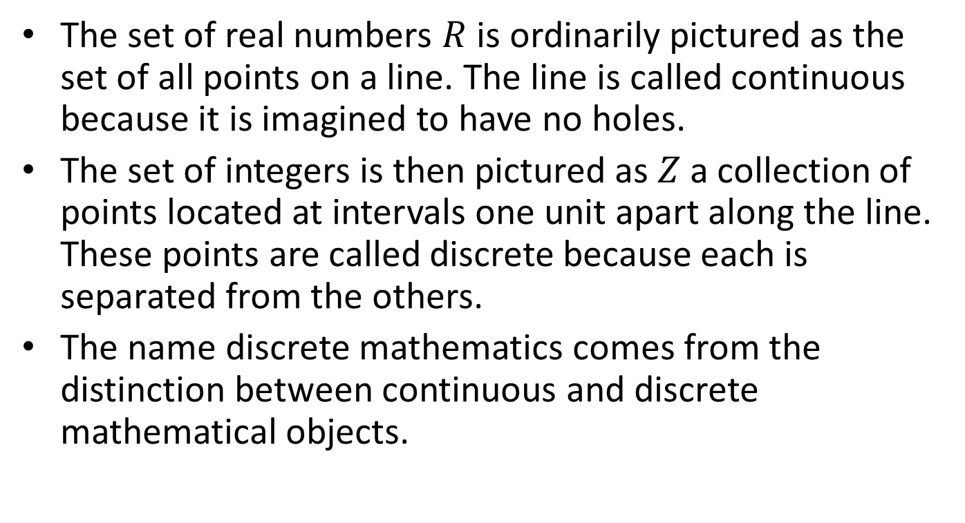
Integers, Rational and Real Numbers
The set of real numbers $R$ is ordinarily pictured as the set of all points on a line. The line is called continuous because it is imagined to have no holes.
The set of integers is then pictured as $Z$a collection of points located at intervals one unit apart along the line. These points are called discrete because each is separated from the others.
The name discrete mathematics comes from the distinction between continuous and discrete mathematical objects.

Slide 9
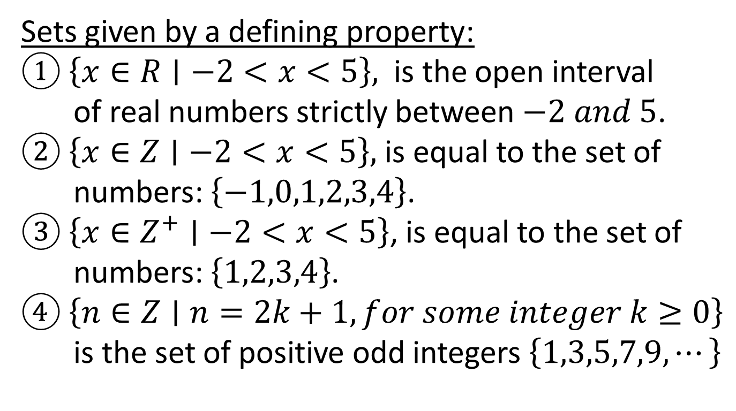
Examples
Sets given by a defining property:
① $\left\{x∈R∣−2<x<5\right\},$ is the open interval
of real numbers strictly between $−2 and 5$.
② $\left\{x∈Z∣−2<x<5\right\},$ is equal to the set of
numbers: $\left\{−1,0,1,2,3,4\right\}$.
③ $\left\{x∈Z^{+}∣−2<x<5\right\}$, is equal to the set of
numbers: $\left\{1,2,3,4\right\}$.
④ $\left\{n∈Z∣n=2k+1, for some integer k≥0\right\}$
is the set of positive odd integers $\left\{1,3,5,7,9,⋯\right\}$

Slide 10
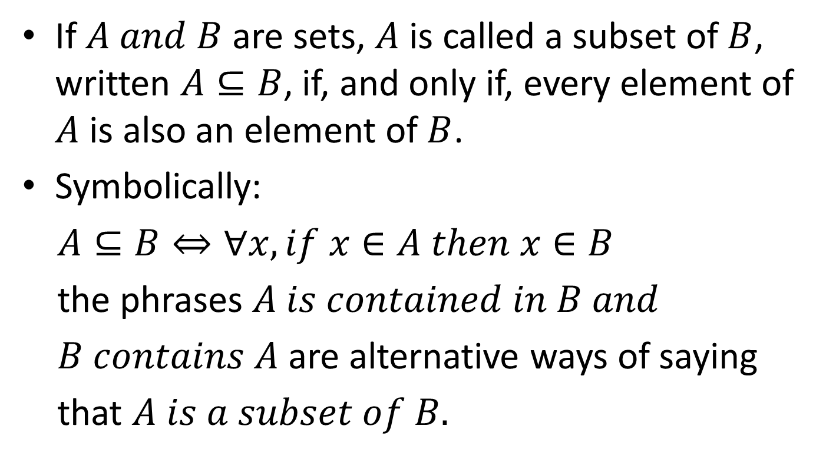
Subsets
If $A and B$ are sets, $A$ is called a subset of $B$, written $A⊆B$, if, and only if, every element of $A$ is also an element of $B$.
Symbolically:
$A⊆B⇔∀x, if x∈A then x∈B$
the phrases $A is contained in B and$
$B contains A$ are alternative ways of saying
that $A is a subset of B.$

Slide 11
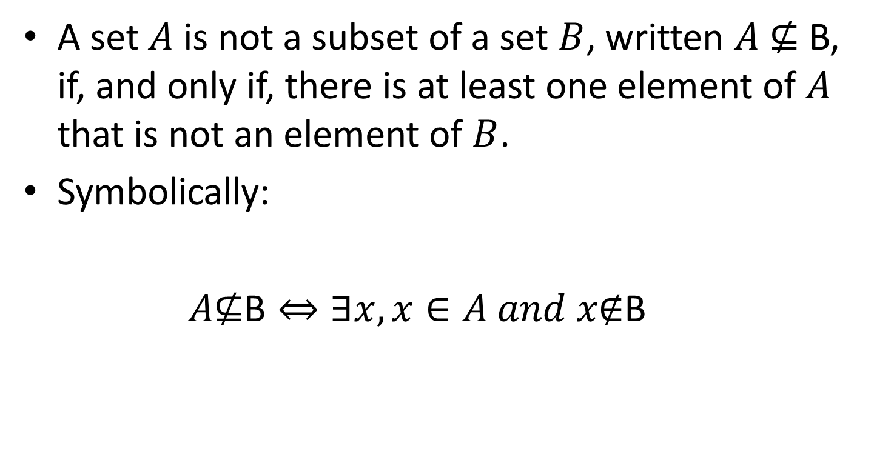
Subsets
A set $A$ is not a subset of a set $B$, written $A \text{⊈} \text{B}$, if, and only if, there is at least one element of $A$ that is not an element of $B$.
Symbolically:
$A\text{⊈}\text{B}⇔∃x, x∈A and x\text{∉}\text{B}$

Slide 12
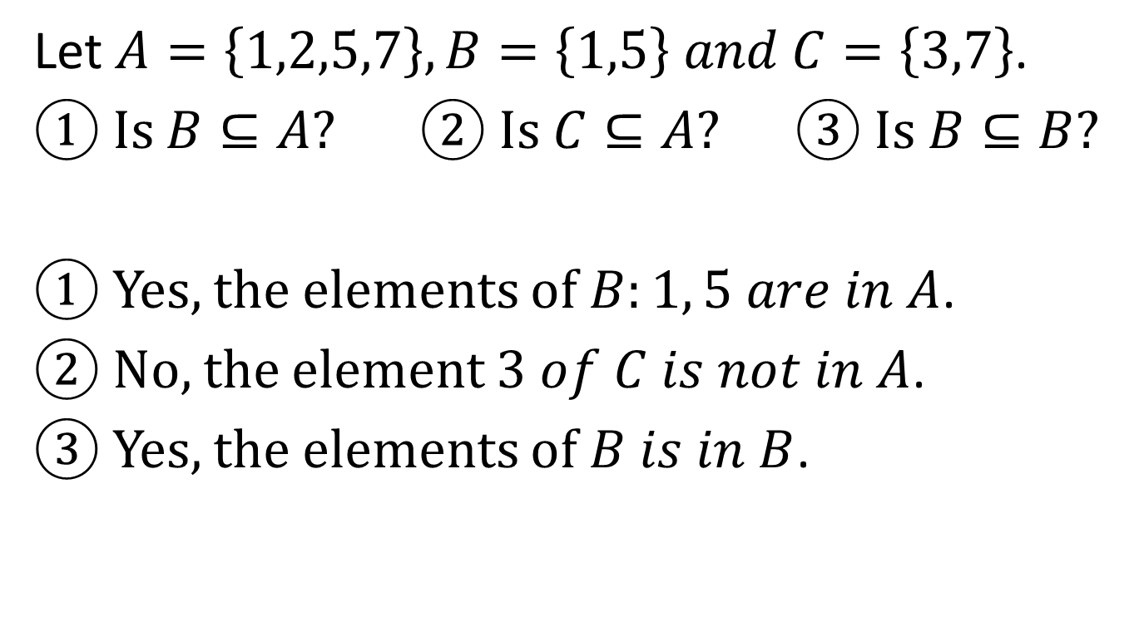
Example
Let $A=\left\{1,2,5,7\right\}, B=\left\{1,5\right\} and C=\left\{3,7\right\}$.
① Is $B⊆A?$ ② Is $C⊆A?$ ③ Is $B⊆B?$
① Yes, the elements of $B:1, 5 are in A$.
② No, the element $3 of C is not in A$.
③ Yes, the elements of $B is in B$.

Slide 13
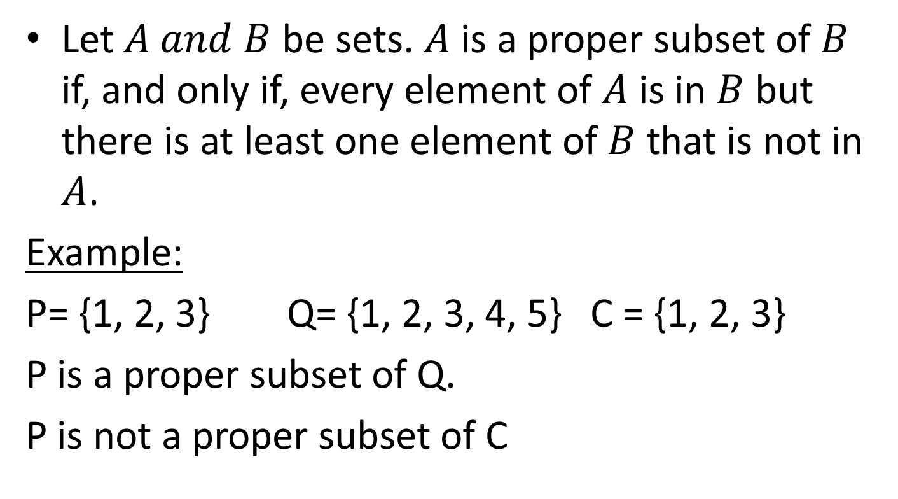
Proper Subsets
Let $A and B$ be sets. $A$ is a proper subset of $B$ if, and only if, every element of $A$ is in $B$ but there is at least one element of $B$ that is not in $A$.
Example:
P= {1, 2, 3} Q= {1, 2, 3, 4, 5} C = {1, 2, 3}
P is a proper subset of Q.
P is not a proper subset of C

Slide 14
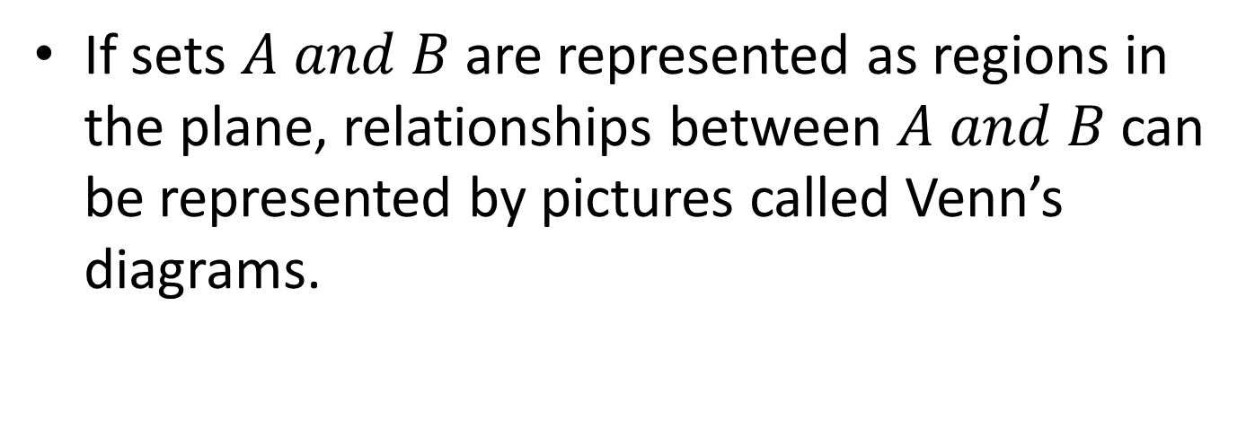
Venn’s Diagrams
If sets $A and B$ are represented as regions in the plane, relationships between $A and B$ can be represented by pictures called Venn’s diagrams.

Slide 15

Venn’s Diagrams
Example 1:
$A⊆B$ can be represented in one of two ways:
A= {1} A= {1, 2, 3}
B= {1,2,3,4} B= {1, 2, 3}
B B
A=B
A

Slide 16

Venn’s Diagrams
Example 2:
$A\text{⊈}B$ can be represented in three different ways:
A= {1, 2} B={3,4} A={1,2} B={2,3}
B= {1,2} A= {1,2,3}, $A\text{⊈}B$
A
B
A
B
A
B

Slide 17

Integers, Rational and Real Numbers
$Z$: set of integers.
$Q$: set of rational numbers.
$R$: set of real numbers.
R
Q
Q
Z

Slide 18
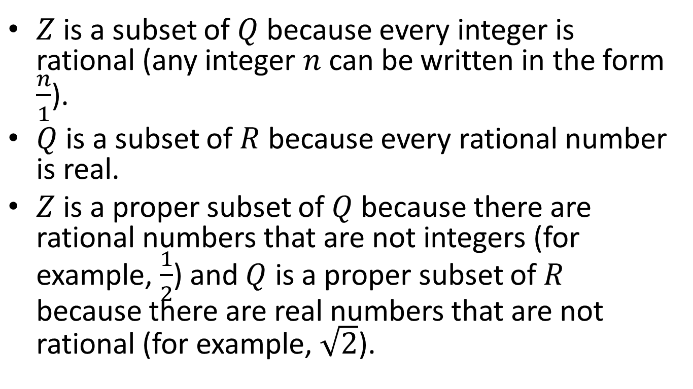
Integers, Rational and Real Numbers
$Z$ is a subset of $Q$ because every integer is rational (any integer $n$ can be written in the form $\frac{n}{1}$).
$Q$ is a subset of $R$ because every rational number is real.
$Z$ is a proper subset of $Q$ because there are rational numbers that are not integers (for example, $\frac{1}{2}$) and $Q$ is a proper subset of $R$ because there are real numbers that are not rational (for example, $\sqrt{2}$).

Slide 19
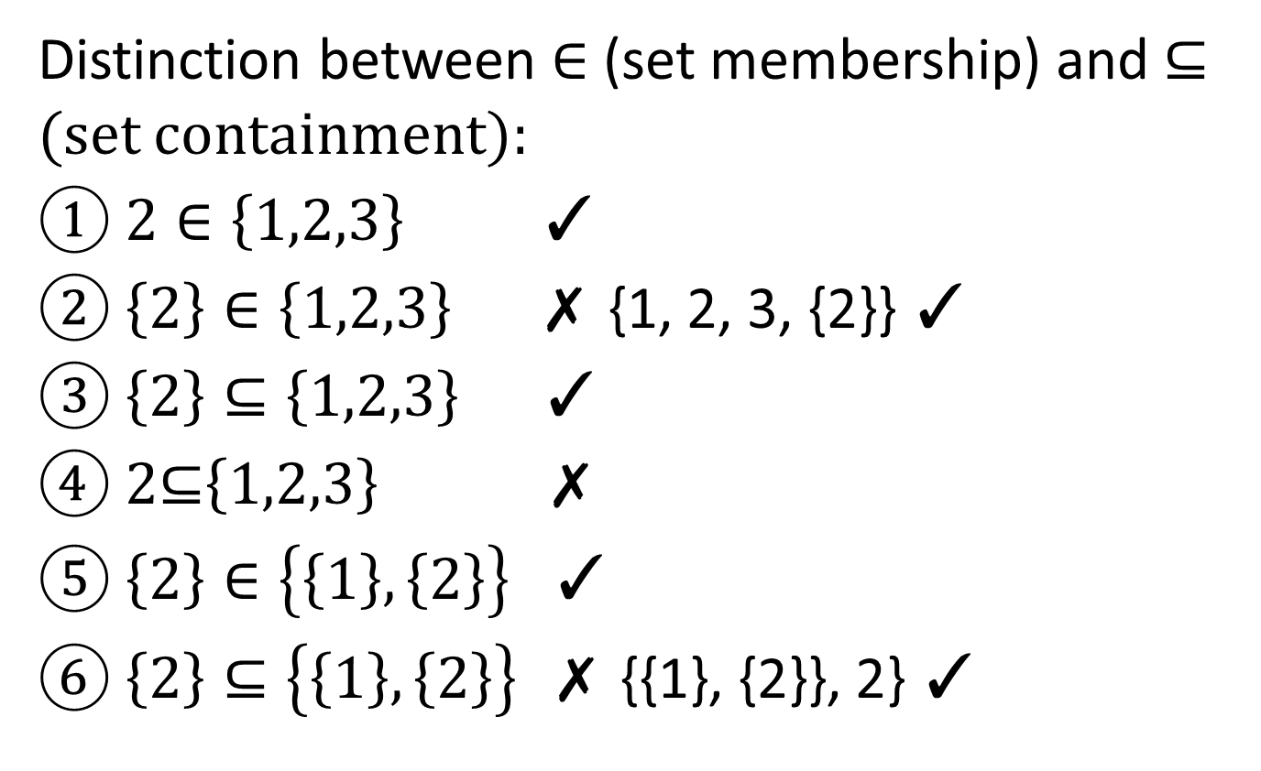
Example
Distinction between $∈$ (set membership) and ⊆ (set containment):
① $2∈\left\{1,2,3\right\} \text{✓}$
② $\left\{2\right\}∈\left\{1,2,3\right\} \text{✗}$ {1, 2, 3, {2}} $\text{✓}$
③ $\left\{2\right\}⊆\left\{1,2,3\right\} \text{✓}$
④ 2⊆$\left\{1,2,3\right\} \text{✗}$
⑤ $\left\{2\right\}∈\left\{\left\{1\right\},\left\{2\right\}\right\} \text{✓}$
⑥ $\left\{2\right\}⊆\left\{\left\{1\right\},\left\{2\right\}\right\} \text{✗}$ {{1}, {2}}, 2} $\text{✓}$

Slide 20
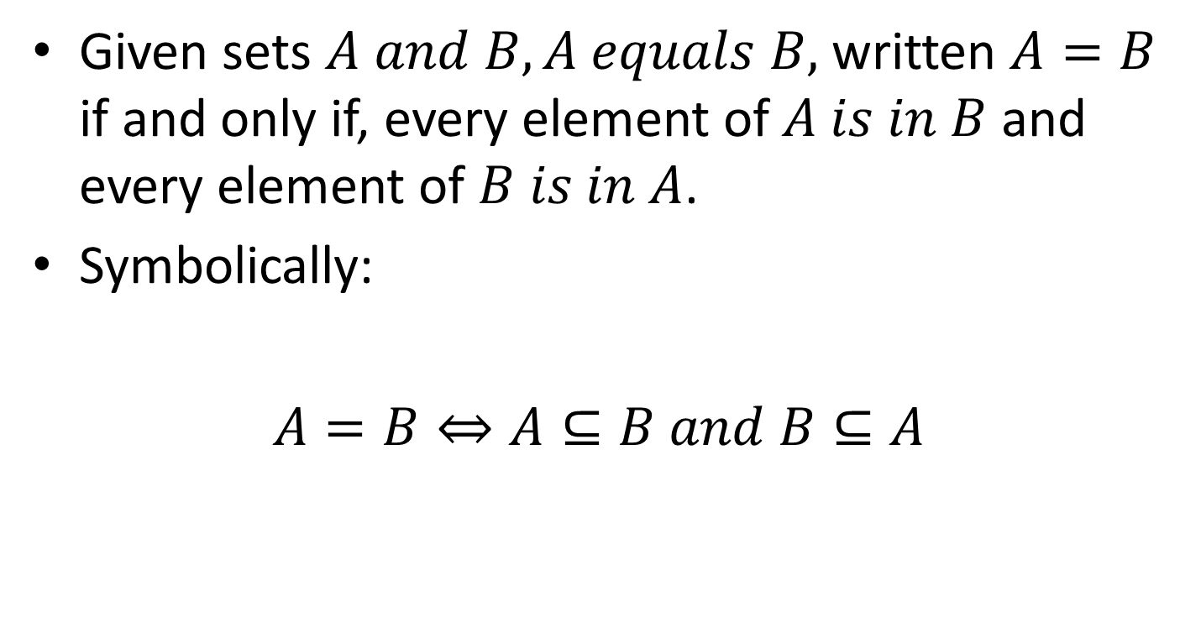
Sets Equality
Given sets $A and B, A equals B,$ written $A=B$ if and only if, every element of $A is in B$ and every element of $B is in A$.
Symbolically:
$A=B⇔A⊆B and B⊆A$

Slide 21
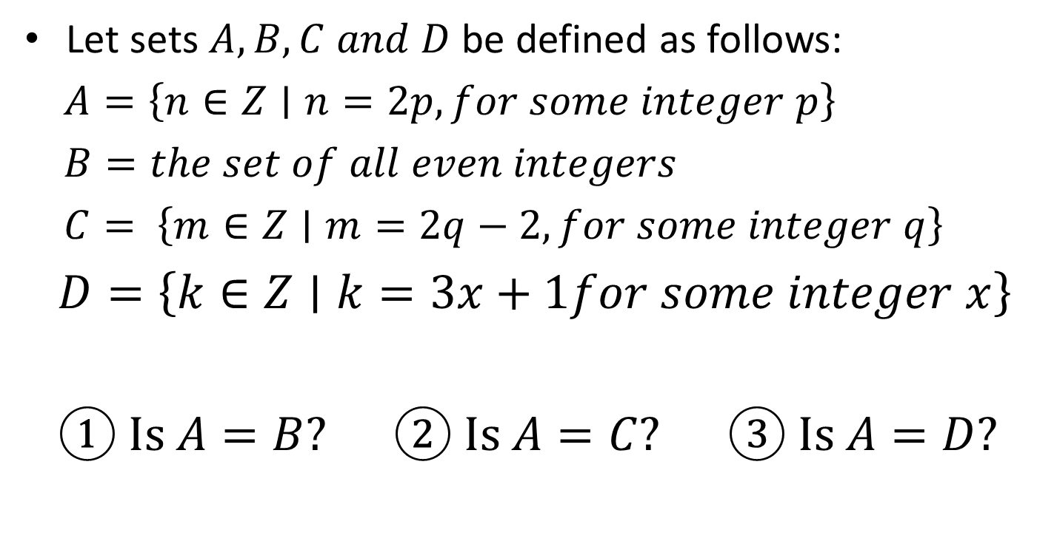
Example
Let sets $A,B,C and D$ be defined as follows:
$A=\left\{n∈Z∣n=2p, for some integer p\right\}$
$B=the set of all even integers$
$C= \left\{m∈Z∣m=2q−2,for some integer q\right\}$
$D=\left\{k∈Z∣k=3x+1for some integer x\right\}$
① Is $A=B?$ ② Is $A=C?$ ③ Is $A=D?$

Slide 22
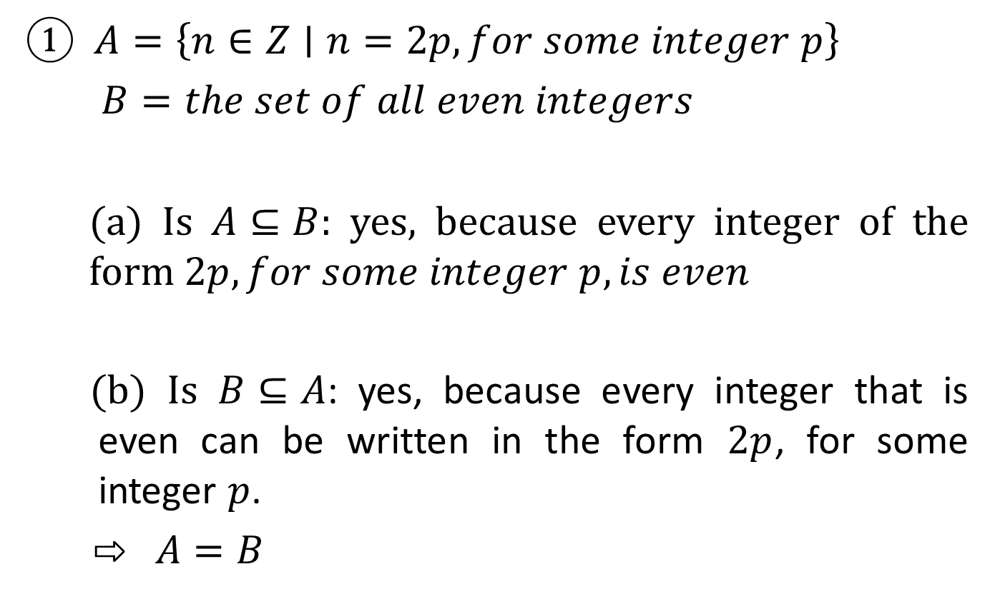
Example
① $A=\left\{n∈Z∣n=2p, for some integer p\right\}$
$B=the set of all even integers$
(a) Is $A⊆B$: yes, because every integer of the form $2p, for some integer p, is even$
(b) Is $B⊆A$: yes, because every integer that is even can be written in the form $2p$, for some integer $p$.
⇨ $A=B$

Slide 23
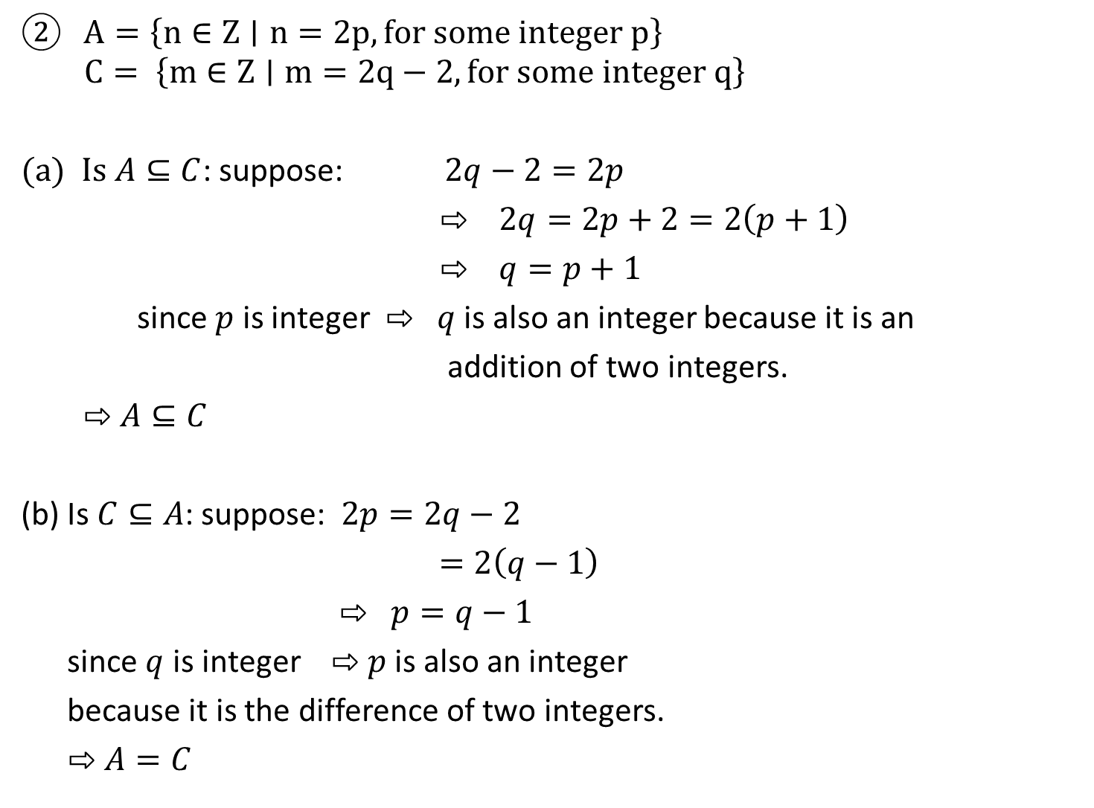
$A=\left\{n∈Z∣n=2p, for some integer p\right\}$
$$C= \left\{m∈Z∣m=2q−2,for some integer q\right\}$$
(a) Is $A⊆C$: suppose: $2q−2=2p$
⇨ $2q=2p+2=2\left(p+1\right)$
⇨ $q=p+1$
since $p$ is integer ⇨ $q$ is also an integer because it is an
addition of two integers.
$⇨$ $A⊆C$
(b) Is $C⊆A$: suppose: $2p=2q−2$
$=2\left(q−1\right)$
⇨ $p=q−1$
since $q$ is integer ⇨ $p$ is also an integer
because it is the difference of two integers.
⇨ $A=C$

Slide 24
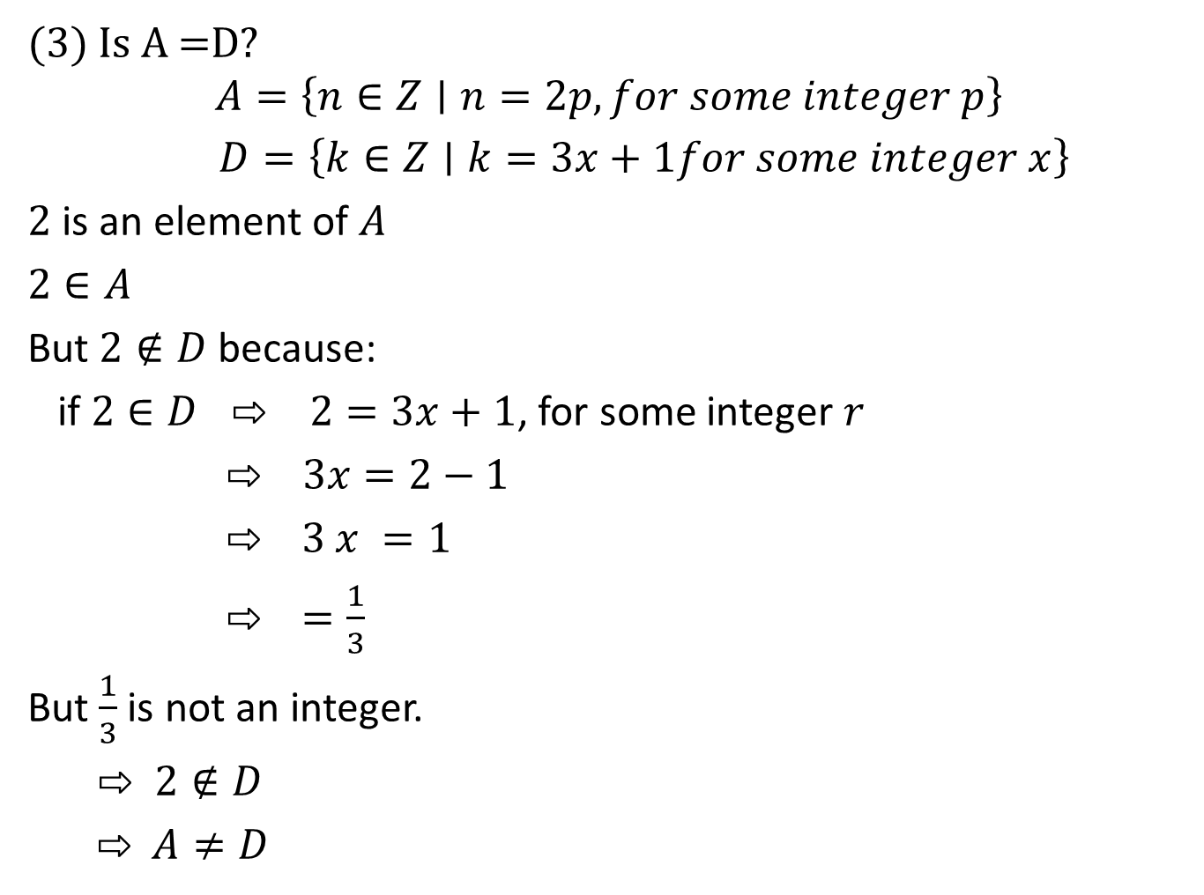
(3) Is A =D?
$$A=\left\{n∈Z∣n=2p, for some integer p\right\}$$
$D=\left\{k∈Z∣k=3x+1for some integer x\right\}$
$2$ is an element of $A$
$2∈A$
But $2∉D$ because:
if $2∈D ⇨ 2=3x+1$, for some integer $r$
$⇨$ $3x=2−1$
⇨ 3 $x =1$
⇨ $=\frac{1}{3}$
But $\frac{1}{3}$ is not an integer.
$⇨$ $2∉D$
⇨ $A≠D$

