Slide 1
Chapter 3
Beginning Problem-Solving
Pre-Programming Solution Design Phase
Control Structures
More on the Selection Structure

Slide 2
Objectives
Explain a nested selection structure in pseudocode and in a flowchart
Recognize common logic errors in selection structures
Explain the switch form of the selection structure in pseudocode and in a flowchart

Slide 3
Nested Selection Structures
Nested selection structure:
Selection structure within another selection structure
Used when more than one decision must be made before the appropriate action can be taken
Primary decision - always made by the outer selection structure
Secondary decision - always made by the inner (nested) selection structure

Slide 4
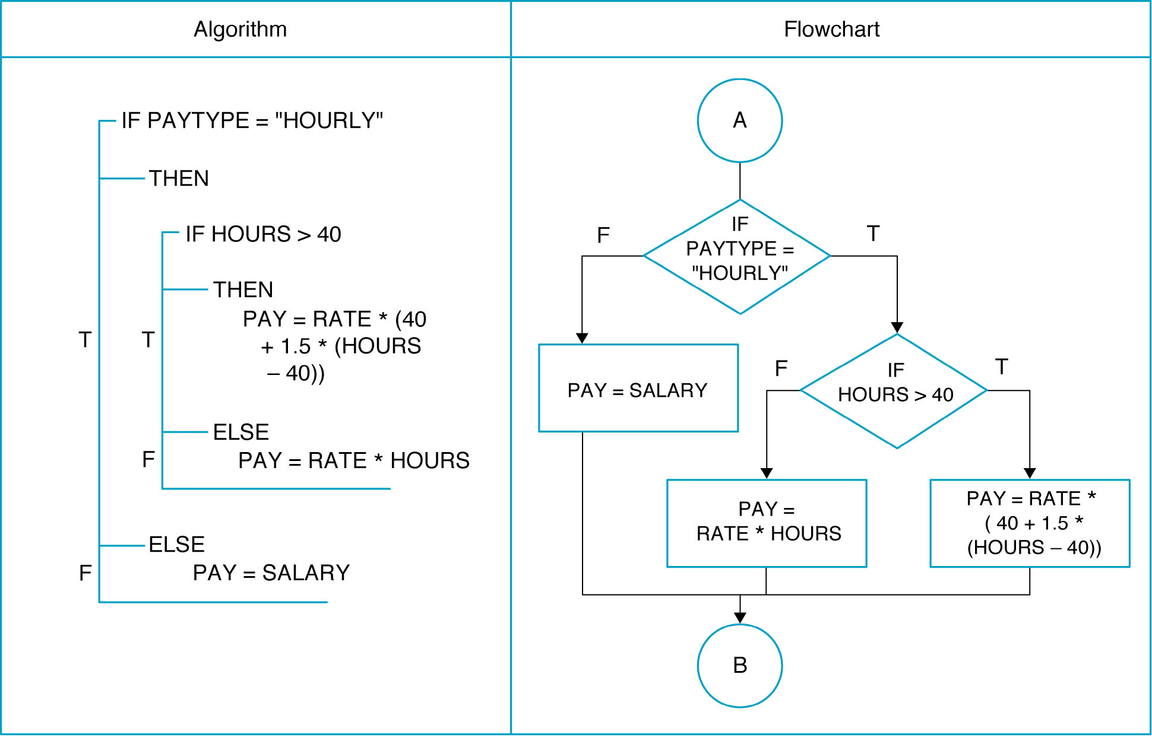
NESTED IF/THEN/ELSE INSTRUCTIONS

Slide 5
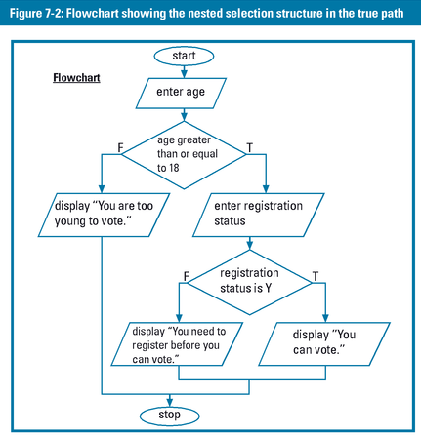
Nested Selection Structures

Slide 6
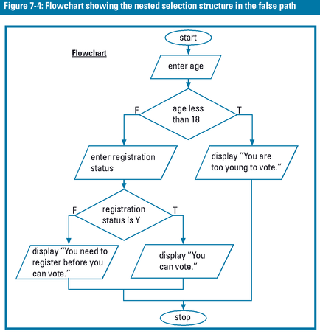
Nested Selection Structures

Slide 7
Logic Errors in Selection Structures
Logic errors are commonly made as a result of the following mistakes:
Using a logical operator rather than a nested selection structure
Reversing the primary and secondary decisions
Using an unnecessary nested selection structure

Slide 8
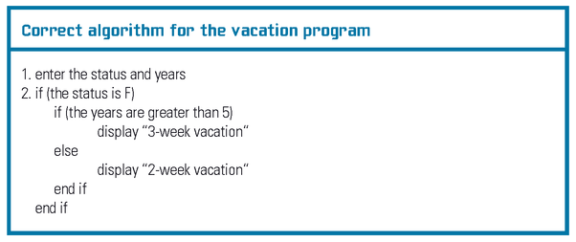
Logic Errors in Selection Structures

Slide 9
Logic Errors in Selection Structures
Test Data for the Correct Algorithm
Test Data for first check
Status: F
Years: 4
Test Data for second check
Status: F
Years: 15
Test Data for third check
Status: P
Years: 11

Slide 10
Using a Logical Operator Rather Than a Nested Selection Structure
One common error made when writing selection structures is
to use a logical operator in the outer selection structure’s condition when a nested selection structure is needed

Slide 11
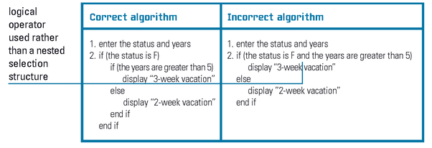
Correct Algorithm and an Incorrect Algorithm Containing the First Logic Error
OUTPUT

Slide 12
Reversing the Primary and Secondary Decisions
Common Error:
putting the secondary decision in the outer selection structure, and putting the primary decision in the nested selection structure

Slide 13
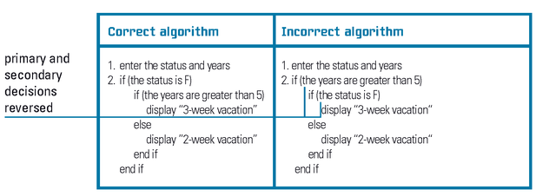
Correct Algorithm and an Incorrect Algorithm Containing the Second Logic Error

Slide 14
Using an Unnecessary Nested Selection Structure
In most cases,
a selection structure containing this error still produces the correct results
However, it is less efficient than selection structures that are properly structured

Slide 15
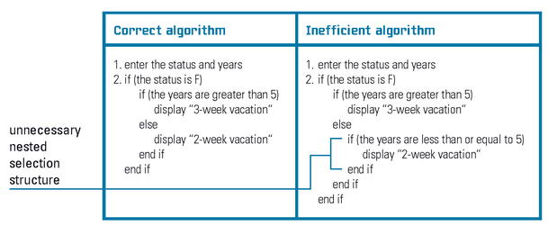
Correct Algorithm and an Inefficient Algorithm Containing the Third Logic Error

Slide 16
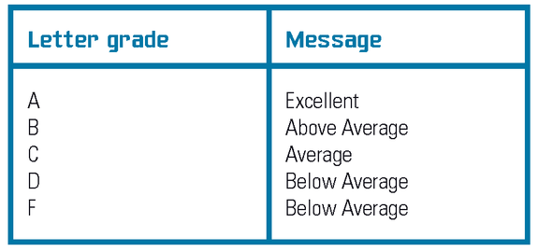
Using the if/else Form to Create Multiple-Path Selection Structures

Slide 17
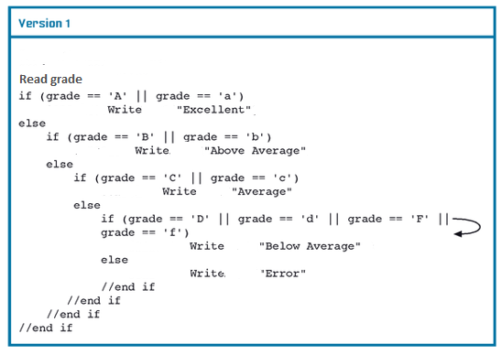
Two Versions of the solution to the Grade Problem

Slide 18
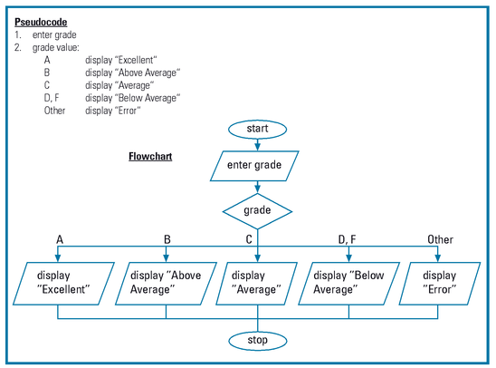
Using the switch Form to Create Multiple-Path Selection Structures

Slide 19
Results of Desk-checking the Grade Program Example

Slide 20
Using the switch Form
Switch statement:
Begins with the switch clause, followed by an opening brace;
Ends with a closing brace
Switch clause - composed of the keyword switch followed by a selectorExpression enclosed in parentheses
selectorExpression - can contain any combination of variables, constants, functions, methods, and operators, as long as the combination results in a value whose data type is either bool, char, short, int, or long

Slide 21
Switch Form (Cont.)
switch(expression) {
case x: // code block break;
case y: // code block break;
default: // code block break; }
Each individual clause within the switch statement contains a value, followed by a colon
Data type of the value should be compatible with the data type of the selectorExpression
Break statement - tells the computer to leave (“break out of”) the switch statement at that point

Slide 22
Example
int day = 4;
switch (day)
{ case 1: Console.WriteLine("Monday"); break;
case 2: Console.WriteLine("Tuesday"); break;
case 3: Console.WriteLine("Wednesday"); break;
case 4: Console.WriteLine("Thursday"); break;
case 5: Console.WriteLine("Friday"); break;
case 6: Console.WriteLine("Saturday"); break;
case 7: Console.WriteLine("Sunday"); break; }
// Outputs "Thursday" (day 4)

Slide 23
Homework
Using the Switch Form (Pseudocode) to Create Multiple-Path Selection Structures

